Slide 1
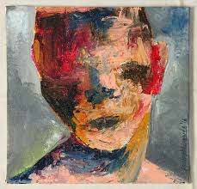
EXPRESSIONISM
NOUSHAD PM
ASSISTANT PROFESSOR
DEPT OF ENGLISH
HKRH COLLEGE

Slide 2
What??
Expressionism is a German movement in literature and the other arts that existed around the First World War years and was a revolt against the artistic and literary tradition of realism, both in subject matter and in style

Slide 3
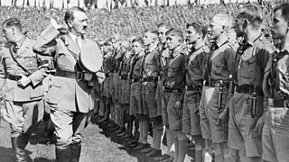
Historical context???
It was at its height between 1910 and 1925-that is, in the period just before, during, and after world war I and began to flag by 1925 and was finally suppressed in Germany by the Nazis in the early 1930s
Notes:
Nazi Germany is the common English name for Germany between 1933 and 1945, when Adolf Hitler and his Nazi Party (NSDAP) controlled the country through a dictatorship. Under Hitler's rule, Germany was transformed into a totalitarian state that controlled nearly all aspects of life via the Gleichschaltung legal process.

Slide 4
Continued….
It has continued to exert influence on English and American, as well as European, art and literature.
The Expressionists were influenced by artists and writers who had in various ways departed from realistic depictions of life and the world and incorporated in their art visionary or powerfully emotional states of mind that are expressed and transmitted by means of distorted representations of the outer world

Slide 5
The precursors in painting were Vincent Van Gough, Paul Gaugin, and Edward Munch, whose The Cry (1894) depicting against a bleak and stylized background, a tense figure with a contorted face uttering a scream of pure horror,is often taken to epitomize what became the expressionist mode.

Slide 6
Expressionism In Literature
Expressionism in literature arose as a reaction against materialism, complacent bourgeois prosperity, rapid mechanization and urbanization, and the domination of the family within pre-World War I European society. It was the dominant literary movement in Germany during and immediately after World War I.

Slide 7
It can also be seen in the poetry of Allen Ginsberg, and other Beat writers and in the prose fiction of Samuel Becket,Thomas Pynchon; and in a number of films manifesting the distorted perceptions and fantasies of disturbed characters, by such directors as Ingmar Bergman, Federico Fellini and Michelangelo Antonioni.

Slide 8
Features????
The expressionist artists or writer undertakes to express a personal vision-usually a troubled or tensely emotional vision-of human life and human society
This is done by exaggerating and distorting what, according to the norms of artistic realism, are objective features of the world, and by embodying violent extremes of mood and feeling.

Slide 9
What is depicted or described represents the experience of an individual standing alone, frightened in an industrial,technological, and urban society which is disintegrating into chaos.

Slide 10
Expressionists who were radical in their politics also projected Utopian views of a future community in a regenerate world.

Slide 11
Expressionists poets including the Germans Gottfried Benn and Georg Trakl,departed from standard meter,syntax, and poetic structure to organize their works around symbolic images

Slide 13
Expressionist writers of prose narratives(most eminently Franz Kafka) abandoned standard modes of characterization and plot for symbolic figures involved in an obsessive world of nightmarish events

Slide 14
Drama was a prominent and widely influential form of expressionist writing and dramatists tended to represent anonymous human types instead of individualized characters. They replaced plot by intense and rapidly oscillating emotional states and fragmented the dialogue into exclamatory and seemingly incoherent sentences or phrases and employed masks and sprawling stage sets

Slide 15
Major Practitioners and texts
Eugene O’ Neill’s The Emperor Jones(1920) projected in a sequence of symbolic episodes, the individual and racial memories of a terrified modern African-American Protagonist
Elmer Rice’s The Adding Machine (1923) used nonrealistic means to represent a mechanical, sterile, and frightening world as experienced by Mr. Zero, a tiny and helpless cog in the impersonal system of big business

Slide 16
Decline Of The Movement
The decline of Expressionism was hastened by the vagueness of its longing for a better world, by its use of highly poetic language, and in general the intensely personal and inaccessible nature of its mode of presentation. The partial reestablishment of stability in Germany after 1924 and the growth of more overtly political styles of social realism hastened the movement’s decline in the late 1920s. Expressionism was definitively killed by the advent of the Nazis to power in 1933. They branded the work of almost all Expressionists as degenerate and forbade them to exhibit or publish and eventually even to work. Many Expressionists went into exile in the United States and other countries.

Slide 17
ARTWORKS AND ARTISTS OF EXPRESSIONISM
The Scream (1893)
Munch's most famous painting, he depicts the battle between the individual and society. The setting of The Scream was suggested to the artist while walking along a bridge overlooking Oslo; as Munch recalls, "the sky turned as red as blood. I stopped and leaned against the fence...shivering with fear. Then I heard the enormous, infinite scream of nature

Slide 18
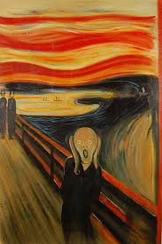

Slide 19
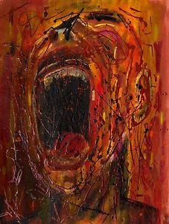

Slide 20
Large Blue Horses (1911) by Franz Marc
The painter, printmaker, and watercolorist Marc was a key member of Der Blaue Reiter, and is known for his use of animal symbolism. This canvas belonged to a series of works that centered on the theme of horses, which he regarded as emblems of spiritual renewal. The lush colors, fracturing of space, and geometric forms show the influence of Cubism and Robert Delaunay's Orphism

Slide 21
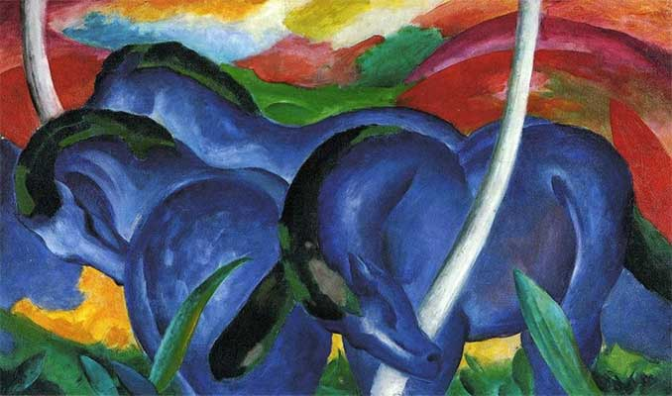
Large Blue Horses (1911) by Franz Marc

Slide 22
Street, Berlin (1913) by Ernst Ludwig Kirchner
Street, Berlin (1913) by Ernst Ludwig Kirchner
In Street, Berlin, Kirchner created a stunningly askew rendition of an alienated, urban street procession. Without regard for realistic depiction of form, he bent and contorted his narrow figures like they were blades of grass in a meadow. Another uniquely modern feature of Street, Berlin was Kirchner's choice to position two prostitutes (identifiable by their signature plumed hats) as the painting's (somewhat off-center) focal point.

Slide 23
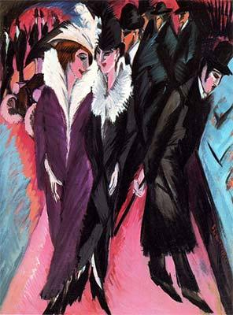

Slide 24
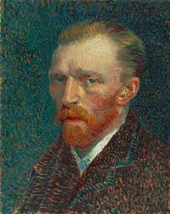

Slide 25
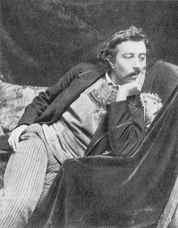

Slide 26
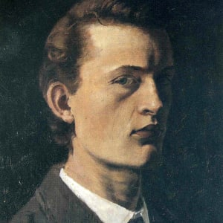

Slide 31
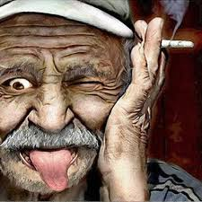

Slide 32
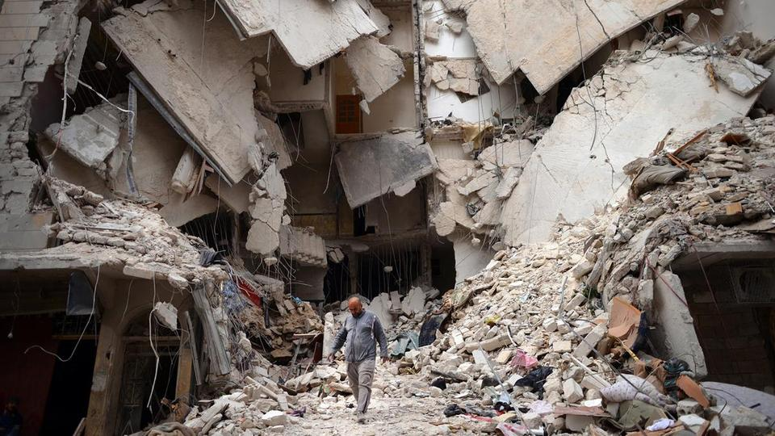

Slide 33
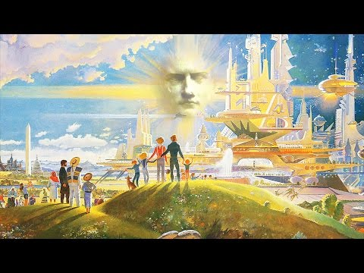
Utopian society

Slide 34
