Slide 1
Ms.M.Rizvana M.A.,B.Ed., M.Phil., Assistant Professor Of English Hajee Karutha Rowther Howdia College

Slide 2
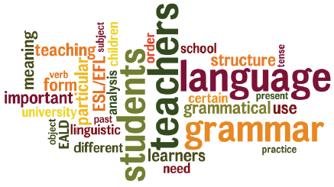
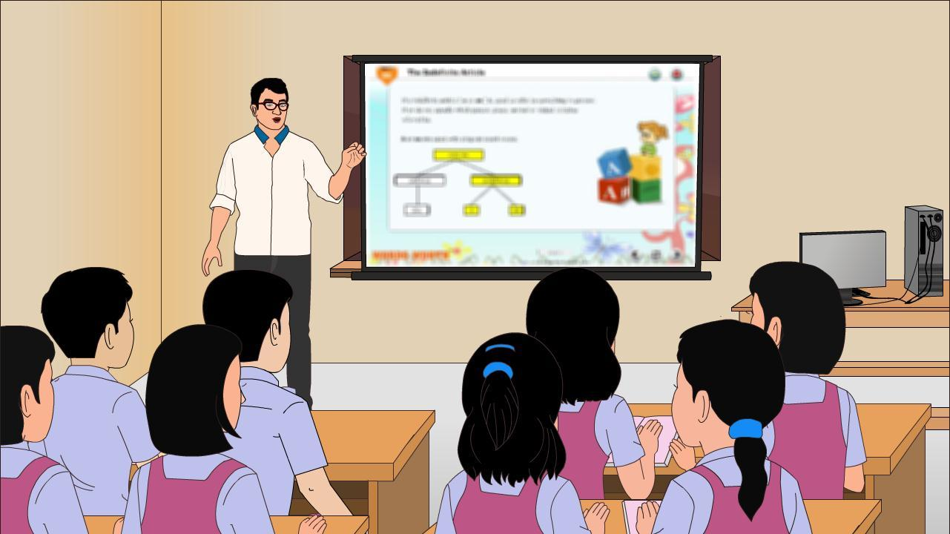
ENGLISH LANGUAGE TEACHING AND PHONETICS

Slide 3
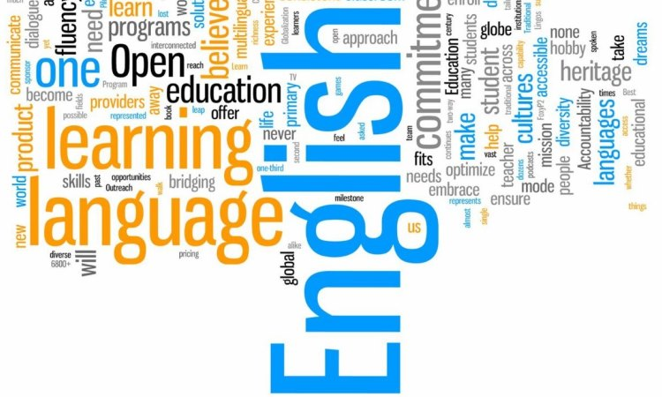
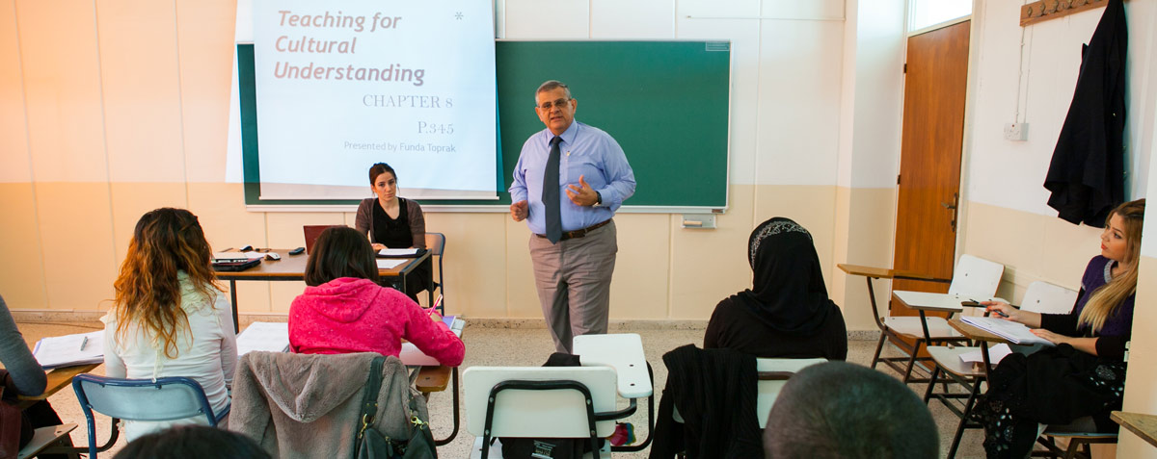

Slide 4
Grammar And Grammars
The term grammar has been used in several ways and it means many different things to different people .
Only written languages have grammar.
This view suggests that spoken languages have no grammar probably the etymology of the word ‘Grammar’ from the Greek word meaning to write lends support to this view.

Slide 5
Correctness
Grammar is seen as a set of prescriptive rules, that tell us how we ought to speak and write.
These rules teach us to say ‘It’s I’, instead of ‘It’s me’, to avoid ending sentences with prepositions, know the difference between ‘owing to’ and ‘due to’ and so on.
The basis of considering these as the correct forms is the grammar book.
At 1st rules of English grammar followed the pattern of Latin Grammar.

Slide 6
Some Traditional Concepts
Grammar is the way a language organized to convey meaning.
Any description of these features will have to use a set of criteria to classify words and later to specify the relationships between classes of words when they combine to make meaningful and acceptable units.
Some of these traditional concepts and find out how these are inadequate in the light of recent linguistic studies.

Slide 7
Word
The word is taken as the basic unit of language.
The sentence is defines as ‘the combination of words’.
But the word itself is not defined.
This is because of the influence of the writing system.
There are Three main approaches to the definition words.

Slide 8
Semantic Approach ( the word as unit of meaning)
Phonetic or Phonological Approach (which considers the words as marked by some features of the sounds of the language).
Linguistic Procedures (the word is said to be a linguistic unit).

Slide 9
Form And Meaning
Wilkins says that ‘the linguistic study of language makes a clear distinction between the use to which we put language (its meaning) and the actual shape
Which units of language have and the relationship which exists between them.
It is the function of linguistic forms to convey meaning.

Slide 10
Speech And Writing
Tradional grammars are based on the written language.
They even imply that the written language is the real language and the spoken language is a ‘corrupt’ form of the language soemtimes they condemn it as ‘dialect’.
But today there are some linguists who have taken exactly the opposite view and regard only speech as language.

Slide 11
Sentence, Clause And Phrase
In traditional grammars sentemce is a basic term.
But like the ‘word’ it has also been left undefined.
All the Auxiliary verbs act as pro-verbs; they alone can stand for the whole of the verbal element:

Slide 12
Examples
Rama is going Is he?
I haven’t see him But I have.
The verb do is the proform where there is no auxiliary verb as in
He played Yesterday. Did he?

Slide 13
Grammatical Categories
In traditional grammars the categories of number, gender and tense are defined in ‘notional’ terms; plural is defined as more than one; gender is identified with sex and tense with time.
They also take over the categories of Latin and impose them upon English.

Slide 14
The traditional categories are:
Gender: masculine, feminine ( and commonly neuter – a feature of nouns, associated with male, female and for neuter), sexless creatures).
Number :singular and plural (and sometime dual) a feature of nouns and verbs, associated with ‘one’ and more than ‘one’ (dual with two)

Slide 15
correctness
Grammar is seen as a set of perspective rules, that tell us how we ought to speak and write.
These rules teach us to say ‘ It’s I’

Slide 16
Person : first person, second person, third person – a classification of the pronouns and a feature of verbs, - I, me, you; he she it, they.
Tense : Present, Past, Future – a feature of verbs associated with time.

Slide 17
Mood : indicative, imperative,subjunctive, and in classical Greek, operative – a feature pof the verb, associated with statement of fact versus possibility, supposition etc.
Voice : active and passive – again a feature of verb largely associated with whether the subject was the ‘actor’ (the one who performed the action) or the ‘goal’ (the one at the receiving end).

Slide 18
Case : nominative, vocative, accusative, genitive, dative and ablative a feature of the nouns, associtated with a variety of largely unrelated semantic and grammatical features – boy, O! boy, boy’s (of a boy), to or for a boy, from or by a boy.

Slide 19
In English, GENDER is associated with biological division of male and female but in many languages gender is a grammatical category and only indecently does it correspond with the natural division of male and female.

Slide 20
concord
In the inflected and agglutinative languages there are different forms of the same word (take, takes, etc…..), The choice of a form depends upon several factors.
To begin with, the choice is free in some cases. Consider
The girl likes chocolates
The girl liked chocolates

Slide 21
government
In Latin prepositions and verbs said to govern nouns in a certain case – ‘a’ (from) governs nouns in the ablative case while ‘ad’ (to) governs nouns in the accusative.
a monte (from the mountain)
ad monetm ( to the mountain)

Slide 22
…THANK YOU…

