Slide 1
HISTORY OF ENGLISH LITERATURE-1
UNIT-IV
AGE OF RESTORATION
Mr. NOUSHAD PM.
DEPARTMENT OF ENGLISH
HKRH COLLEGE
UTHAMAPALAYAM, THENI-625533 TAMIL NADU

Slide 4
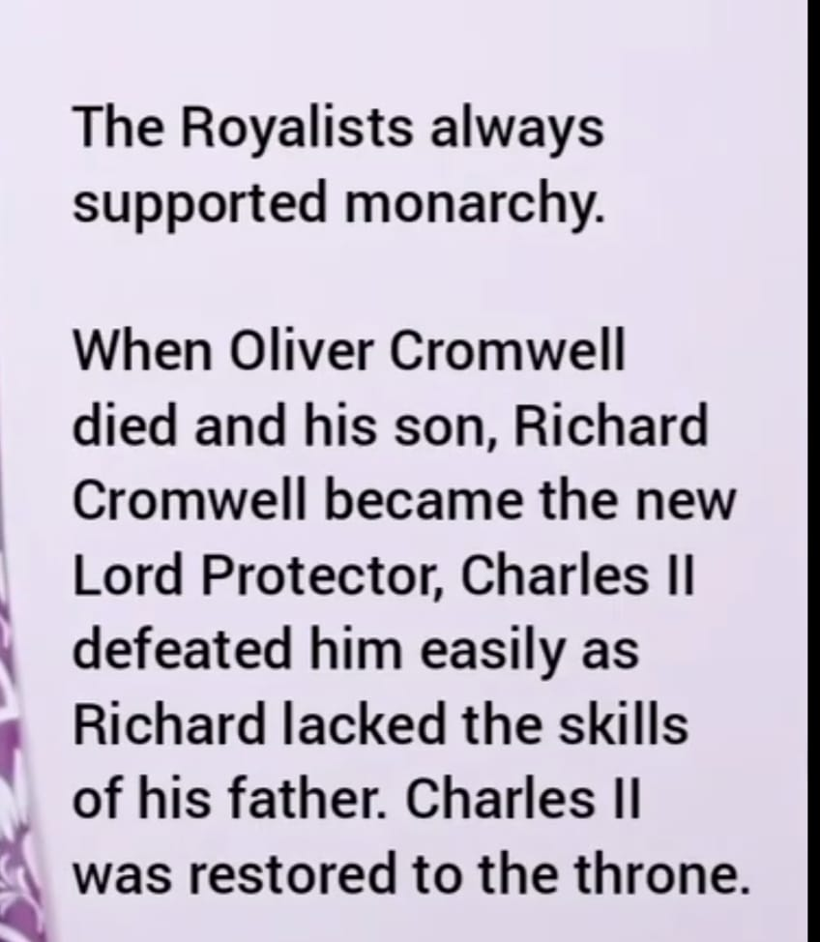

Slide 22
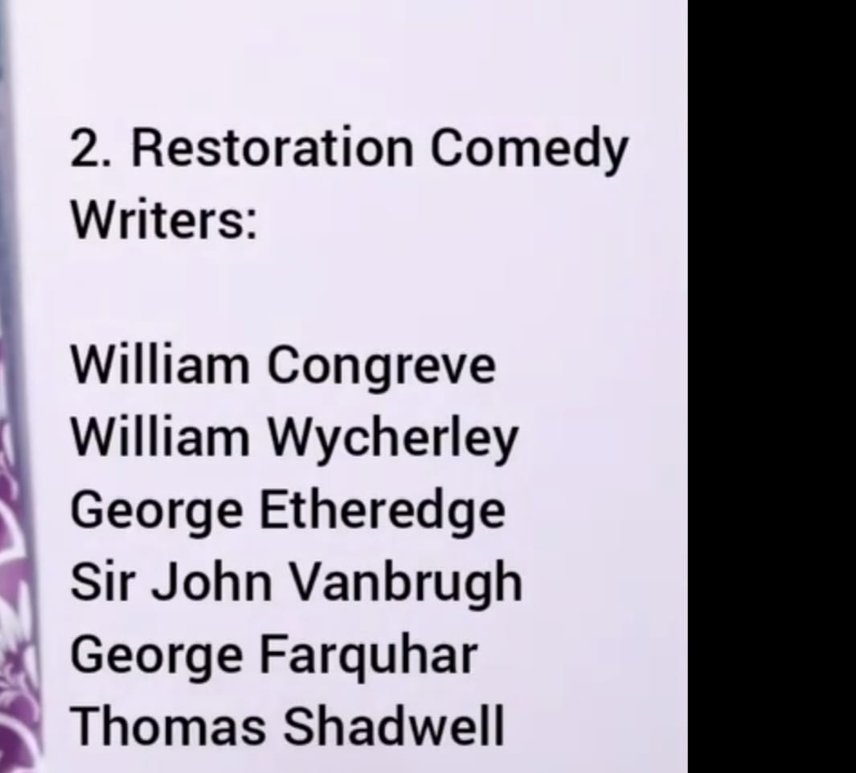

Slide 24
