Slide 1
A.Sumaya Banu
Assistant Professor of English
H.K.R.H College
English for Enrichment –I
Happy Prince-Oscar Wilde

Slide 2
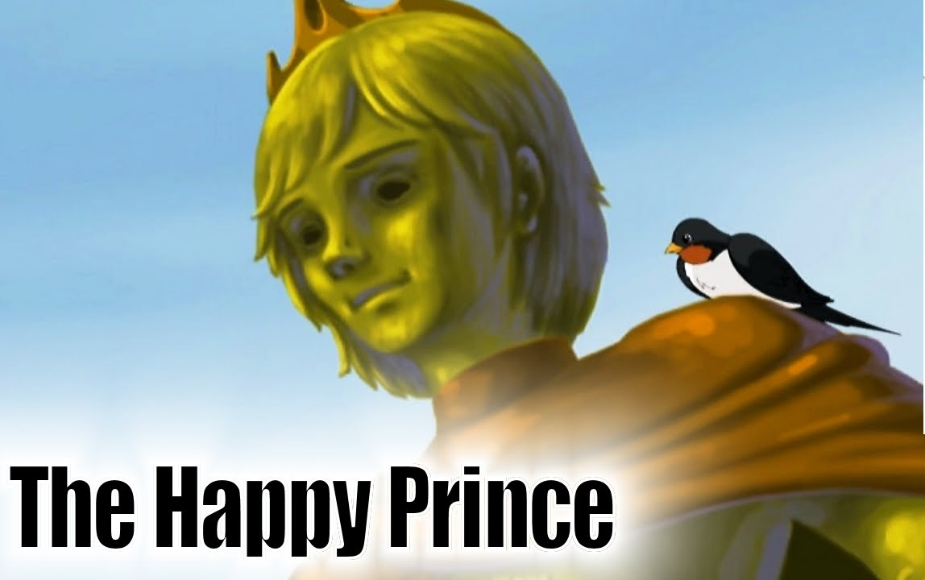
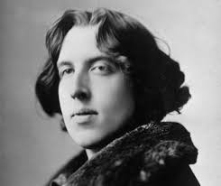
OSCAR WILDE

