Slide 1
H.K.R.H College Uthamapalayam
Ms.D.Gayathri Devi
Assistant Professor of English
Topic: Job Seeking Skills

Slide 3
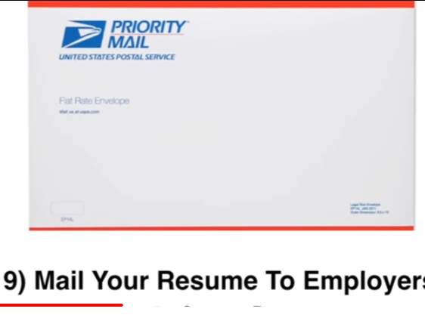

Slide 4
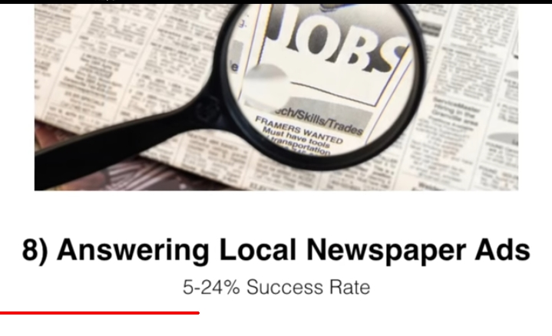

Slide 6
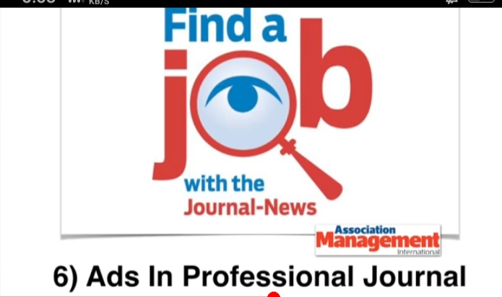

Slide 7
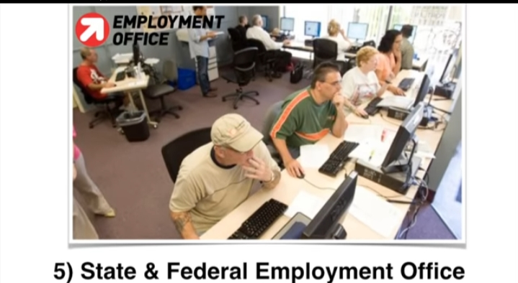

Slide 9
