Slide 1
JOURNALISM AND MASS COMMUNICATION UNIT – III- NEWS AND WORTHINESS
Mr. M. MATHAN
ASSISTANT PROFESSOR OF ENGLISH
HAJEE KARUTHA ROWTHER HOWDIA COLLEGE (AUTONOMOUS)
UTHAMAPALAYAM-625522

Slide 2
NEWS AND NEWS WORTHINESS

Slide 3
What is News?

Slide 4
NEWS MEANS:
An account of an event, or a fact or an opinion that interests people.
A presentation of current events
Anything that enough people want to read is news, provided it meets the standards of “good taste” and isn’t libelous.

Slide 5
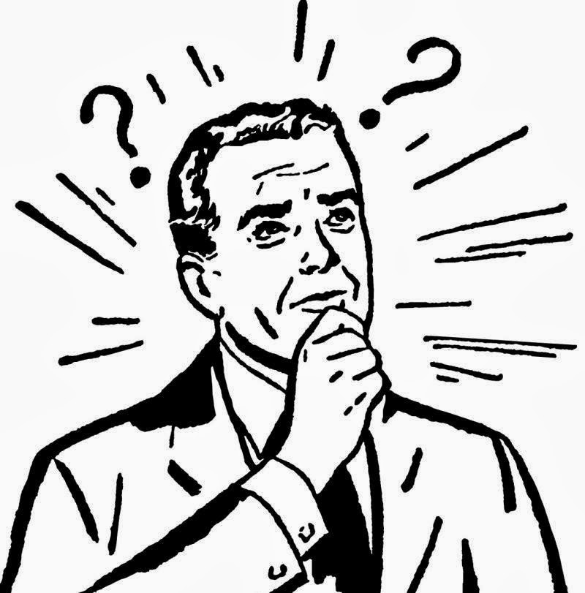
NEWS WORTHINESS
WHAT MAKES NEWS
AS “NEWS”?

Slide 6
Timeliness
The news happened recently (since the last edition)
It’s new, otherwise, we’d call it “olds”
Almost every story has some timeliness aspect
For example: A teen driver is hit by another car at the intersection of Miller and Russell today, in the newspaper tomorrow.

Slide 7
Conflict
War, elections, sports
Any time there is a struggle
For example: In an election year a lot of stories about the election are news. The conflict in Iraq is news.

Slide 8
Consequence
The subject of a story has an impact on how people live their lives.
For example: A story on a new curfew that will take effect, or a street that is under construction, or a scientific breakthrough

Slide 9
Proximity
Closeness, either because of geographical proximity or because of relationship
For example: News about the area (geographical) or news about things of interest/concern to locals (relationship).

Slide 10
Prominence
Elected, wealthy, famous
For example: If I choke on a pretzel, it’s not news. When the president does, it is news.

Slide 11
Human Interest
“Warm and fuzzy” feeling
Makes interest physically or mentally
For example: Olympic athlete bios, Dateline “Survivor Stories”

Slide 12
Hard News and Soft News
Journalists often refer to “hard” news and “soft” news.
What’s the difference?

Slide 13
Hard News
HARD NEWS is important to large numbers of people. It has impact and consequence, and it is always timely.

Slide 14
Soft News
SOFT NEWS is less important and has little consequence. It entertains as well as informs. It is less timely (or sometimes not at all), it usually involves human interest, and appeals more to emotions than intellect.

