Slide 1
JOURNALISM AND MASS COMMUNICATION
Mr. NOUSHAD PM.
DEPARTMENT OF ENGLISH
HKRH COLLEGE
UTHAMAPALAYAM, THENI-625533 TAMIL NAD

Slide 2
JOURNALISM-DEFINITION AND SCOPE
“Journalism is instant history, an account of history as it is being made.” (Anonymous)
“Journalism is a report of things as they appear at the moment of writing, not a definitive study of a situation”. (Anonymous)
“Journalism is a contemporary report of the changing scene, intended to inform readers of what is happening around them.” (Anonymous)
“ literature in a hurry” –Jose A. Quirino
Journalism is unbiased production and distribution of reports on current or past events based on facts and supported with proofs or evidences. The word journalism applies to the occupation, as well as citizen journalists who gather and publish unbiased information based on facts and supported with proofs or evidences.

Slide 3
What is journalism?
‘Journal’ is a French word derived from the Latin term ‘diurnalis’ which means ‘daily’
The word’s first newspaper was perhaps the Acta Diurna - a handwritten bulletin put up daily in the Forum in ancient Rome.

Slide 4
SCOPE OF JOURNALISM
Journalism covers three channels or area of mass communication
Audio
Audio-Visual
Print

Slide 5
THE SCOPE OF JOURNALISM
The Press is often called the Fourth Estate. The term ‘The Press’ refers to printed periodicals or the newspapers, in general. Every newspaper has its own identity and wins the loyalty of is reader though a combination of words, pictures, presentation techniques, distinctive comments and exclusive news stories
The newspaper is a powerful medium. It is powerful because it has the ability to influence the way people view the world, as well as their opinion of what they see.

Slide 6
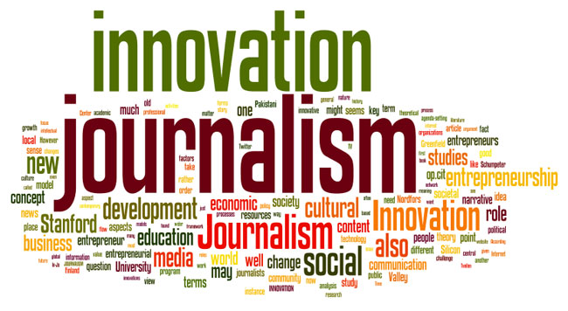

Slide 7
Scope of Journalism
In today’s world people want to know about the current information regarding politics, sports, weather, entertainment or so on, it is possible through mass communication. The scope of mass communication increasing day by day. It is the best source to collect information from all over the world. Mass Communication considering the fourth pillar of any state. Journalism investigating and analyzing the matters and discuss it with experts.
Over the years, the scope of journalism has increased as communication channels have broadened the mediums from radio, television sets, and newspapers to social media and online news websites. ... Presently in India, journalism has become a prestigious career choice for many students

Slide 8
Scope of Journalism
May be divided into three areas
1)Written
2)oral
3) visual
Periodicals such as newspapers and magazines fall under written journalism.Periodical is a publication that comes out at regular intervals —daily, weekly, fortnightly, monthly, bi-monthly, quarterly, annually, etc.
A newspaper, compared to a magazine, prints more news, has no special cover, and is printed on a special paper called newsprint. News is printed on the front page as wells as on the inside and back pages.

Slide 9
Contd…
A magazine prints more features and human interest stories, has a special cover usually with a big cut on it, and is often printed on bookpaper. If ever news is printed, it is brief, featurized, and found in the inside pages.
Periodicals, brochures, journals, books, and graphic arts are classified under print media.
Radio falls under oral journalism, while television, movies, and documentaries are under visual journalism. ➢
Radio and television are examples of broadcast media while movies and documentaries are examples of film media.

Slide 10
Study of Journalism
Different institutes offer a bachelor in Mass communication. In that degree students learn how to report the news, writing the news and also improve their speaking skills. It is very important for a journalism student to watch the latest events happening around the world for healthy debate.
Undergraduate students have the opportunity to start an internship in vacations. It helps them to increase their credibility and potential.

Slide 11
Journalism as Career
Journalism is divided into two parts-
1) Print Media everything which is printed falls into print media. It includes Newspapers, magazines, Journals, Books, dailies, and Tabloids
2) Electronic MediaThe news which is provided through electronic devices is known as Electronic Media. It includes Radio, Television, and the Internet
.A Journalist must be an all-rounder because he can collect information about Sports, Entertainment, and spiritual, Crime, Politics, and Culture and so on. They also work in newspapers and magazines. There is a lot of magazines printed in these days on education, sports, political and also for career counseling.

Slide 12
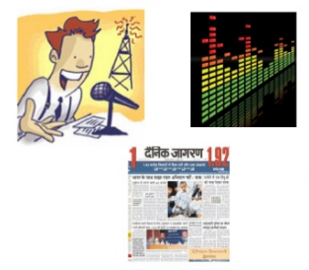
Career Platforms
There different career platforms for a journalist:
1) Educational institute
2) Newspapers
3) Magazines
4) Advertising agencies
5) Website of publishing
6) Television channels
7) Radio Channels.
A career in journalism has a lot of opportunities to work. It is a competitive field that has a huge demand in the market. There are a lot of communities of journalists in which they can share their unique ideas and give suggestions to the people about any specific issue

Slide 14
THANK YOU

