Slide 1
A.Sumaya Banu
Assistant professor of English
H.K.R.H College
Literary Criticism - I
John Dryden

Slide 2
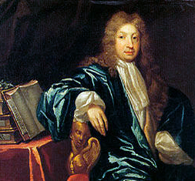
JOHN DRYDEN

Slide 9
Critical works
An Essay on Dramatic Poesy- Formal treatise on criticism
Learnt manner of critical writings-French-Montaigne and Corneille-suited his temperament for more reason.
Essay of Dramatic poesy, Epistle Dedicatory of the Rival Ladies- advocating the use of heroic couplet for dramatic purpose.

Slide 10
Dedication to Annus Mirabilis- four line stanza with alternative rhyme to the heroic couplet for heroic verse.
Essay of Dramatic poesy, A Defence of an Essay of Dramatic Poesy, Indian Emperor defend the use of rhymed couplet in tragedy.

Slide 11
The Grounds of criticism in Tragedy, prefixed to Troilus & Cressida containing an exposition of Aristotle’s theory of tragedy and an examination of an exposition of Shakespeare & Fletcher
“A Discourse concerning the original and progress of satire” prefixed to the translation of “ The Satires of Fuvenal”

Slide 12
“A Parallel of poetry & painting” prefixed to the translation of Du Fresnoy’s Latin poem De Arle Graphica
Dedication of the Aeneis, prefixed to the translation of Virgil’s work discussing epic poetry with particular reference to Virgil
‘Preface to the Fables’- appreciation of Chaucer

Slide 14
Dryden’s criticism-thought of nature, function of poetry, its form, business of criticism & masters who interested him.
He gave new turn to English criticism-combines merits of both native tradition & classical

Slide 15
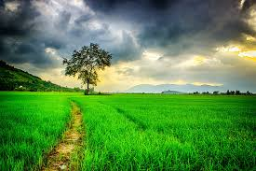
THE NATURE OF POETRY

Slide 16
Dryden uphold Aristotle’s ‘Definition of poetry’ as a process of imitation.
It imitates what was or is( fact, past or present) what is said or thought to be( popular beliefs & superstitious) and what ought to be( things in their ideal form)
Generally accepted view of poetry in his day-fact, past or present.

Slide 17
Dryden take pains to emphasize the other two forms of imitation in Aristotle’s definition.
‘The Ground of Criticism in Tragedy’-poet to imitate “things as they are said or thought to be”
He defends Shakespeare’s use of the supernatural, founded on popular belief.

Slide 18
Dryden gives his own explanation of why imitation pleases.
‘As truth’, he says ‘is the end of all our speculations, so the discovery of it is the pleasure of them.
Nature gives as pleasure, lively imitation of its either in poetry or painting

Slide 19
FUNCTION OF POETRY

Slide 20
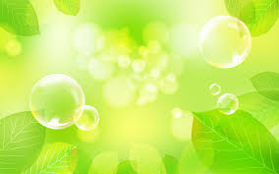
The poet in his day did not unburden his soul only to himself.
Scott James says ‘No Art for Art’s Sake.
Plato had wanted poetry to instruct, Aristotle to delight, Horace to do both and Longinus to transpor

Slide 21
Dryden familiar with them all-conclude-final end of poetry was delight and transport rather than instruction and to realize it-did not imitate life but offered its own version of it-`a beautiful resemblance of the whole’(A Defence of an Essay of Dramatic Poesy)

Slide 22
According to Dryden poet is neither a teacher nor a bare imitator - a photographer - but a creator - life or Nature as his raw material –a work of art rather than a copy.
Aristotle also meant the same – replying to Plato`s objection that poetry gave a copy of copy, he said that the truths of poetry were not be confounded with the truth of life.
Dryden feels the necessity of fancy or what Coleridge calls ‘the shaping spirit of imagination’s

Slide 23
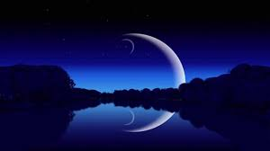
s
THANK YOU

