Slide 1
B.Nagia M.A.,M.Phil
Assistant Professor of English
English for Enrichment-IV
The Merchant of Venice

Slide 2
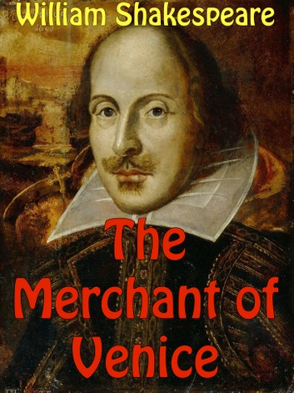
SHAKESPEARE The Merchant of Venice

Slide 8
Characters:
Antonio
The merchant of Venice, a wealthy and generous man
Bassanio
His closest friend, a poor nobleman
Portia
His wife, a wealthy heiress

Slide 9
Characters (cont.)
Shylock
Antonio’s arch-rival, a Jewish moneylender known for his selfishness
Jessica
Shylock’s daughter

Slide 10
Characters (cont.)
Graziano
A friend to Antonio and Bassanio
Nerissa
His wife, Portia’s maid
Duke of Venice
The ruler of Venice
Lorenzo
Antonio’s friend

Slide 11
Bassanio needs money…
He wants to marry the wealthy Portia, but he needs 3000 ducats
He asks Antonio for aid
Antonio is depressed for no reason, but he promises to help his friend

Slide 12
They go to Shylock
Antonio’s ships are at the sea
They go to Shylock to borrow money
Shylock hates Antonio, but allows him to borrow 3000 ducats
They make a contract: Antonio will pay Shylock a pound of his flesh if he cannot return the money within 3 months
Bassanio is worried, but Antonio agrees

Slide 13
Bassanio leaves with the money
On the very same day, Shylock’s daughter, Jessica, whom he loved a lot, ran away with Lorenzo, one of Antonio’s friends, taking a bag of Shylock’s jewels with her
Shylock runs through the streets; he vows revenge
He is later sad that his daughter sold away a jeweled ring he had given her for a money

Slide 15
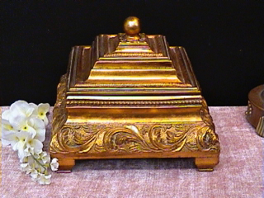
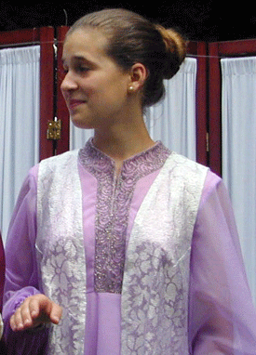
Who chooses
me will get
what he desires.
All that glitters is not gold.
Who chooses
me shall gain
what many
men desire.
There are many fools covered in silver.
Who chooses
me will be ready
to lose all that
he has

Slide 20
THANK YOU

