Slide 1
B.Nagia
Assistant Professor of English
H.K.R.H College
Indian Writing in English
Girish Karnad - Nagamandala

Slide 3
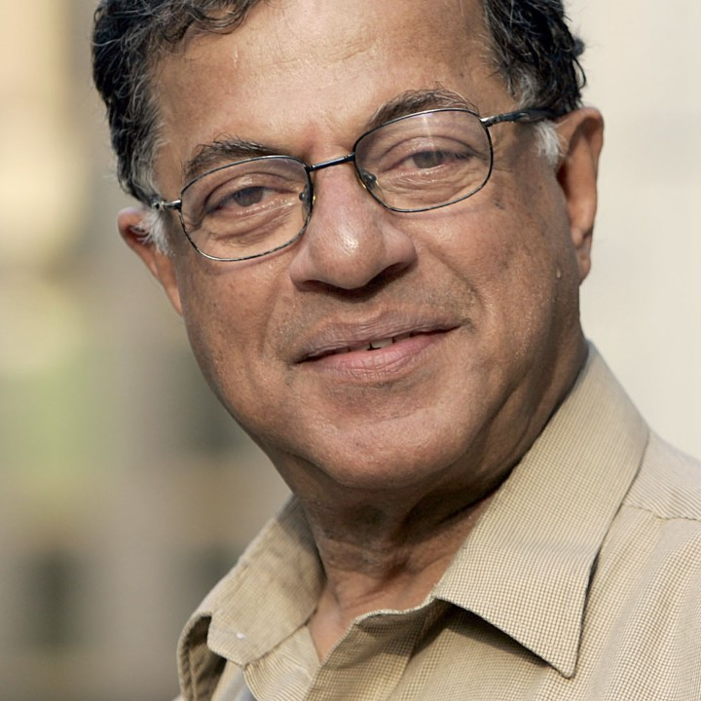

Slide 12
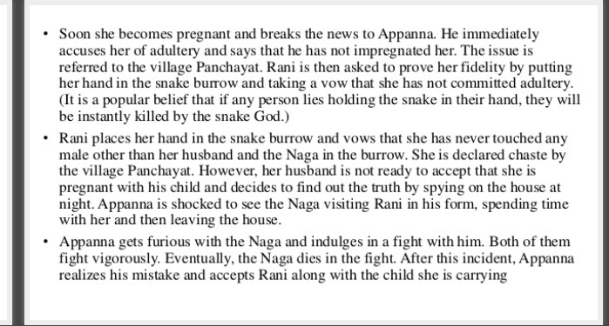

Slide 13
THANK YOU

