Slide 1
H.K.R.H College Uthamapalayam
Ms.D.Gayathri Devi
Assistant Professor of English
Topic: Poem- On His Blindness

Slide 4
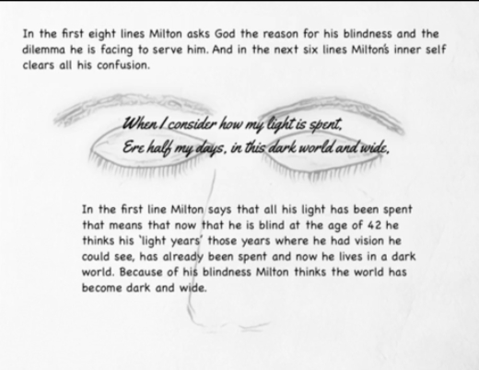

Slide 5
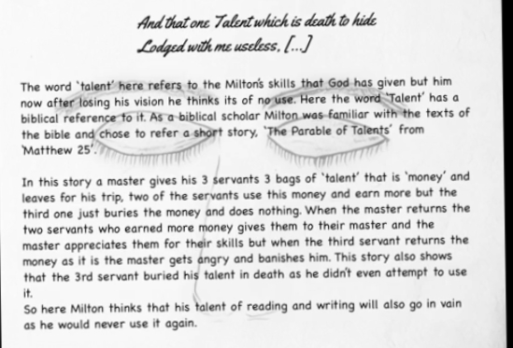

Slide 6
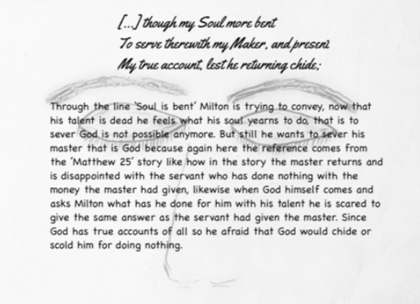

Slide 9
