Slide 1
B.Nagia
Assistant Professor of English
H.K.R.H College
English for Enrichment – III
Robert Frost – Road Not Taken

Slide 3
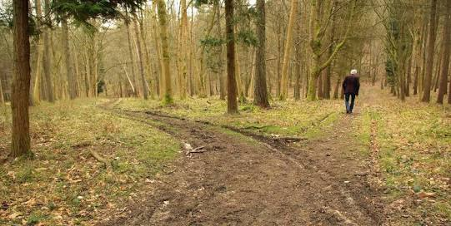
About the Author
Robert Lee Frost(March 26,1874-January 29,1963) was an American poet. His work was initially published in England before it was published in America. He is Highly regarded for his realistic depiction of rural life and his command of American Colloquial speech. Frost was honoured frequently during his lifetime, receiving four Pulitzer Prizes for Poetry. He became one of the America’s rare public literary figures almost an artistic institution. He was awarded the Congressional Gold Medal in 1960 for his poetical works

Slide 4
About The poem
First published in 1916, “The Road not Taken” shows Frost at his best as a pastoral who combines rustic simplicity with hidden, indirect and clarity of style and language

Slide 5
Poem’s Title
The road is the symbol of the choice made by us in life. Many times, we regret the choice we make but what is done once cannot be undone
Man regrets for what he has denied himself in life, rather than what he has chosen. Hence, the poet has given his poem the title “The road not taken”
The word “road” not only means “way”, it also means “journey” or a “stage of journey”. Here “road” does not signify any ordinary road, but functions a metaphor of a vital decision in our life.

Slide 6
Summary of The Poem
This poem talks about the choices one has to make in life and their consequences. One day while walking in a wooded area full of tress, the poet comes to a place where he has to decide which road he should take. He starts debating over the choices as he realises he cannot walk on both. However he decides to take the second path with the intension of travelling on the first some other time in future.

Slide 7
THE POEM

Slide 8
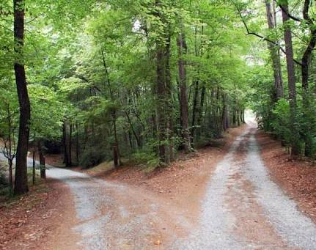
First stanza
Two roads diverged in a yellow wood,
And sorry I could not travel both
And be one traveller, long I stood
I looked down one as fair as I could
To where it bent in the undergrowth;

Slide 9
Summary of the first stanza
The speaker describes his position. He has been out for walking in the woods and comes in between the diversion of two roads, he stands there looking as far down each one as he can see. He would like to try out both, but doubts he could do that, so therefore he continues to look down the roads for a long time trying to make his decision about which road to take.

Slide 10
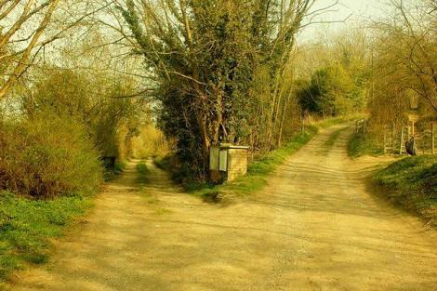
Second Stanza
Then took the other, as just as far
And having perhaps the better claim,
Because it was grassy and wanted wear;
Though as for that, the passing there
Had worn them really about the same,

Slide 11
Summary of the second Stanza
He looked down the first one “to where it bend in the undergrowth”, and then the second one, and he decided to take the other path, because it seemed to have less travelled than the first. But then he goes on to say that they actually were very similarly worn. The second one that he took seems less travelled but as he thinks about it, he realizes that there were “ really about the same”. Not exactly the same but only “ about the same”.

Slide 12
Third Stanza
And both that morning equally lay
In leaves no step had trodden black.
Oh, I kept the first for another day!
Yet knowing how way leads on to way,
I doubted if I should ever come back.

Slide 13
Summary of the third Stanza
The third stanza continues with the cogitation about the possible difference between the two road. He had noticed that the leaves were both fresh fallen on them both and had not been walked on, but then again claims that maybe he would come back and also walk the first one sometimes, but he doubted he would be able to, because in life one thing leads to another and time is short.

Slide 14
Fourth Stanza
I shall be telling this with a sigh
Somewhere ages and ages hence:
Two roads diverged in a wood, and I-
I took the one less travelled by,
And that has made all the difference.

Slide 15
Summary of The Fourth Stanza
In this poem the word “difference” is taken in a positive way. But there is nothing in the poem that suggests that this difference signals a positive outcome. The speaker could not offer such information, because he has not lived the “difference” yet. The other word that leads non-discerning readers astray is the word “sigh” by taking “difference” to mean a positive difference, they think that the sigh is one of nostalgic relief; however a sigh can also mean reader regret. There is the “ oh, dear” kind of sigh, but also the “what a relief” kind of sigh. Which one is it? We do not know. If it is the relief sigh, then the difference means the speaker is glad he took the road he did; if it is the regret sigh, then the difference would not be good, and the speaker would be sighing in regret.

Slide 16
Message of This poem
Robert Frost’s poem “The road not taken” seems to be hold out the mortal that life is a continuous journey full of divergence now and then. The important thing is to move on without looking back whether the choice of paths taken was right or wrong. The right or wrong are relative terms. We cannot get everything in life and have to make choices. Whatever direction in our life takes is determined by the choice made by us. In the journey of life, one can seldom come back to travel the ‘roads’ not taken earlier.

Slide 17
THANK YOU

