Slide 1
B.Nagia
Assistant Professor of English
H.K.R.H College
Indian Writing in English
Kiran Desai – The Inheritance of Loss

Slide 2
The Inheritance of Loss KIRAN DESAI
«A story of exiles at home and abroad,
of families broken and fixed, of love both bitter and bittersweet.»
Chicago Tribune

Slide 3
Kiran Desai
Kiran Desai was born on 3rd September 1971 in Chandigarh.
The family shifted to Delhi and when Kiran was fourteen, they moved to England and a year later to the United States, where she completed her University studies graduating in creative writing.

Slide 4
She was born into a cluster of various cultures. Her mother is the noted Indian, half-German writer Anita Desai, who was three times shortlisted for the Booker Prize. Desai now lives in Brooklyn, New York, but still every year she visits India.
She first came to literary attention in 1997 when she was published in the New Yorker and in Mirrorwork, an anthology of 50 years of Indian writing edited by Salman Rushdie whose closing piece was her story “Strange Happenings in the Guava Orchard”.
In 1998, she published her first book Hullabaloo in the Guava Orchard.
Desai based this book on a real-life story in which a man, Kapila Pradhan, lived up a tree for 15 years.
The book received a 1998 Betty Trask Prize from the British Society of Authors.

Slide 5
After more than seven years of work, in 2006 she published The Inheritance of Loss.
It was hailed by critics as a keen, richly descriptive analysis of globalization, terrorism, and immigration. When she received the Booker Prize for the novel in 2007, Desai became the youngest female writer to win the award.
Kiran Desai’s works are post-modern both in theme and form.
In Desai’s first novel, the modernist strain of alienation of self, fragmented family structure, breaking and questioning of the institutions of marriage, religion and politics are clearly discernible.
This sense of estrangement is carried on further in the second novel in the point of view of illegal immigrants, loss of homeland, diasporic articulation and the dialectics of marginality.

Slide 6
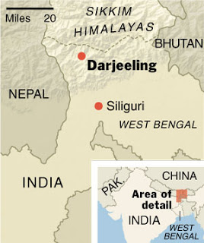
The Inheritance of Loss HISTORICAL CONTEXT
«Here, where India blurred into Bhutan and Sikkim, and the army did pull-ups […], it had always been a messy map. The papers sounded resigned. A great amount of warring, betraying, bartering had occurred; between Nepal, England, Tibet, India, Sikkim, Bhutan; Darjeeling stolen from here, Kalimpong plucked from there – despite, ah, despite the mist charging down like a dragon, dissolving, undoing, making ridiculous the drawing of borders.» (Kiran Desai, The Inheritance of Loss, p. 9)

Slide 7
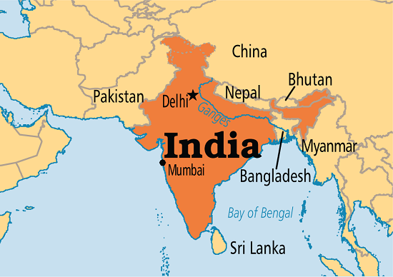
The chronological structure in The Inheritance of Loss broadens itself into a wide physical, geographical dimension. Not only time and space intersect, but the two of them also include, in almost 50 years, a passage from India, to Great Britain, America and back, concerning different cultures and languages.

Slide 8
Set in the late 1980s, The Inheritance of Loss switches between the ancient fast of the city of Kalimpong, at the base of mount Kangchengjunga in the West Bengal and the chaotic, cosmopolite Manhattan.
The story should be divided in time and space, between British colonialism and Indian independence according to the main characters; as they float among continents, so does the story.

Slide 9
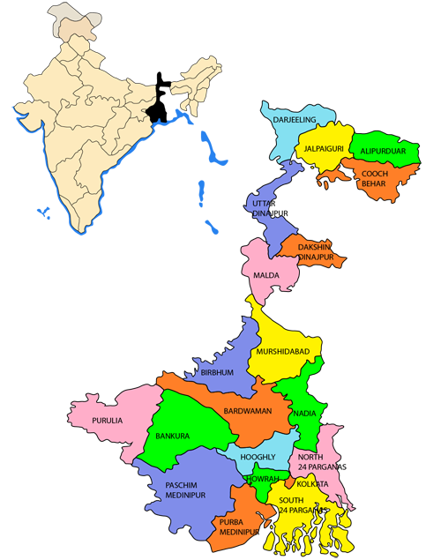
Kalimpong and neighbouring Darjeeling were major centres calling for a separate Gorkhaland state in the 1980s, and more recently in 2010.
The demands for separate statehood in India have been there even before India’s Independence. Even after the state re-organization of 1956, there were demands from various corners of the country for the creation of a separate state. Linguistic, cultural, ethnic and economic distinctions can be traced as the core reasons behind these demands.

Slide 10
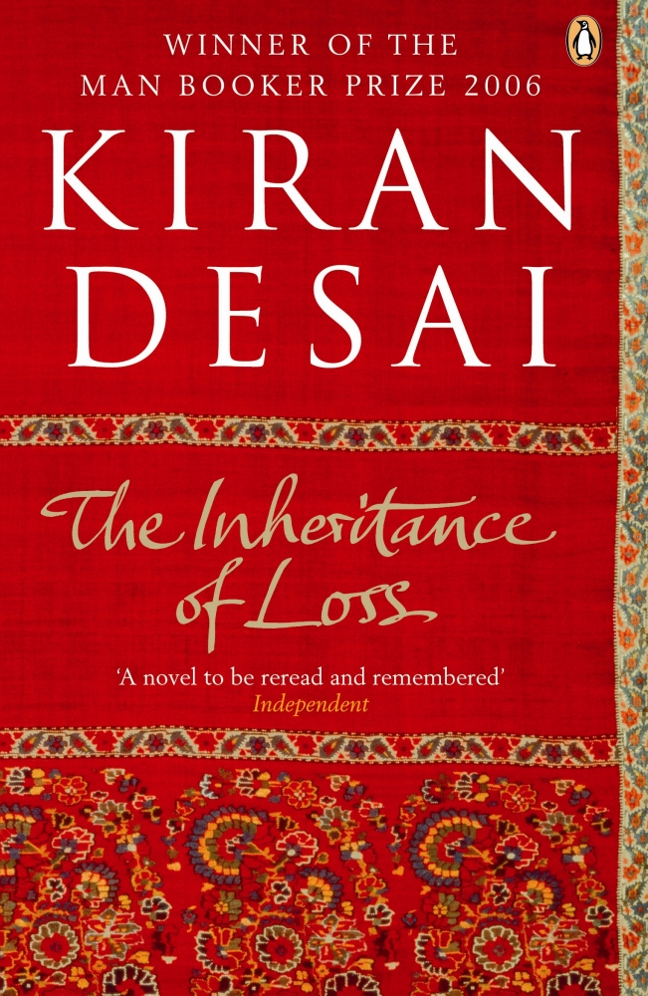
The Inheritance of Loss PLOT
The story is set in the 1980s in Kalimpong, located in the northern part of India in the foothills of Himalayas. Throughout the novel, there are two story strands—one following the lives of the people in Kalimpong, and one following the life of Biju.
Chapters alternate between India and the US, juxtaposing the slow pace of life in the hills with the frantic movements of an illegal migrant's existence, but also the conflict between the traditions of the Indian way of life and the shiny opulence of England and the US.

Slide 11
The story opens with Sai, a well-educated Indian girl who lives with her grandfather in the mountains of India. It is a turbulent time because ethnic Nepalese want to separate from India and have their own country.
She falls in love with her tutor, Gyan, but they fail to consummate their love, because of their differing social class.
Sai’s grandfather is a judge and has watched over her since her parents died.
The cook of the house looks after Sai. He also worries about his son, Biju, who lives in the US illegally.
Biju, despite his father’s tall stories of his wealthy life in America, lives in the same squalor he hoped to leave when he came to the country. After struggling, he gives up his dream, takes his earnings and returns to India.

Slide 12
The Inheritance of Loss is a novel all about divisions: between continents, between nationalities, between religions. But the most important divisions are typographic. Each one of the novel's 53 short chapters is subdivided into sections, separated from each other by centre-justified lines. The author has introduced hundreds of gaps into her narrative.
A novel of shifting points of view,
The Inheritance of Loss flits from one character to another, from one emotion or sense impression to the next, its narrative form acting out the sense of dislocation that is its theme.
Divisions allow the insertion of each character's back story.
The division of the narrative into self-contained fragments gives memories the same status as present events.

Slide 13
The Inheritance of Loss CHARACTERS
Sai: a seventeen-year-old girl living with her grandfather, who is a judge.
At the convent school, she learned English as well as Western values and appreciation of all things English. She falls in love with Gyan, her mathematics tutor.
She is strong and ambitious. She is open-minded about the world around her.

Slide 14
The judge (Jemubhai Patel): an angry and stern old man who attended Cambridge University.
When he returns to India, he feels like a foreigner. In addition, he is ridiculed because of his westernized way of life. When he returns to India, he feels like a foreigner. In addition, he is ridiculed because of his westernized way of life and in particular for the obsession with powdering his face. Jemubhai meets with his wife after being separated from her while he was in England. No longer interested in being married to an Indian woman, he sends her back to her parents, an act that brings shame to his own family.
Gyan: Sai's tutor and boyfriend. He is a young Nepali. Even though he is much lower in caste, she still treats him as her equal. Gyan gradually becomes attracted to the Nepali insurgency movement.
Biju: son of the Judge's cook. He manages to get a tourist visa to move to New York to try to make a better life for himself. He is uneducated. In fact, he could not even understand the announcements at the American embassy:
"Where is the Amriken embassy?"
"It is there". The man pointed back at the same building.
"That is U.S.“
"It is the same thing", said the man impatiently. (p. 182)
Biju lives a “secret” life in poverty and humiliation.

Slide 15
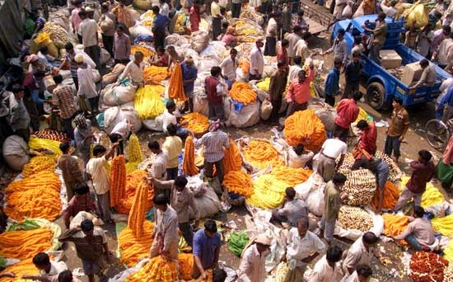
Sayeed: Biju's friend. He has a comfortable life in America. He has not been affected by the frustrations of an immigrant.
When Sayeed talks, he makes a lot of grammar mistakes (he work here or the phrase He have to share, p. 98).
The cook: proud of his son, Biju, whom he imagines to be successful in America. He is nameless and poor. While Sai and the cook seem to have a close relationship, by the end of the novel their relationship has been weakened and then broken by their economic inequality.

Slide 16
Lola and Noni: they represent the few Indians who have been able to benefit from the British influence.
When Lola becomes widowed, Lola's unmarried sister Noni moves to her cottage Mon Ami and they live on pension of Lola's husband. Noni helps out by starting to tutor Sai. They prefer British authors, they watch programs and news from the BBC and they celebrate English Christmas.
Uncle Potty and father Booty: they represent the privileged people from the west living in India.

Slide 17
The Inheritance of Loss MAIN THEMES
The novel is about Post-Colonialism in India and Orientalism. Thanks to Edward Said’s new interpretation the East stands for the barbaric, the uncultured and the “other”, the West is the true “self”. Most of the characters look up to the West as a model of behavior and reject their original background.
The Judge Patel is an Indian educated to the British lifestyle and mentality that he totally absorbed, he feels ashamed of his Indian roots. However, he is not completely accepted by the English he admires so much because of his origins. He is on the edge of two worlds.

Slide 18
Also the cook admires the West and he believes in the American dream: he sends his only son to USA to find a job and a better life there and he considers a degradation to work for non-English people. His son is an illegal immigrant in America who jumps from an illegal job to another.
Sai is also anglicized. She is brought up in a convent and educated to the English way of life and language.
In the end, all the characters are defeated. They experience an identity crisis because they are split between two different cultures. So Hybridity is not achieved.
Migrancy and diasporic displacement increase with globalization. Biju is a migrant but he fails in finding a new home in New York, in his process of “reterritoralization”, because he entered the invisible area of illegal immigrants from the third world.
The novel concerns the problem of race and racism resulting from the destabilizing meeting of West and East. Every character somehow experiences or practices racist attitudes. First, there is the judge that carries out intolerance. Biju experiences racism as well as exploitation. Lastly, there is Gyan that, because of his biases against the English, loses Sai and joins a terrorist force.

Slide 19
The novel deals with Indian social classes and injustice. Indians are divided into religious castes which are strictly respected. The judge and his granddaughter Sai belong to the upper middle class. Therefore, they are well educated and have lived in the West.The cook and his son Biju belong to the lower class and they work as servants. Sai and Gyan are in love but they cannot marry because he is of a lower class. They are in the same house but utterly separated by social status.
The author depicts the traditional gender gap between men and women. Women are subjected to men and live in their shadows as loyal, servile wives. The judge’s father buys to his son a bride. He beats her, abuses her, despises her for being Indian.
Another topic discussed here is about politics and the Gorkha insurgency. In the ‘80s they started to protest to create their own land, independent from India, and to find their own national identity.

Slide 20
The Inheritance of Loss STYLE
Descriptive and narrative style (nature and events)
Simple Syntax (coordinate clauses more frequent than subordinate clauses)
Many digressions, no linear development of the story and of the themes

Slide 21
Language and rhetorical devices
International and intercultural language (words from many languages)- estrangement effect (different cultures are connected, they don’t always understand each other, sometimes the reader doesn’t understand what is said)
Use of many rhetorical devices: methaphors, similes, hyperboles, etc. (nature, events)
Irony and conversational implicatures (things are not said directly but implied in the discourse, what is implied is sometimes explained in digressions, sometimes it remains ambiguous)

Slide 22
THANK YOU

