Slide 1
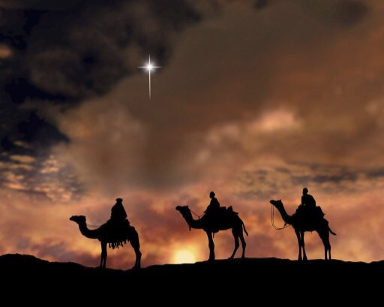
THE JOURNEY OF THE MAGI - T. S. ELIOT
Faculty Name : Mr. S. Abubacker Siddiq
Semester : V
Course : Twentieth Century Literature
Code : 17UENC52
Unit : I
Topic : The Journey of the Magi by T. S. Eliot

Slide 2
Background
First published in 1927 in a series pamphlet connected to Christmas.
Written after conversion to the Anglican faith.
“A Classicist in literature, a royalist in politics and Anglo-Catholic in religion.”

Slide 3
Background
Received the British citizenship
Opening lines were influenced by the sermon preached by Anglican Bishop Lancelot Andrewes in 1622, in fact a Christmas sermon, Nativity Sermons
Focuses on Matthew 2. 1 - 12 (no direct references in poem)

Slide 4
about the poem
Three Magi – ‘wise men’/ ‘kings’
Balthazar - King of Candia
Gasper - King of Ethiopia
Melchoir - King of Nubia
Journey of wise men from East to Palestine

Slide 5
about the poem
Three magi are on a journey to see the newborn/ infant Jesus Christ
Overtones are found about the crucifixion of Jesus Christ
Form – Dramatic Monologue, accounted from the point of view of a Magi, may be the first Magi

Slide 6
about the poem
Narration can be divided into THREE parts
inbound - journey towards - doubt
destination - arrival - satisfaction
outbound - journey afterwards - contemplation
Cycle
(Re)Birth - Life - Death

Slide 7
About the title
‘Journey’ - the act of travelling from one place to
another place
Venturing from ‘a known place’ to ‘an unknown place’
Different seasons/ people/ culture

Slide 8
theme
Literal/ Mythic/ Spiritual journey
Inner and outer journeys - an arduous process of personal change
Death of the old and Birth of the new
Birth of Christ/ Redemption of Humanity

Slide 9
Key words

Slide 10
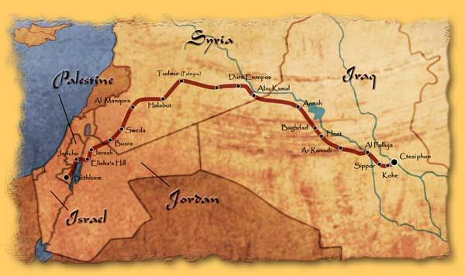
MAP

Slide 11
THE JOURNEY OF THE MAGI (TEXT)
“A cold coming we had of it,
Just the worst time of the year
For a journey, and such a long journey:
The ways deep and the weather sharp,
The very dead of winter.”

Slide 12
THE JOURNEY OF THE MAGI (TEXT)
And the camels galled, sore-footed, refractory,
Lying down in the melting snow.
There were times we regretted
The summer palaces on slopes, the terraces,
And the silken girls bringing sherbet.

Slide 13
THE JOURNEY OF THE MAGI (TEXT)
Then the camel men cursing and grumbling
And running away, and wanting their liquor and women,
And the night-fires going out, and the lack of shelters,
And the cities hostile and the towns unfriendly
And the villages dirty and charging high prices:
A hard time we had of it.

Slide 14
THE JOURNEY OF THE MAGI (TEXT)
At the end we preferred to travel all night,
Sleeping in snatches,
With the voices singing in our ears, saying
That this was all folly.

Slide 15
THE JOURNEY OF THE MAGI (TEXT)
Then at dawn we came down to a temperate valley,
Wet, below the snow line, smelling of vegetation;
With a running stream and a water-mill beating the darkness,
And three trees on the low sky,
And an old white horse galloped away in the meadow.

Slide 16
THE JOURNEY OF THE MAGI (TEXT)
Then we came to a tavern with vine-leaves over the lintel,
Six hands at an open door dicing for pieces of silver,
And feet kicking the empty wine-skins.
But there was no information, and so we continued
And arrived at evening, not a moment too soon
Finding the place; it was (you may say) satisfactory.

Slide 17
THE JOURNEY OF THE MAGI (TEXT)
All this was a long time ago, I remember,
And I would do it again, but set down
This set down
This: were we led all that way for
Birth or Death? There was a Birth, certainly,
We had evidence and no doubt. I had seen birth and death,

Slide 18
THE JOURNEY OF THE MAGI (TEXT)
But had thought they were different; this Birth was
Hard and bitter agony for us, like Death, our death.
We returned to our places, these Kingdoms,
But no longer at ease here, in the old dispensation,
With an alien people clutching their gods.
I should be glad of another death.

Slide 19
REFERENCES
https://www.poetryinvoice.com/poems/journey-magi
https://www.cegastacademy.com/2019/10/04/journey-of-the-magi-analyzed-subject-matter-themes-poetic-devices/
https://interestingliterature.com/2016/12/a-short-analysis-of-t-s-eliots-journey-of-the-magi/
https://poemanalysis.com/t-s-eliot/journey-of-the-magi/
https://www.bl.uk/collection-items/journey-of-the-magi-by-t-s-eliot-illustrated-by-e-mcknight-kauffer

Slide 20
THANK YOU

