Slide 1
T.S.Eliot
Course title : Literary Criticism
Course code : 17PENC24
Staff name : Vel Murugan
Unit : v

Slide 5
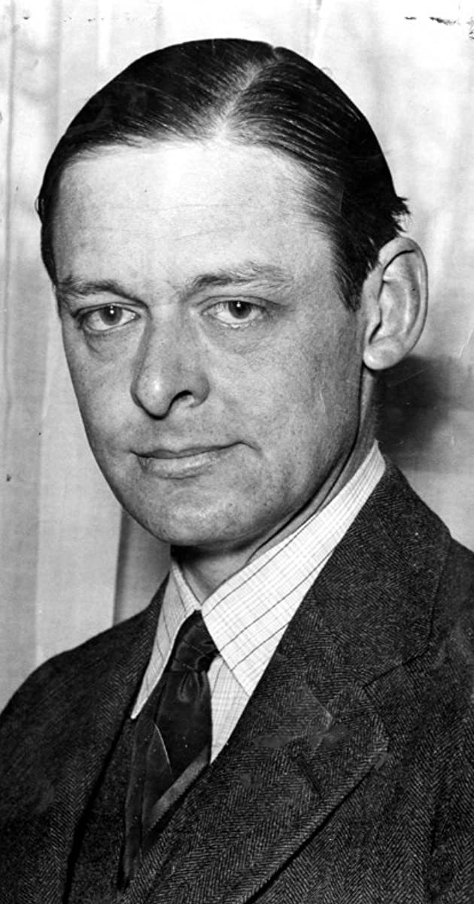

Slide 12
Thank you

