Slide 1
VERB
Mr. NOUSHAD PM.
DEPARTMENT OF ENGLISH
HKRH COLLEGE
UTHAMAPALAYAM, THENI-625533 TAMIL NADU

Slide 2
UNIT-III VERBS-MAIN VERBS-REGULAR AND IRREGULAR VERBS
what is a verb?
A verb is just a word that shows an action or a state .
There are two kinds of verbs-
1)State Verbs 2) Action Verbs
They are also called as Stative Verbs and Dynamic Verbs

Slide 3
WHAT IS ACTION VERBS?
‘Action verbs express physical activities or processes.
Examples:kick, shout, run, climb, stand, sit, grow - all of these show us physical activities or processes.

Slide 4
WHAT IS STATIVE VERB?
A state verb is a verb that expresses a situation.
Examples: be, have, think, like and own are all state verbs

Slide 5
QUESTIONS?????
“I have a large family”.(state/Action)
Julia likes chocolate ice cream.(state/Action)
The children are playing in the park(state/Action)
Who is shouting?(state/Actions)

Slide 6
MAIN VERBS AND HELPING VERBS(AUXILIARY VERBS)
When a verb is used in a sentence, it can be used in two ways - it can either be used as the main verb of the sentence or it can be a helping verb - that is it can help the main verb.
The most important helping verbs are be, do and have.
Example: Tom is working now

Slide 7
QUESTION?????
“Tom is working now.”
1)Identify the verbs in this sentence
2) Which is the main verb?
3) Which is the helping verb?

Slide 8
ANSWERS!!!!!
The main verb is 'working' because that shows the action that is happening
Is' is a helping verb - that shows the tense of sentence-Luciano is working now because we said 'is'.

Slide 9
VERBS: MODALS AND AUXILIARIES
An auxiliary is a helping verb. It is used with a main verb to form a verb phrase
For example, • She was calling her friend.
Here the word calling is the main verb and the word was is an auxiliary verb
The words be, have, do, can, could, may, might, shall, should , must, will, would, used, need, dare, ought are called auxiliaries

Slide 10
The verbs be, have and do are often referred to as primary auxiliaries. They have a grammatical function in a sentence
The rest in the above list are called modal auxiliaries, which are also known as modals. They express attitude like permission, possibility, etc

Slide 34
modal auxiliaries OR
modals

Slide 36
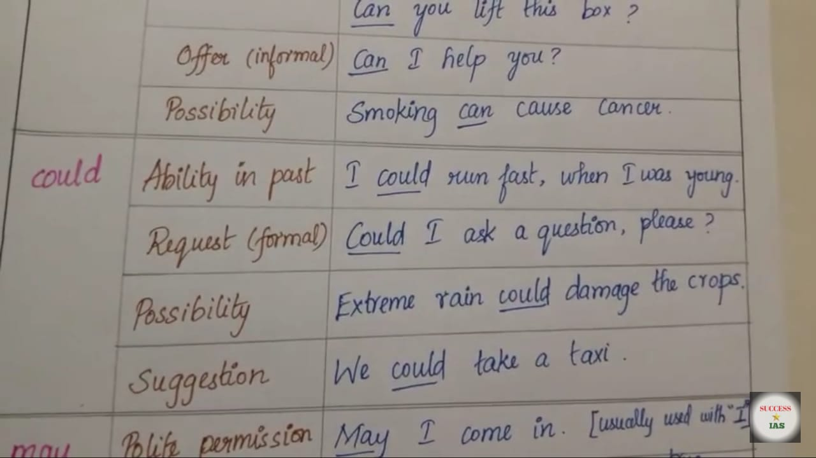

Slide 37
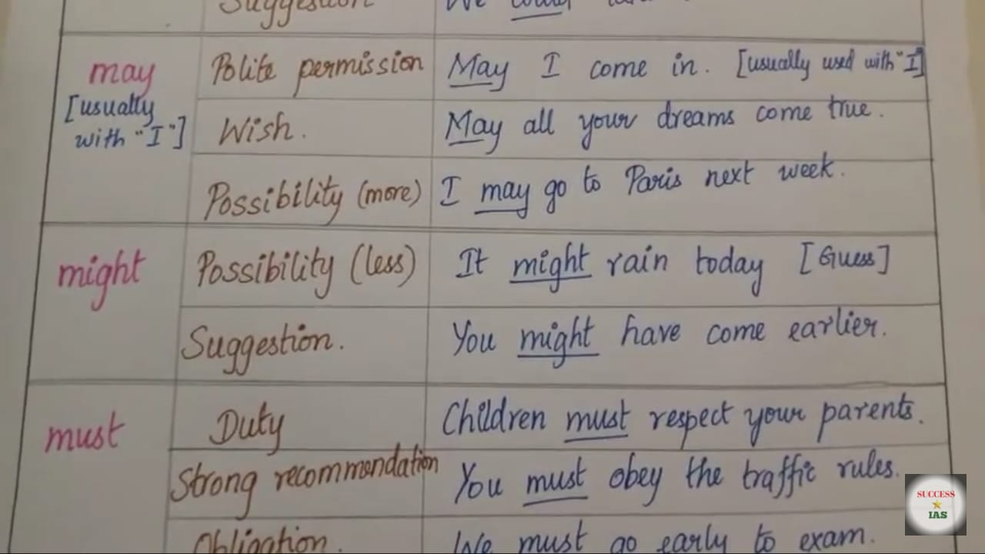

Slide 39
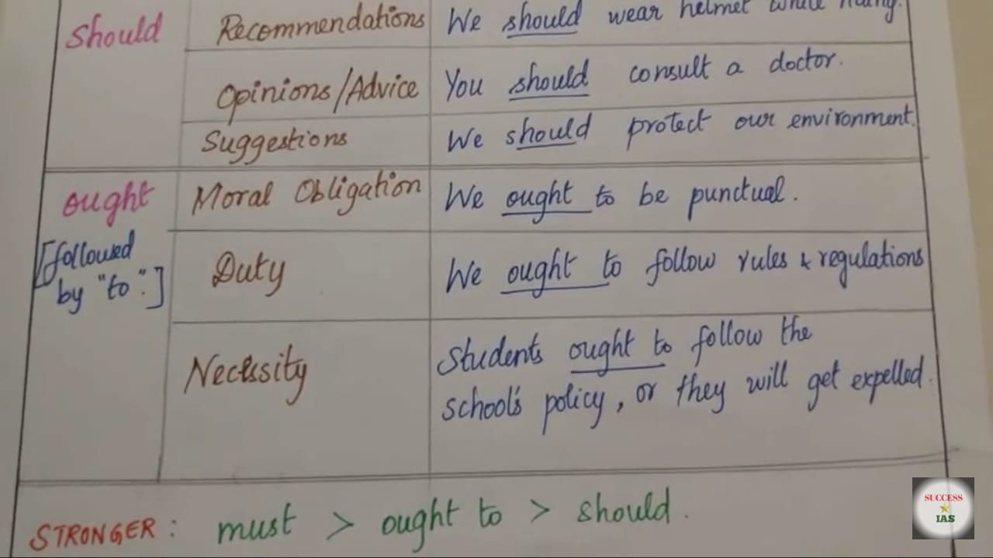

Slide 40
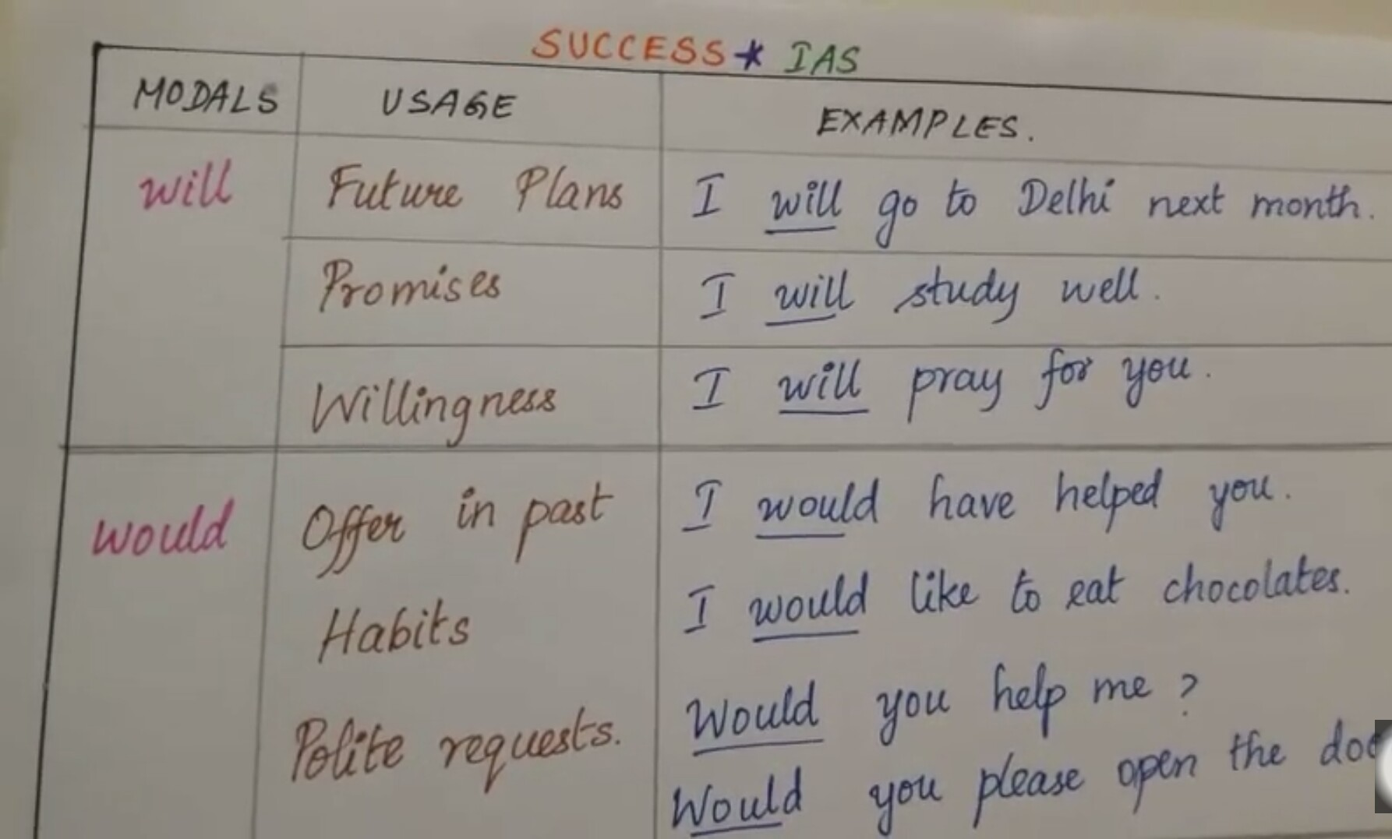

Slide 45
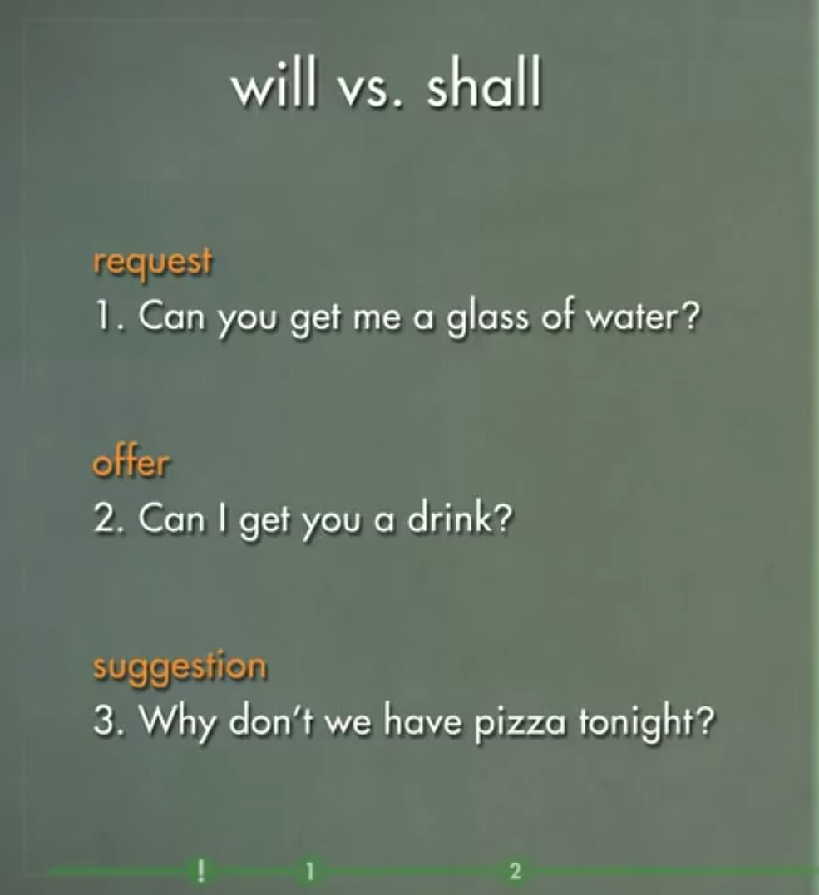

Slide 49
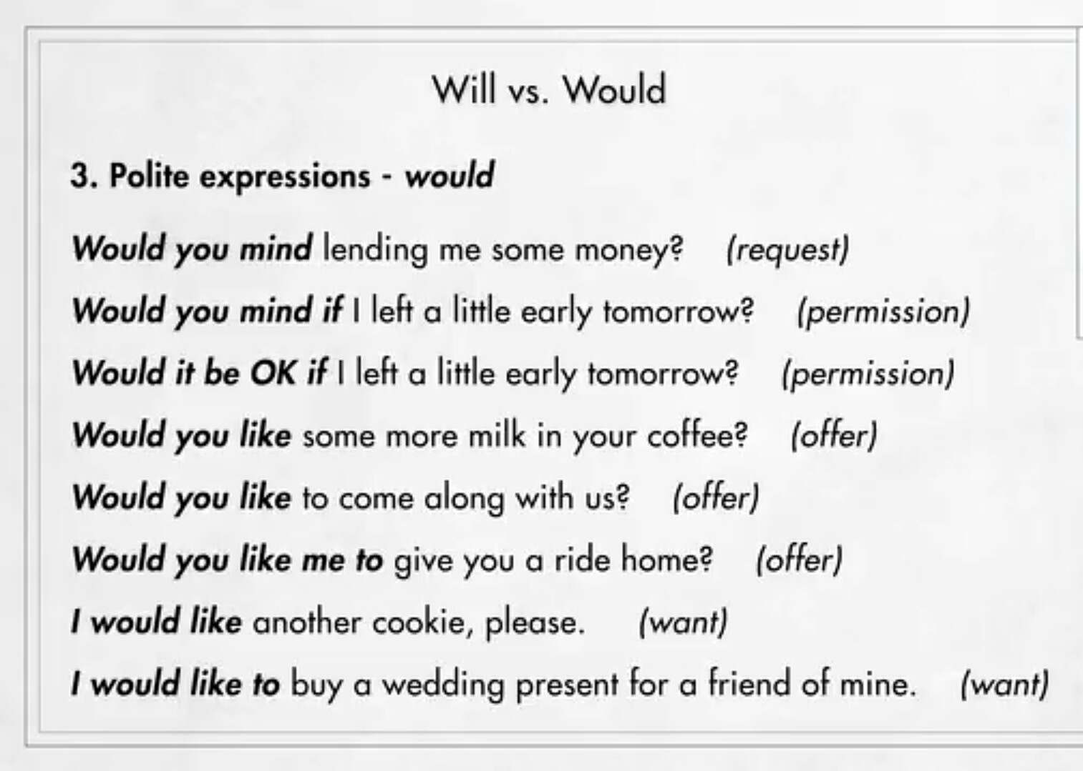

Slide 50
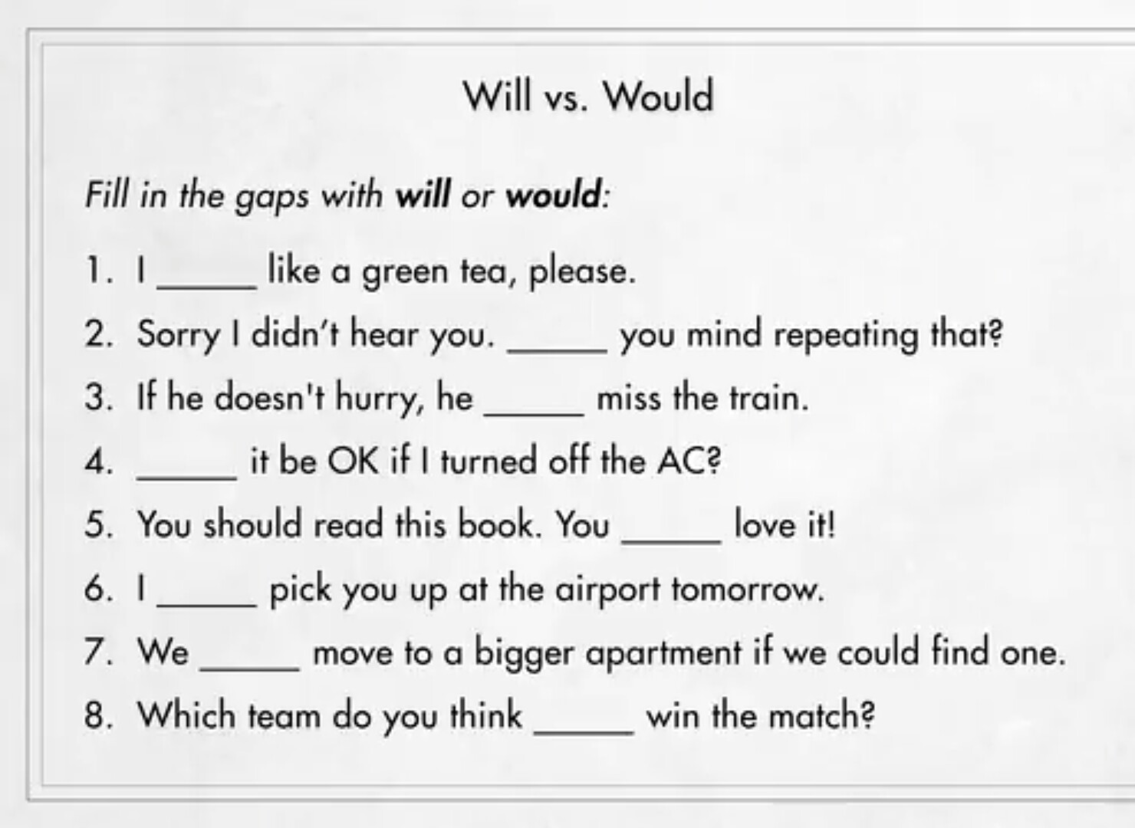

Slide 51
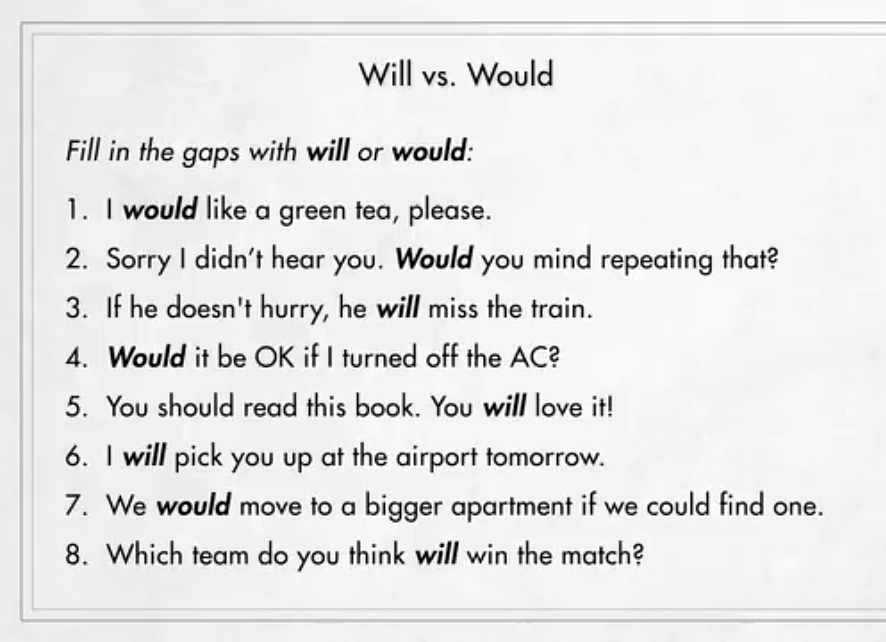

Slide 52
REGULAR VERBS AND IRREGULAR VERBS

Slide 53
REGULAR VERBS AND IRREGULAR VERBS
Based on the formation of Past and Past Participle Forms, Verbs are divided into two types.
1.) Regular Verbs
2.) Irregular Verbs.
Regular Verbs are the verbs that follows a fix pattern while conversion from present to past and past participles
Irregular Verbs are the verbs that do not follow a fix pattern while conversion from present to past and past participle form.

Slide 54
Regular verbs are formed by adding 'ed', 'd' or 'ied' to verb's base form as per the last character in the Verb.
As irregular verbs do not follow any such pattern, we can not form just by adding a specific character.

Slide 55
REGULAR VERB FORMATION IS BASED ON LAST CHARACTER OF VERB.
1.) Most Regular Verbs are formed by adding 'ed' to the base form of the word
Examples: Walk-walked ,Jump-Jumped, Call-Called, look-looked
2.) Regular Verbs are formed by adding 'd' to the base form of the word if verb ends with '-e‘

Slide 56
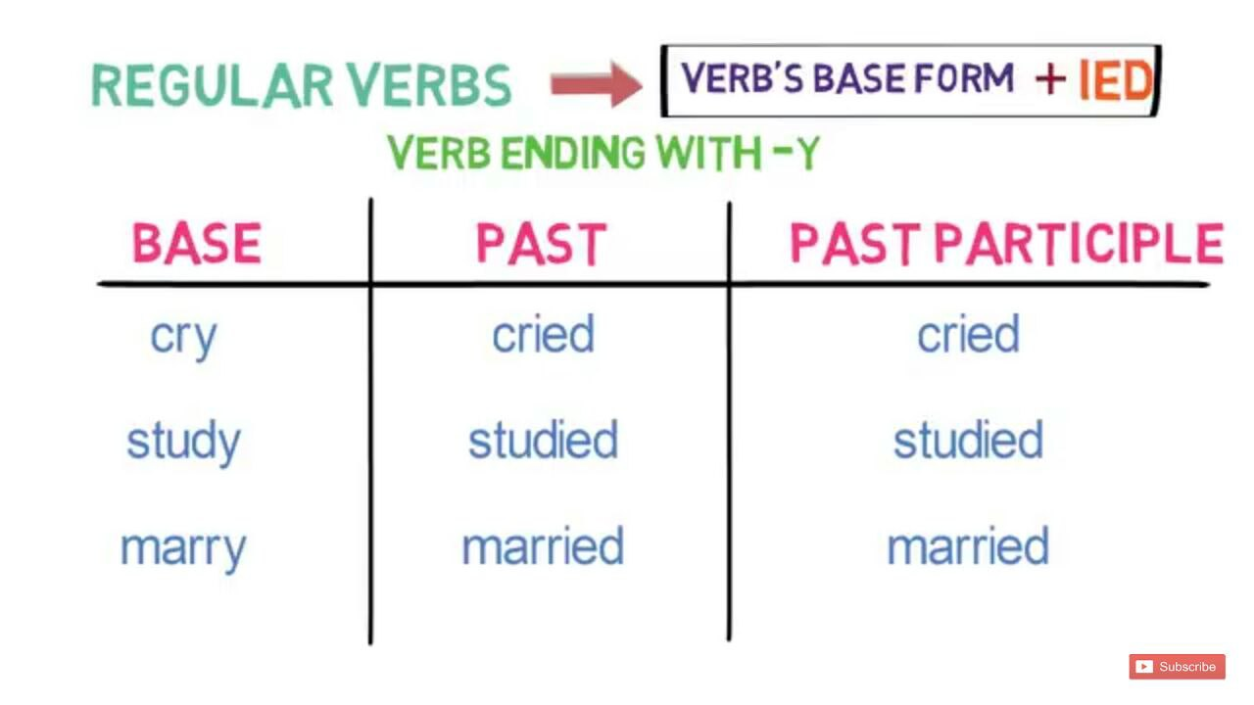
3.) Regular Verbs are formed by adding 'ied' to the base form of the word if verb ends with '-y'

Slide 57
IRREGULAR VERBS DO NOT FORM ANY FIX PATTERN.
Group 1 : all three verb forms are same

Slide 58
Group 2 : same 'past' and 'past participle' form.

Slide 59
Group 3 : same 'base' and 'past participle' form

Slide 60
Group 4 : All three forms are different.

