Slide 1
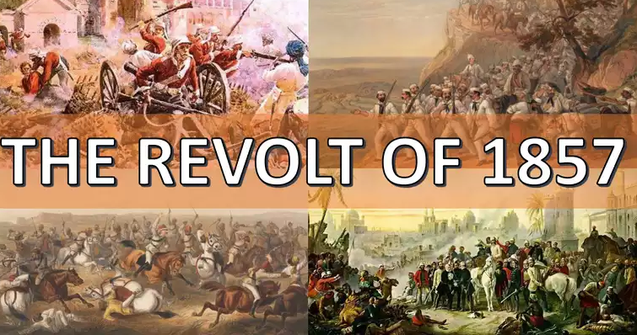
K.C RAIHANATH
ASSISTANT PROFESSOR OF HISTORY
HAJEE KARUTHA ROWTHER HOWDIA COLLEGE
UTHAMAPALAYAM

Slide 2
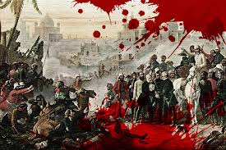
Other Names of Revolt of the 1857
Sepoy Mutiny
Great Rebellion
Indian Resurrection
First War of Indian Independence”

Slide 3
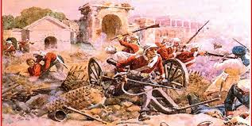
CAUSES OF THE REVOLT
Political Causes
Economic Causes
Socio- Religious Causes
Military Causes
Administrative Causes

Slide 5
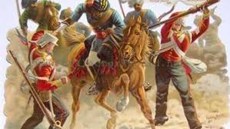
Economic Causes
Eviction of Land
Heavy Taxation
Discriminatory Tariff Policies
Destruction of traditional handicrafts
Breakdown of village self sufficiency
Commercialisation of Agriculture
De-industrialaisation
Drain of Wealth

