Slide 1
South Indian Architecture
Raihanath KC
Asst. Professor of History
H.K.R.H COLLEGE

Slide 2
HISTORY OF THE SOUTH INDIAN ARCHITECTUTRE BEGAN WITH PALLAVAS

Slide 3
REACHED ITS ZENITH DURING THE CHOLAS

Slide 4
ROCK CUT TEMPLES – 7TH C
STRUCTURTAL TEMPLES - 8TH AND 9TH C

Slide 5
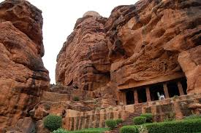

Slide 6
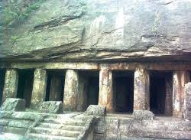

Slide 7
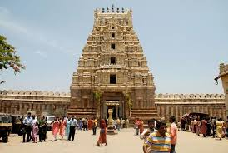

Slide 8
MAHABALIPURAM OR MAMALLAPURAM

Slide 9
SEVEN RATHAS OF MAHABALIPURAM --MOST IMPORTANT PALLAVA ROCK CUT TEMPLE(NARASIMHAVARMAN -7TH C)
1)GANESH
2)DRAUPATI
3)DHARMAPUTRA
4)BHIMA
5)ARJUNA
6)NAKULA
7)SAHADEVA

Slide 10
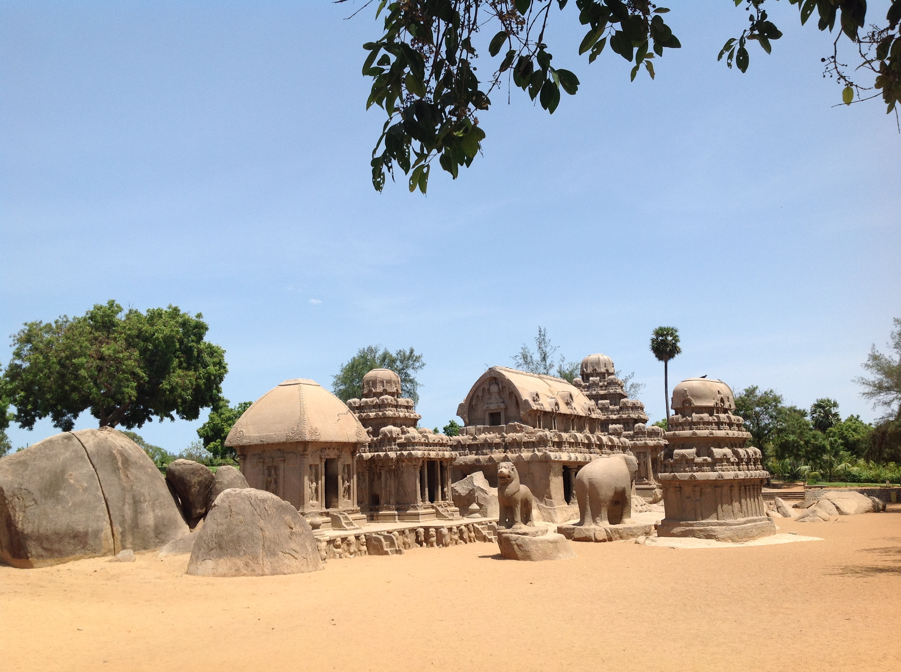

Slide 11
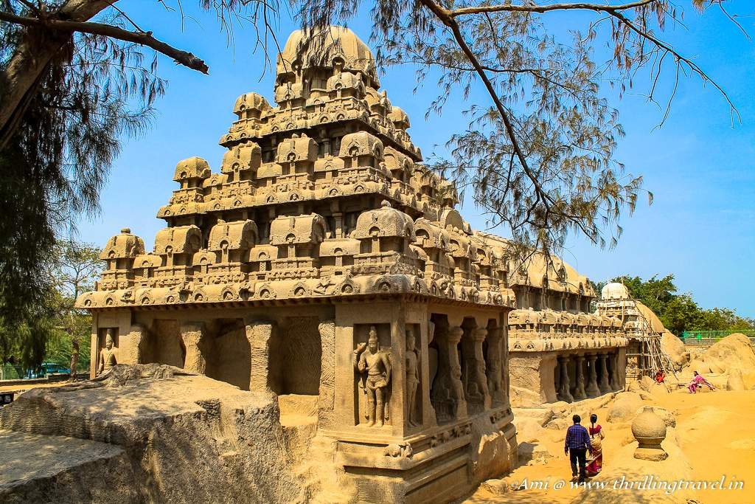

Slide 12
SOLID ROCK
MANDAPAS
PILLARED ROCK
FIRST PHASE PALLAVA ARCHITECTURE ARE MODELLED ON THE BHUDDIST VIHARAS OR MONASTERIES
DHARMAPUTRA OR DHARMARAJA RATHA –LARGEST
DRAUPATHI RATHA - SMALLEST AND MOST ELEGANT

Slide 13
RATHAS HAVE AROUND THEM IMAGES OF LION ,ELEPHENTS AND BULLS CARVED ON ROCKS AS SYMBOLS OF DURGA,INDRA AND SHIVA RESPECTIVELY

Slide 14
KAILASANATHA TEMPLE IS THE LARGEST – STRUCTURAL TEMPLES
VAIKUNTA PERUMAL TEMPLE-KANCHI
SHORE TEMPLE AT MAHABALIPURAM (NARASIMHAVARMAN II)
- the courtyard is surrounded by number of NANDIS
- outer walls separated by LION figures

Slide 15
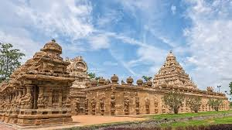
KAILASANATHA TEMPLE

Slide 16
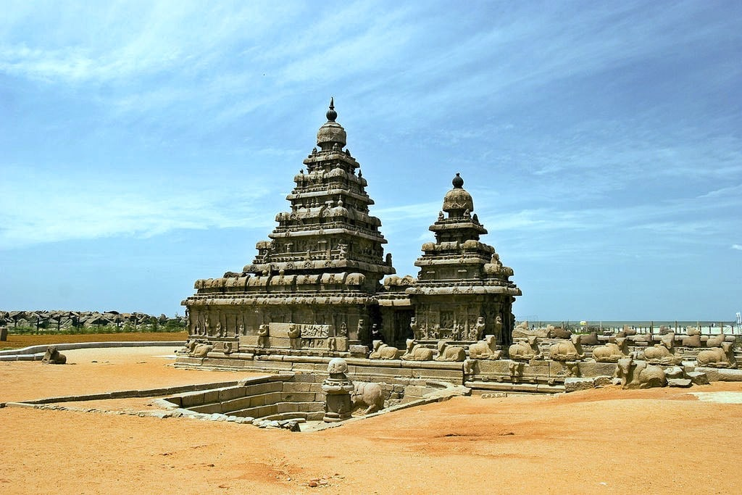

Slide 17
CHOLAS

Slide 18
REACHED ITS ZENITH(9TH AND 13TH C)
DRAVIDIAN OR SOUTH INDIAN STYLE
CONSTRUCTION OF NUMBER OF STOREYS ABOVE THE MAIN DEITY ROOM OR GARBHAGRIHAM (5-7)
THE TYPICAL STYLE OF THESE STOREYS IS CALLED VIMANA STYLE
PILLARED HALL CALLED MANDAPA
LOFTY GATES CALLED GOPURAMS

Slide 19
TANJORE OR THANJAVUR
BRIHADESWARA OR RAJARAJESHWARA TEMPLE(SHIVA TEMPLE)
- GODS AND GODDESSES
- NANDIS (LARGEST IN SOUTH INDIA)
- GOPURAM ON THE ENTRANCE
- ASHTADHIKPALAKAS OR THE GUARDIANS OF DIRECTIONS-INDRA,AGNI,YAMA,NIRTI, VARUNA, VAYU,KUBERA

Slide 20
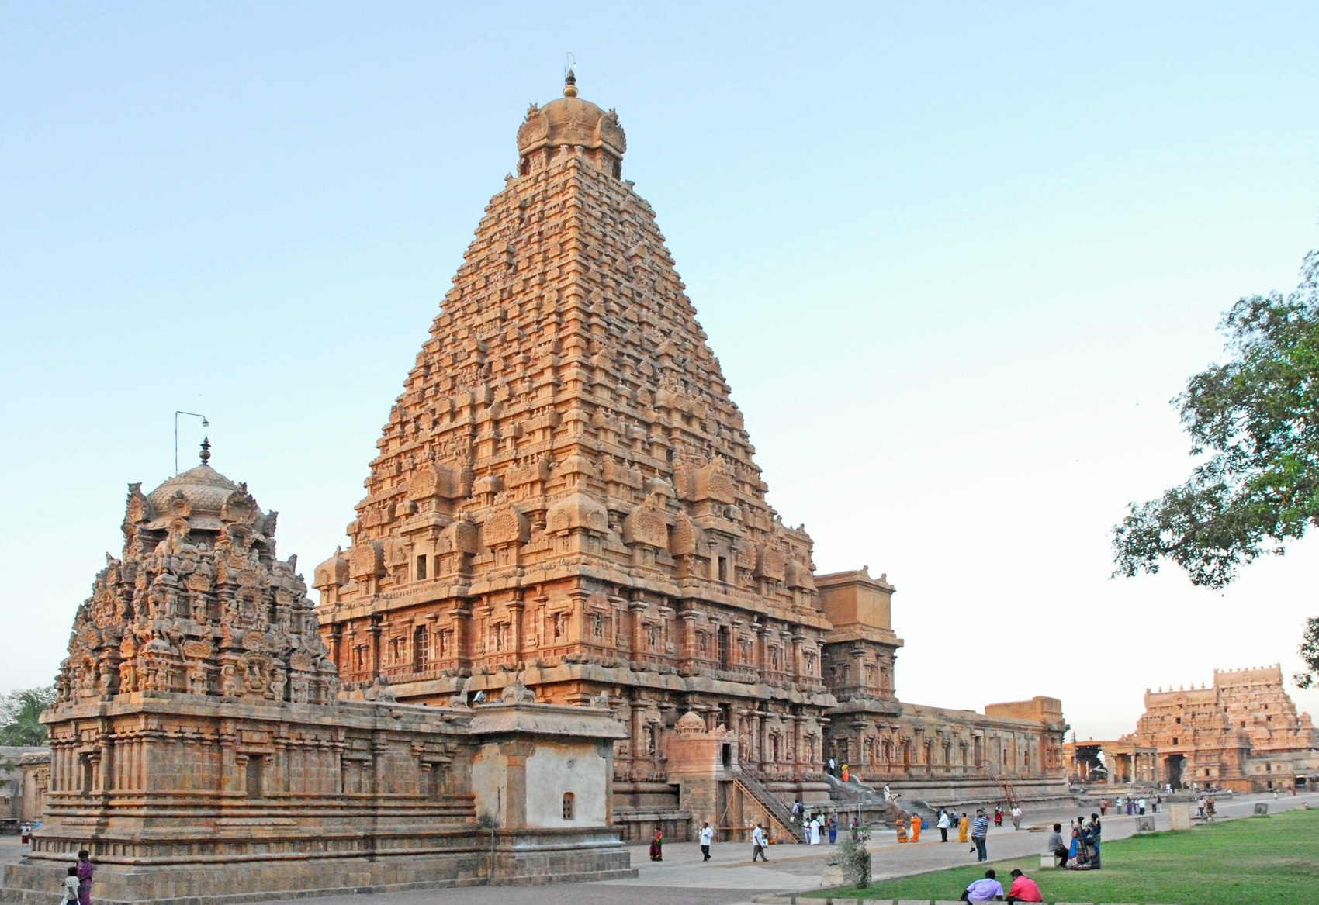

Slide 21
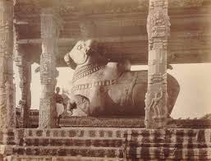

Slide 22
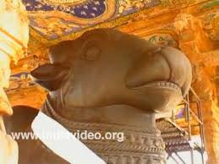

Slide 23
GANGAIKONDA CHOLAPURAM
CAPITAL OF CHOLAS IN 11TH C(RAJENRA CHOLA)
EASTERN ENTRANCE CALLED MAHADUVAR
VIMANA IS RELATIVELY LOW BUILDING
WELL CALLED SIMHAKENI OR LION WELL
NANDI

Slide 24
VIJAYA NAGAR – HUMBI RUINS

Slide 25
VIRUPAKSHA TEMPLE COMPLEX
GOPURAMS
MONOLITHIC STATUE –NANDI
VITTALA TEMPLE
-RATHA SITUATED INFRONT OF IT
- MUSICAL PILLARS
- HAZARA RAMA TEMPLE
QUEENS BATH OR PUSHKARANI

Slide 26
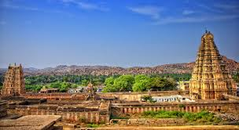

Slide 27
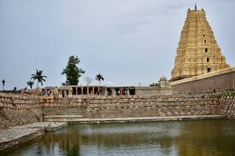

Slide 28
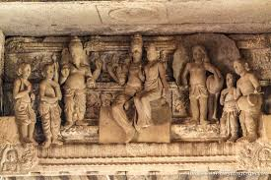

Slide 29
BHAHMANI OR GOLGUMBAS
JAMI MASJID 1367 AT GULBARGA
MADRASA – MAHMUD GAWAN
GOL GUMBAS – MUSOLIUM OF MUHAMMED ADIL SHAH
LOCATED IN BIJAPURE, COMPLETED IN 1656
- ARCHITECT – YAQUT OF DABUL
WORD MEANING – CERCULAR DOME
CUBE , DOME,SEVEN STOREYS,WHISPERING GALLERY,

Slide 30
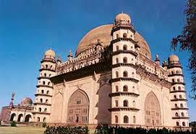

Slide 31
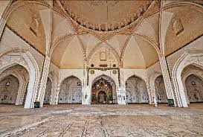

Slide 32
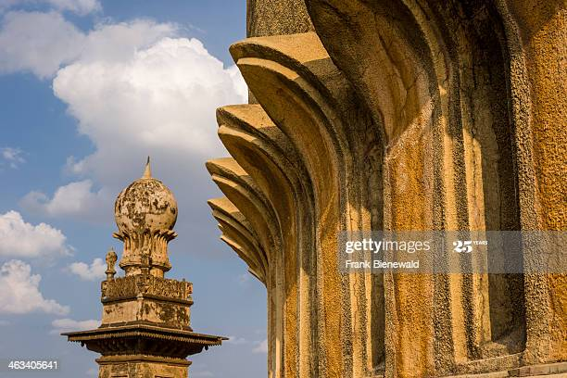

Slide 33
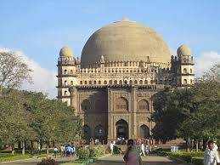

Slide 34
THE END

Slide 35
THANK YOU

