Slide 1
MAP STUDY
RAIHANATH. K.C
Asst. Professor of History
Class: III BA
History of Arabs 570-1258AD
17UHIC31/17UHVC31

Slide 2
WORLD MAP

Slide 3
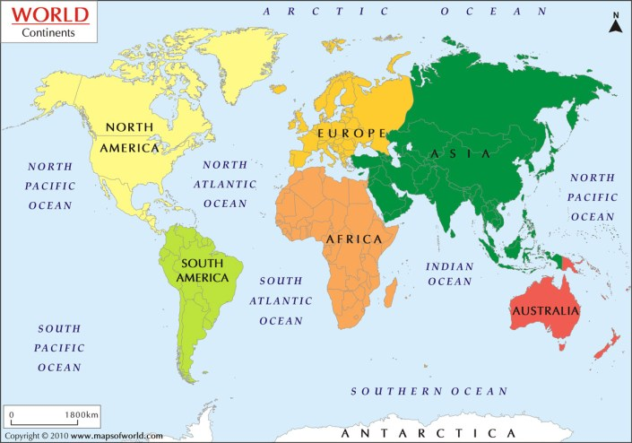

Slide 4
IMPORTANT CENTRES OF MEDIEVAL ARAB WORLD
Caliphate CE 632-661 Madeena
Umayyad Caliphate CE 661-750 Damascus
Abbasid Caliphate CE 750-1258 Baghdad
Caliphate CE 632-661 Madeena
Umayyad Caliphate CE 661-750 Damascus
Abbasid Caliphate CE 750-1258 Baghdad

Slide 5
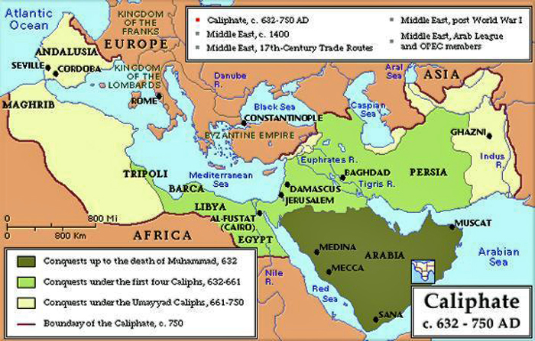

Slide 6
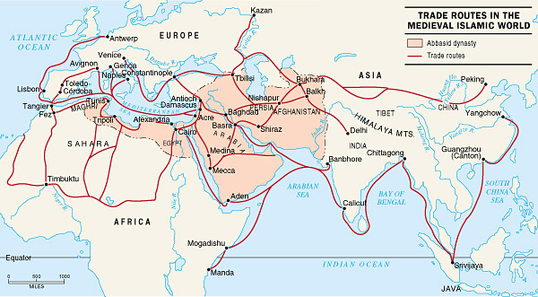

Slide 7
BYZANTINE EMPIRE
It is also known as Eastern Roman Empire.
The term came from Byzantium
Emperor Constantine change its name to Constantinople
Justinian , greatest Byzantine ruler

Slide 9
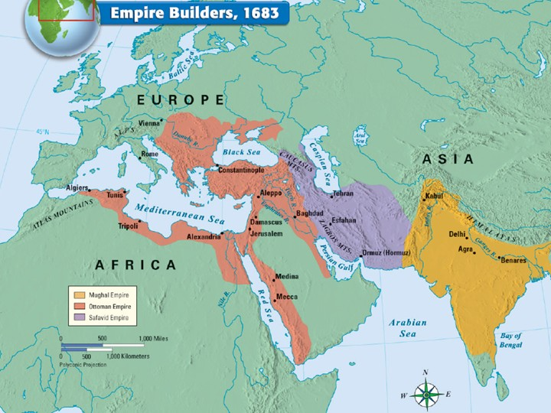
OTTOMAN EMPIRE
SAFFAVID EMPIRE

Slide 11
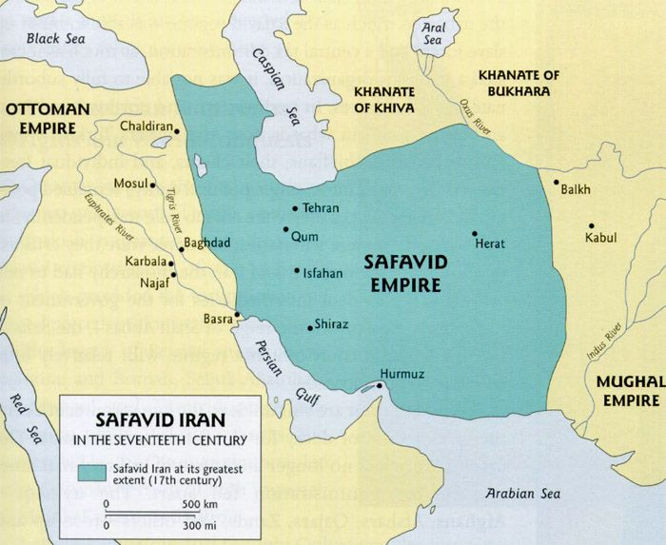

Slide 12
SAFFAVIDS OF PERSIA(IRAN)
SAFFAVIDS ruled from 1502-1722
Their origin from Shiate sect
Shah Ismail= founder
Shah Abbas is greatest ruler
He transformed tribal confederation into modern imperial government

Slide 13
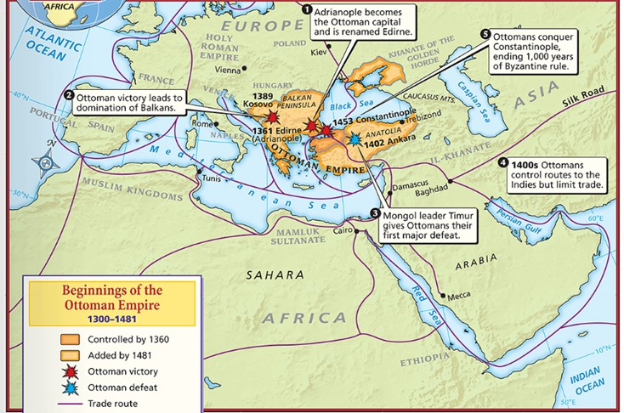
OTTOMAN EMPIRE

Slide 14
OTTOMAN EMPIRE
Ottoman turks ruled between 1299 to 1922
It is also known as Turkish empire
Sulaiman the Magnificent was the tenth and longest sultan of the Ottoman Turkish empire .
Art,architecture and poetry flourished under Sulaiman as the Ottoman Empire experienced a cultural renaissonce.

Slide 15
THANK YOU

