Slide 1
M. JAMAL MOHIDEEN
DEPARTMENT OF HISTORY

Slide 2
PROGRAMME
B.A HISTORY
COURSE TITLE – FUNDAMENTALS OF TOURISM
COURSE CODE – 17UHVA11

Slide 3
ACCOMMODATION
Two Major categories:
International Hotels.
Supplementary Hotels.

Slide 4
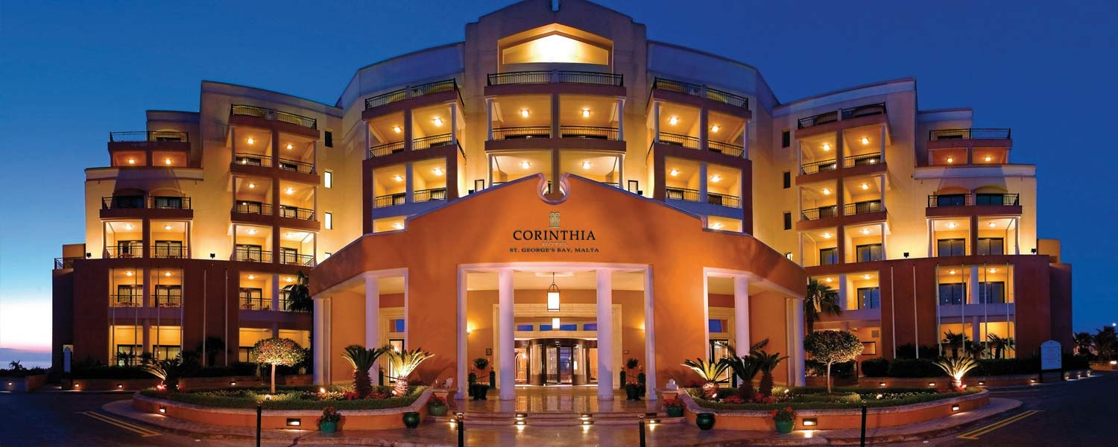
INTERNATIONAL HOTELS

Slide 5
TYPES OF INTERNATIONAL HOTELS
International Hotels
Commercial Hotels
Resort Hotels
Residential Hotels
Floating Hotels

Slide 6
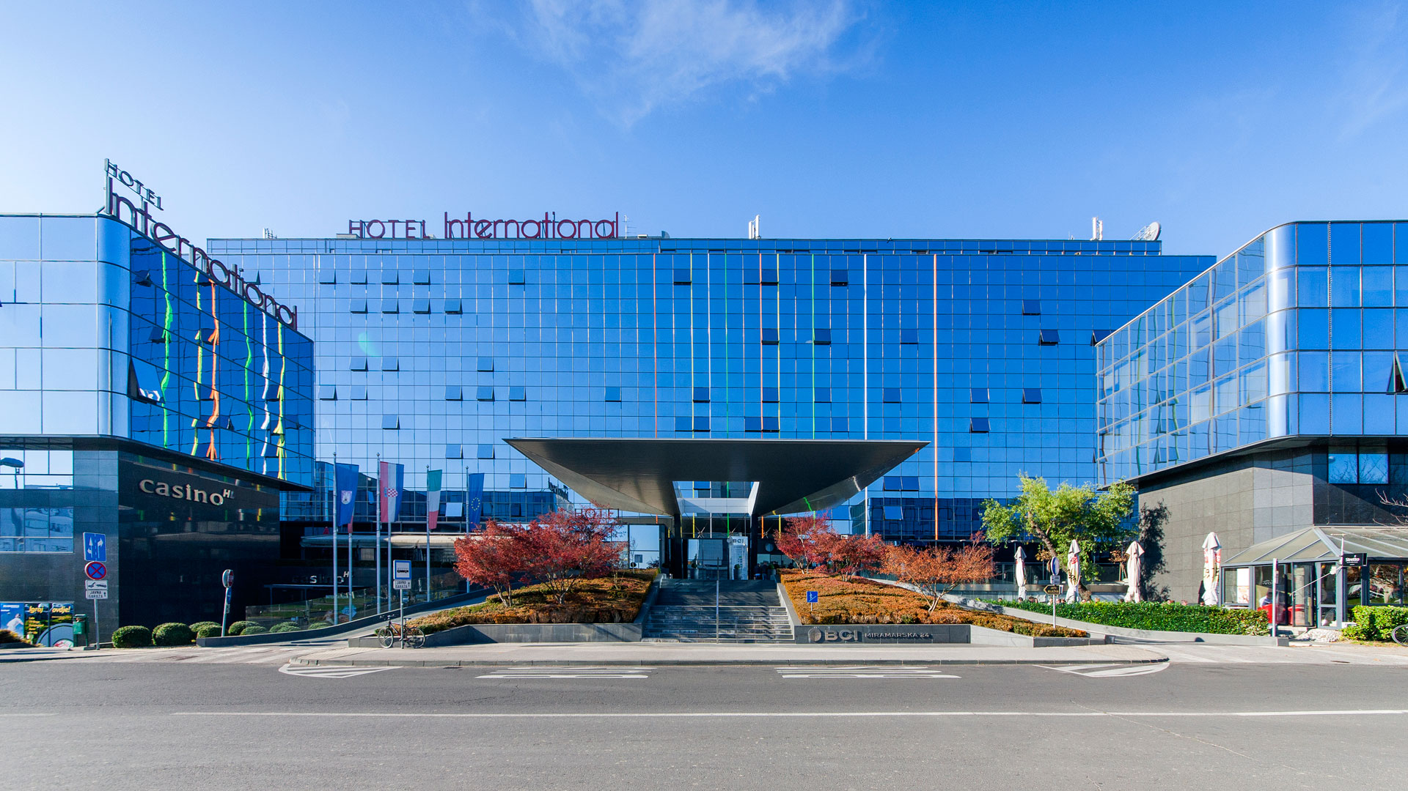
International Hotels

Slide 7
International Hotels
Modern Western Style
Located Metropolitan & Tourist Centers
Luxury and Comfortable

Slide 8
Facilities:
24 Hours Services
Front Elevation
Reception & Information Counter
Bar and Banqueting
Conference Hall
Restaurant
Travel Agency
Swimming Pool
Entertainment
Indoor & Outdoor Games
Small Park
Money Exchange Counter

Slide 9
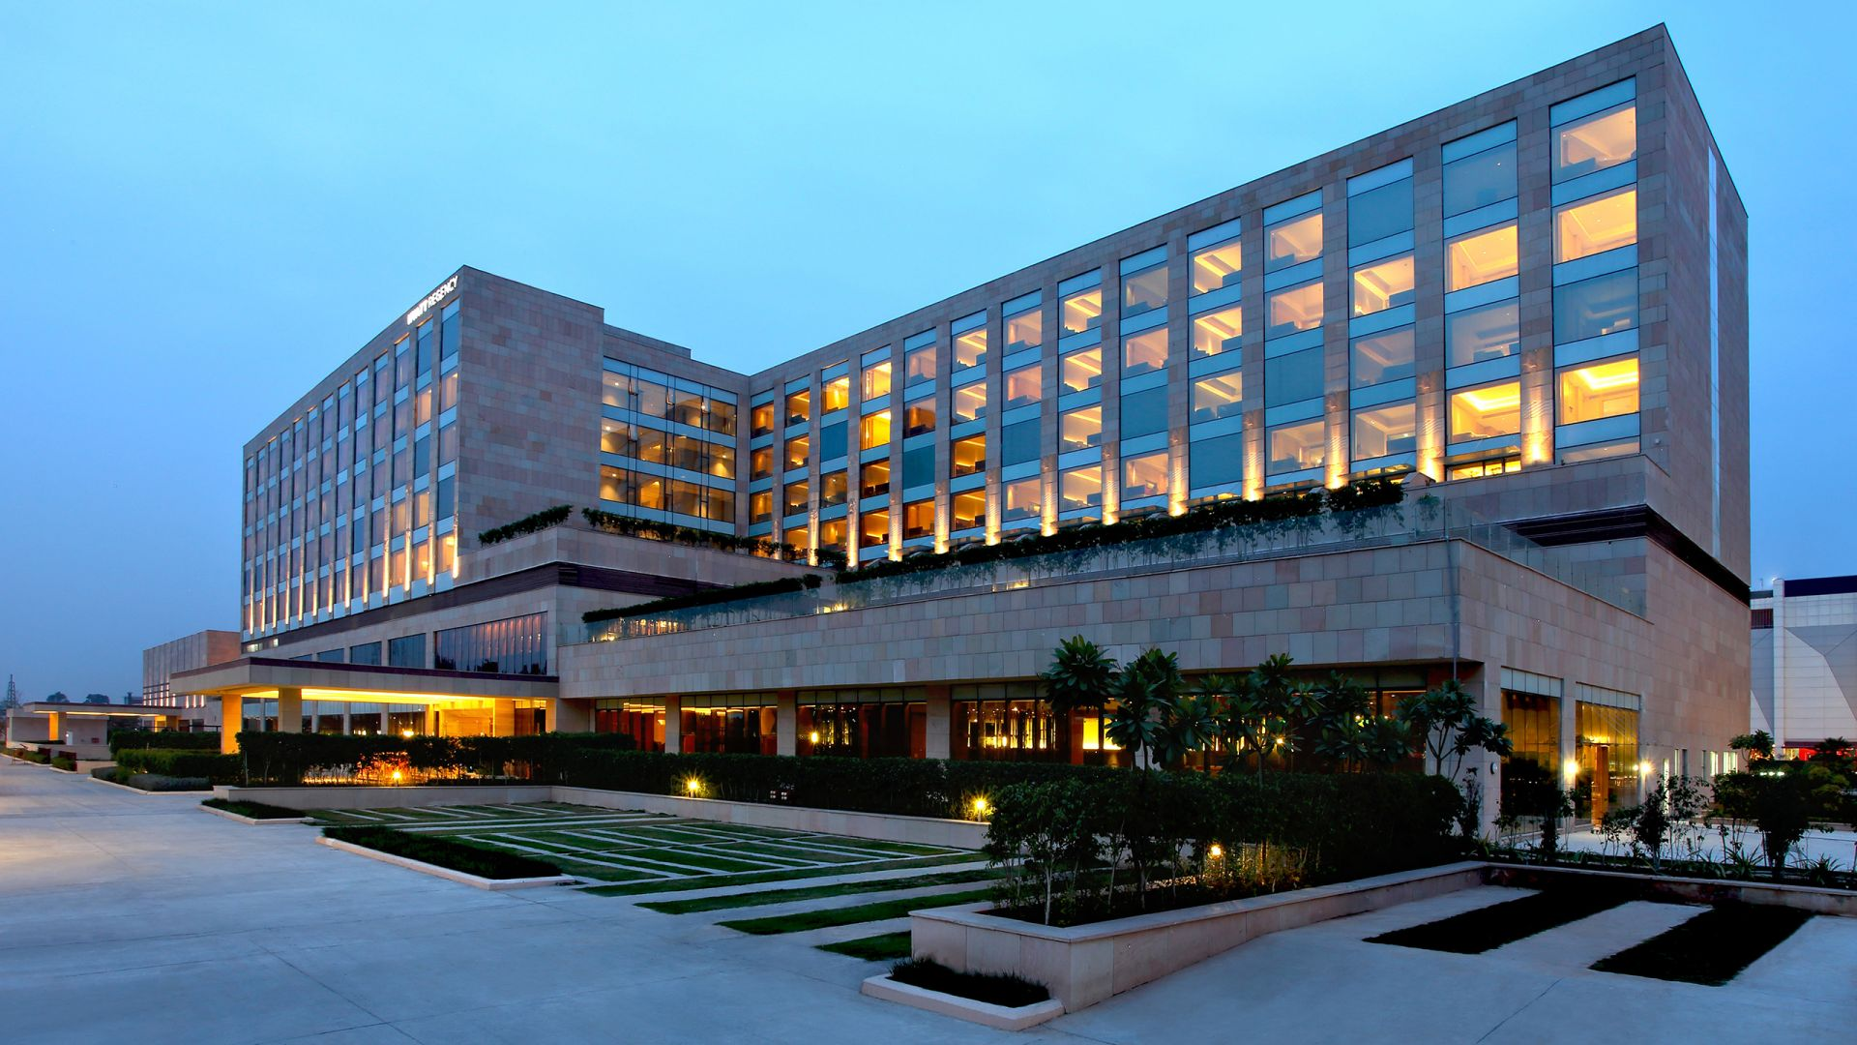
Commercial Hotels

Slide 10
Commercial Hotels
Business Purposes
Located Important Commercial and Industrial Centers

Slide 11
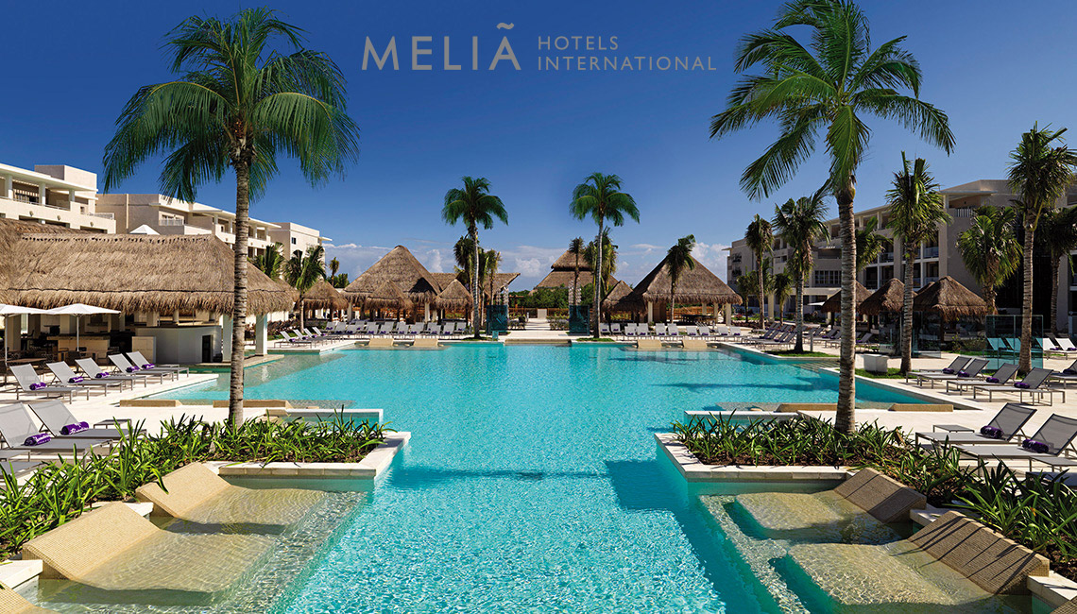
Resort Hotels

Slide 12
Resort Hotels
Located near the Sea, Mountain and Other Natural Beauty
Swimming Poll, Golf Course, Tennis Court, Skiing, Boating, Surf Riding
Types of Resorts:
1. Summer Resorts
2. Winter Resorts
3. Hill Resorts
4. Health Resorts
5. All reason Resorts.

Slide 13
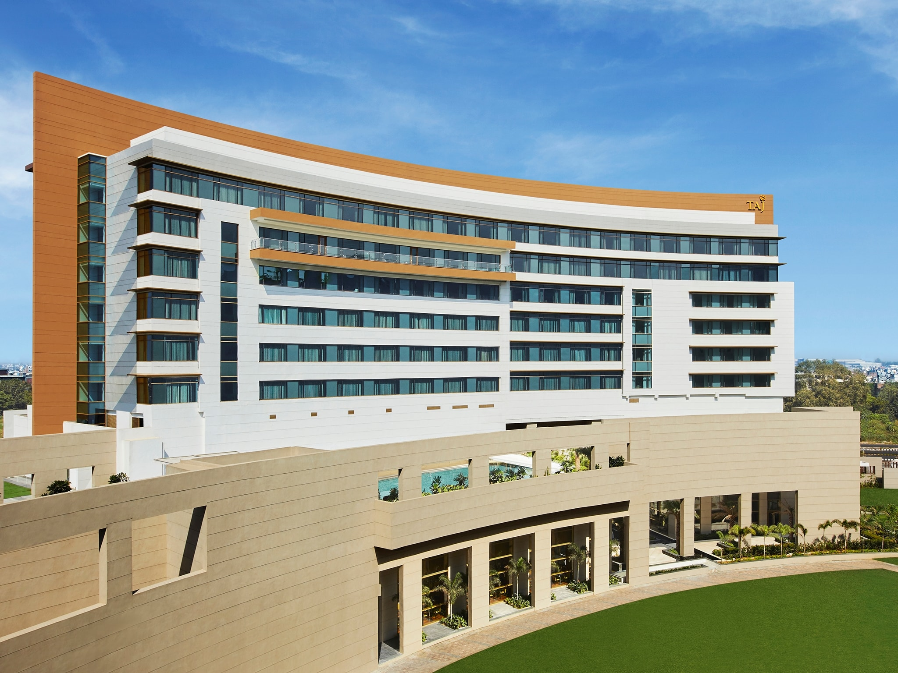
Residential Hotels

Slide 14
Residential Hotels
Apartment House with Hotel Services
Located big cities with European Plan
Charged Monthly, Half Yearly and Yearly
No Meals provided
Amenities provided

Slide 15
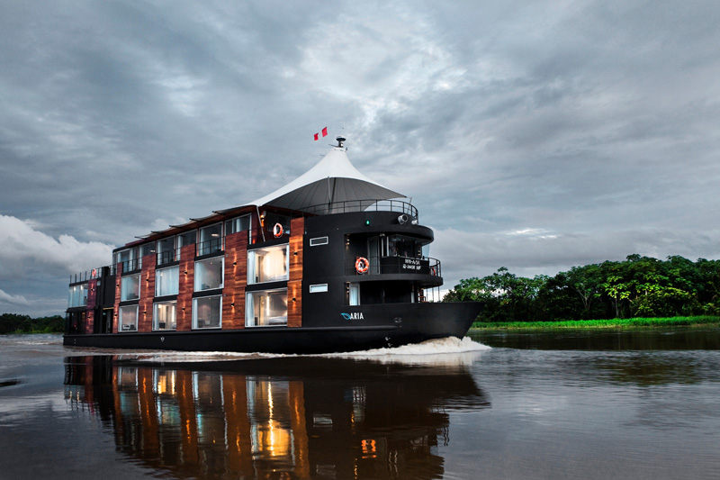
Floating Hotels

Slide 16
Floating Hotels
Located on the Surface of the Water
It may on Sea water, River water and on a Lake
Luxury ships converted in to floating hotels
Boat House famous for Kerala.

Slide 17
THANK YOU

