Slide 1
I-BA HISTORY
Course: HISTORY OF INDIA up to 1206 ad
Course Code: 20UHIC11L20UHVC11
Topic:- Sources for the study of Ancient Indian History
T. Anas Babu
Asst. Professor of History
HKRH College
Uthamapalayam
Tamil Nadu

Slide 2
I-BA HISTORY
Course: HISTORY OF INDIA up to 1206 ad
Course Code: 20UHIC11L20UHVC11
Topic:- Indus Valley Civilization
T. Anas Babu
Asst. Professor of History
HKRH College
Uthamapalayam
Tamil Nadu

Slide 3
INDUS VALLEY CIVILIZATION/ HARAPPAN CIVILIZATION
(3300-1300 B.C)
Indus Valley Civilization was an oldest civilization in the world along with Egyptian civilization and Mesopotamian civilization
Indus valley civilization was a ‘Bronze Age’ and Urban Civilization
It was developed on the bank of river Indus in the modern Northwest India and Northeast Afghanistan and Pakistan.
Indus Valley Civilization was also known as the ‘Harappan Civilization’, after excavating its first site at Harappa located in Punjab province of Pakistan

Slide 4
The other important Indus Valley sites are:
- Mohenjo-Daro of Sind
- Lothal of Gujarat
- Chanhu-daro of Sind
- Kalibangan of Rajastan
- Ropar of Punjab
- Rangpur of Gujarat
- Rakhigarhi – Hariyana
- Dholovira- Gujarat
- Rakhigarhi is the biggest site of Indus Valley Civilization

Slide 5
Si. No | Site | Important Findings
1 | Harappa | First excavated Indus Valley site (1921) Excavated under Daya Ram Shahi Evidences on pottery, copper and bronze implements, chert blades, seals etc
2 | Mohan-jodaro | Known as ‘Mound of the Dead’ Excavated under R.D. Banerjee (1922) Shed important light on Indus Valley town planning and one of the largest urban centre of IVC Evidences on Great Bath, Great Granary, houses, drainage system, seals etc.
3 | Kalibangan | Oldest ploughed field Known for Fire-Altars, tiled floor etc
4 | Lothal | Found a artificial dockyard, seal
5 | Chanhu-Daro | Evidence of factories various figurine, toys, bone implements etc

Slide 6
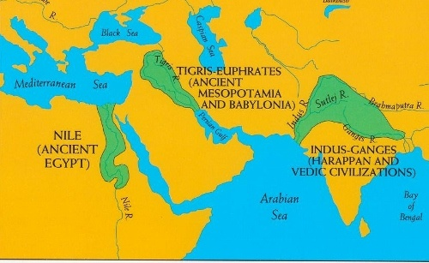
Map of Indus Valley Civilization

Slide 7
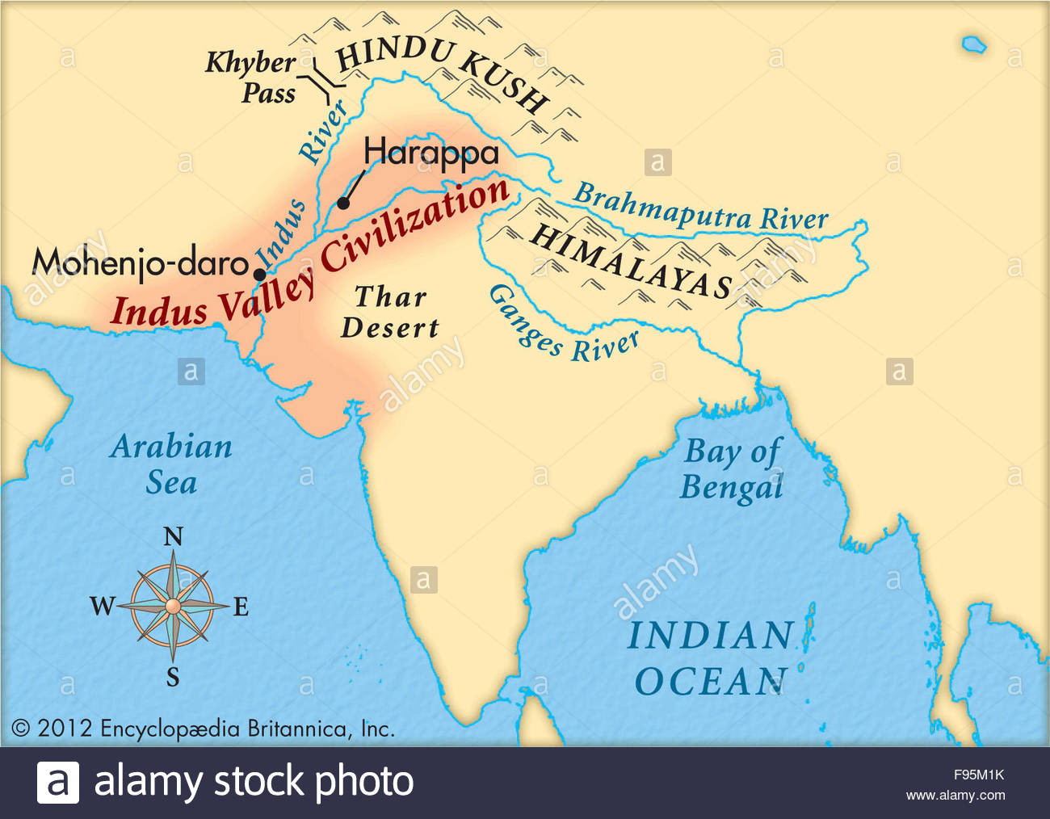
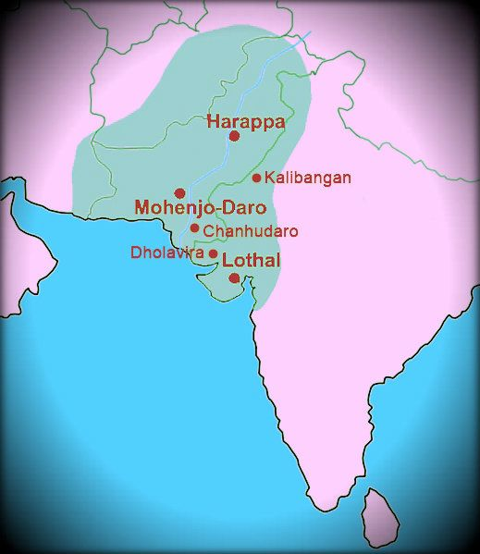

Slide 8
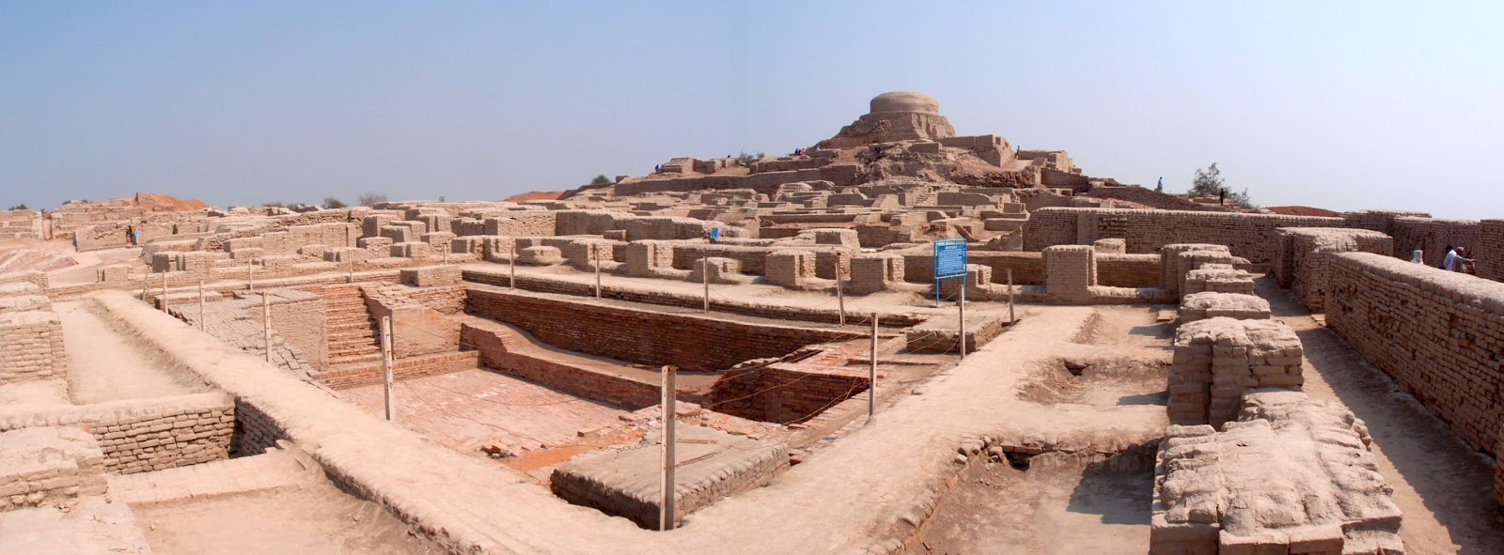
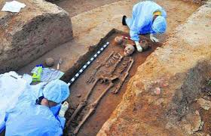
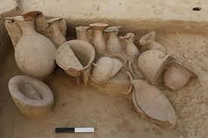
Site Excavations of IVC

Slide 9
Salient Features of Indus Valley Civilization
Indus Valley Civilization was an urban civilization
Town Planning
The Harappan cities had their own Town planning The towns were divided into two
1. Upper Town also called Citadel (rulers area)
2. Lower Town (common people’s area)
The features of towns are;
A. Granaries
B. Great Bath
C. Drainage System
D. Houses
E. Streets and
F. Town Hall
Houses were built with burnt bricks

Slide 10
2. Social Condition
They eat foods like wheat, barely, milk, mutton, pork, fish etc.
They wore gold, silver, copper and ivory ornaments
3. Economic Condition
Agriculture was the major occupation of the people
Their main crops were wheat, barley, cotton, etc
They domesticated animals like sheep, goat, cow, buffalo, camel etc
The other occupation of the people was pottery making, weaving, carpentry etc
They used metrals like copper, bronze and silver
- The usage of Iron was unknown to them

Slide 11
4. Trade and Commerce
They carried trade both sea and land
They had trade contacts with the Mesopotamian civilization and Afghanistan
For sea-trade, big boats were used
For land trade, bullock-carts were mainly used
Seals were used for exchange
5. Religious Condition
They worshipped many gods including mother-goddess
But they were not used temples
They worshipped natural forces like trees, stones, animals etc.

Slide 12
Decline of Indus Valley Civilization
But IVC declined around 1300 BC.
The reasons for the decline IVC are:
1. Aryan Invasion
2. Climate Change
changed the cause of river Indus
Flood of river Indus
Heavy monsoon
By 1700 BC most of the Indus cities died

Slide 13
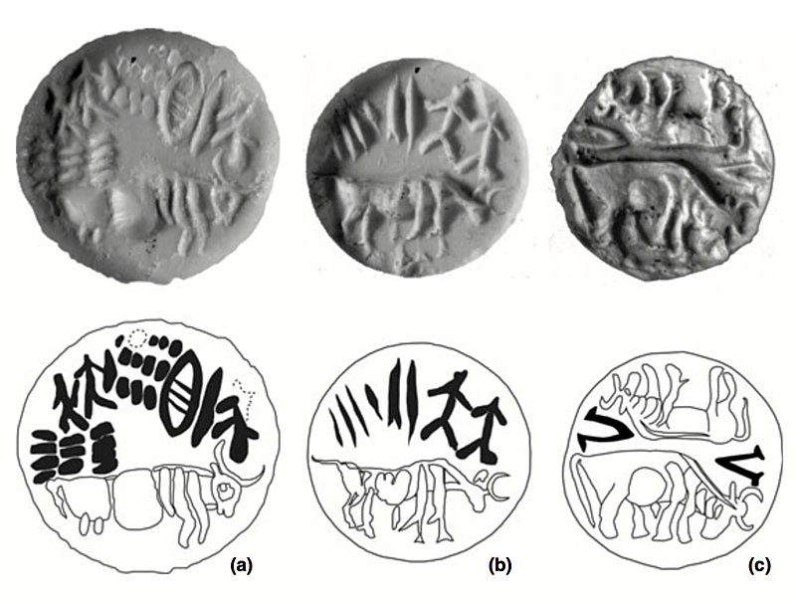
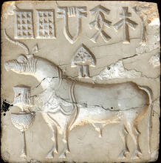
Seals of IVC

Slide 14
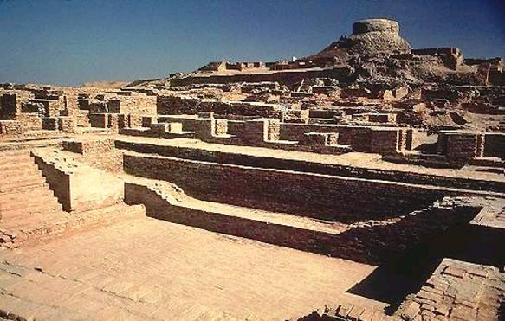
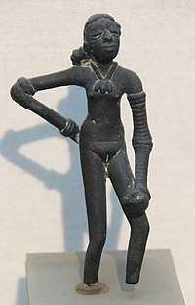
Dancing Girl sculpture at Mohenjo-Daro Great Bath

