Slide 1
II-BA HISTORY Course: HISTORY OF EUROPE FROM 476 TO 1453 A.D. COURSE CODE:17UHIC32/17UHVC32 Topic: Rise and Spread of Islam T.ANAS BABU Assistant Professor of History Hajee Karutha Rowther Howdia College Uthamapalayam Tamil Nadu

Slide 2
Rise and Spread of Islam
Origin of Islam
Introduction
Islam is one of the major religions in the world
This religion was born in Arabia, especially in modern Saudi Arabia
Islam was founded by Prophet Muhammed (PBUH) in 7th century AD.
It is a monotheistic religion.
The followers of Islam is called Muslims
Today, Islam spread all over the world.

Slide 3
Arabia Before Islam
Before Islam Arabia was dominated many tribes.
There was no unity among them
Mecca was their marketplace and pilgrimage centre.
Kaa’ba in Mecca was their chief pilgrimage centre which had hundreds of idols.

Slide 4
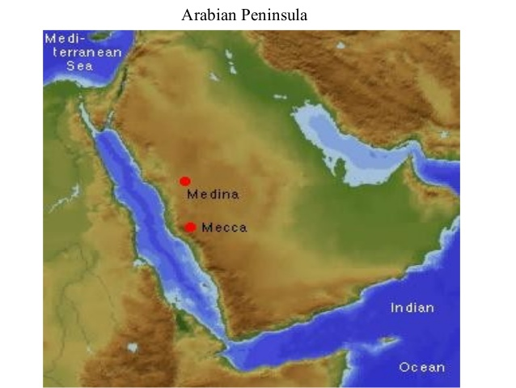

Slide 5
Prophet Muhammed (PBUH)
Muhammed was born in 570 A.D. at Mecca in Quraysh tribe
His father was Abdullah and mother was Amina
His father was died before his birth and mother also passed away at his age of 6.
Then Muhammed was brought up by his uncle Abu Talib.
Muhammed had no formal education.
He was a merchant and at the age of 25 he became the commercial agent of wealthy widow Khadijah

Slide 6
Khadijah was impressed her with his honesty.
Later, Muhammed married Khadijah who was elder to him.
Muhammed was dissatisfied with the idol worship of the Arabs and started raising question against it.
At the age of 40, he attained prophet hood through angel Gabriel.
Gabriel delivered the words of God Allah to Prophet Muhammed
Muhammed began to share these words of Allah to people.

Slide 7
Hijrah (622 AD)
The leaders of Mecca feared the growing power of Muhammed.
They aimed to kill Muhammed
Therefore, Muhammed and his followers secretly migrated from Mecca to Medina in 622 AD.
This flight of Prophet from Mecca to Medina (the city of Prophet) called as Hijrah (migration).
The people of Medina was well received them.
The Quraysh of Mecca continued to trace Muhammed which led to the battle between Mecca and Medina.
Muhammed fought three wars.

Slide 8
1. Battle of Badr (624)
2. Battle of Uhud (625) and
3. Battle of the Trench (627)
Prophet Muhammed achieved his final victory with the occupation of Mecca in 630 AD.
The Meccans accepted him as their political and religious leader.
He died in 632 A.D at Mecca while pilgrimage.

Slide 9
Teachings of Prophet Muhammed (PBUH)/Islam
The teaching of Islam available to us in Quran and Hadith.
Quran is the religious book of Islam which contains the messages of Allah to people through Prophet Muhammed.
Hadith is the sayings of Prophet to his disciples
The most important teaching of Prophet was ‘belief in one God’.
He was against idol worship and polytheism.
He declared that Islam is based on five pillars. They are:

Slide 10
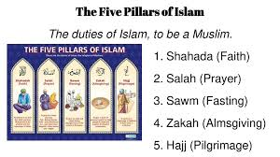

Slide 11
Faith: Every Muslim must believe that
‘Thereis no God but Allah and Muhammed is his Prophet
2. Prayer: Every Muslim must pray five times in a day by facing Kaa’ba.
3. Fasting: Fast in the month of Ramadan.
4. Charity: Give charity to poor.
5. Pilgrimage: Undertake pilgrimage to Mecca at least once in life time.
- Islam prohibits drinking wine and eating dog and pork

Slide 12
Spread of Islam/Attacks on Europe
Over centuries, Islam spread through military conquests, trade, pilgrimage and missionaries.
After the death of Prophet Muhammed in 632 AD, Islam was led by four Khalifas.
They were elected by the people and called as orthodox Khalifa’s
1. The first Khalifa was Abu Bakr (632-634), the close friend of Muhammed
2. The second Khalifa was Umar (634-44)
3. Third Khalifa was Usman (644-656)
4. Fourth Khalifa was Ali (656-661)

Slide 13
During the time of Umar, Islam was spread to Syria which was an important province of the Byzantine Empire.
He also conquered Egypt and Persia
After the murder of Ali, the rule of orthodox Khalifs came to an end.
Umayyad Empire
After four orthodox Khalifs, Islam was led Umayyad dynasty.
They were ruled between 661 to 750 AD
Under Umayyads, Islam spread to Spain and India.
In 716, Umayyads laid siege on Constantinople.
It led to long rivalry between Arabs and Byzantine Empire.

Slide 14
The Arab attack of France was defeated by Charles Martel.
An Islamic Empire was established by Umayyads which was spread to three continents of Asia, Africa and Europe
Abbasid Empire
After Umayyads, Abbasid dynasty became the rulers of Islamic Empire
They ruled between 750-1258 AD.
They also extended territory of Islamic Empire
Under them Islamic art and culture flourished.

Slide 15
Ottoman Empire
After Abbasid Empire, Ottoman Turks became the leaders of Islamic Empire.
They ruled from 1281 to the end of first world war.
They conquered and put to an end to the Byzantine Empire in 1453.
Later, Islam spread all over the world.

Slide 16
Thank You

