Slide 1
II-BA HISTORY cOURSE: HISTORY OF EUROPE FROM 476 TO 1453 A.D. COURSE CODE:17UHIC32/17UHVC32 Topic: The Byzantine Empire and Justinian the Great T.ANAS BABU Assistant Professor of History Hajee Karutha Rowther Howdia College Uthamapalayam Tamil Nadu

Slide 2
The Byzantine Empire
Formation
In 284 AD, Diocletian became the Roman Emperor.
He split Roman Empire as West and East for administrative purpose.
In 330 AD, Constantine became the emperor.
He made Constantinople, earlier known as Byzantium as the capital of Eastern Rome.
In 335 AD, the Roman Empire divided into two Empire: Eastern Roman Empire and Western Roman Empire

Slide 3
Rome was the capital city of Western Roman Empire and Constantinople (present day Istanbul in Turkey) was the capital city of the Eastern Roman Empire
In 476, the Western Roman Empire collapsed with the conquest of German barbarians.
But the Eastern Roman Empire continued again 1000 years till 1453 AD.
This Eastern Roman Empire came to known as Byzantine Empire, originated the name from Byzantium, the old name of Constantinople.
They carried Greco-Roman traditions

Slide 4
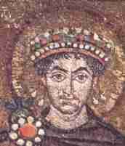
Justinian (527-565 AD)
Introduction
Justinian was the greatest
ruler of Byzantine Empire.
He became the Emperor of
Byzantine Empire in 527 AD.
Byzantine Empire reached its
climax under Justinian
- Justinian’s goal was to revive the ancient glory of Rome by recovering the parts of Western Roman Empire

Slide 5
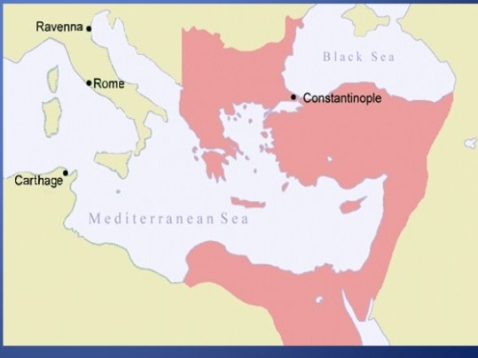
Byzantine Empire

Slide 6
Justinian as a King
Justinian was a great leader
He controlled military, law and justice
His rules and orders were final which was never questioned
Justinian conquered vast territories of Western Roman Empire by defeating Vandals from North-Africa and Ostrogoths from Italy
By his lavish conquest, he reunited Roman Empire
His army was led by Belisarius in this attacks
Justinian was helped by his wife Theodora in administration.

Slide 7
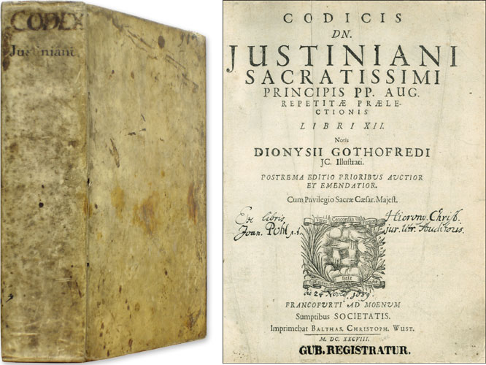
Justinian Code of Law
Corpus Juris Civils
Justinian was a great
administrator.
One of the greatest
administrative achieve
ment of Justinian was
his Code of Law.
He was a greatest
Legislature of the world.
He codified Roman Law.
This new codified law was called Corpus Juris Civils

Slide 8
Law before Justinian
Before him, the Roman Law was in full of confusion
Different laws existed in different parts of the empire.
Codification of Law
To establish a single system of law in his empire, Justinian appointed a 10 members committee
This committee was headed by Tribonian
They prepared Justinian’s Code between 529 to 534 AD.
It was prepared in Latin language

Slide 9
Justinian Code of Law has four parts
Code Digest Institute Novelle
Code was a collection of imperial laws arranged in a order
Digest contains the opinions of famous Roman jurists on Roman Law
Institute is a text book on Roman Law for students

Slide 10
4. Novelle consists imperial ordinance issued after the code
This four parts of Justinian’s Code together called as ‘Corpus Juris Civils’ (Body of Civil Law)
With this Code Justinian established his better control over his people.
The declared that Christianity as the religion of the Empire.
Strict punishment was given to those violate his laws

Slide 11
Art and Architecture
Justinian immensely contributed to Byzantine art and architecture
His period is considered as the golden period of Byzantine art and architecture
He built his own style of buildings
The most famous among them was Hagia Sophia church of Constantinople.
The Hagia Sophia was the church of holy wisdom.
The first pandemic in history was reported during the reign of Justinian
The Bubonic Plague of 543 killed 2 Lakh people of his empire
Justinian was died in 565 AD

Slide 12
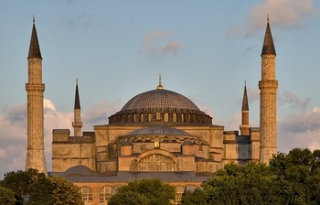
Hagia Sophia at Constantinople

