Slide 1
I-BA HISTORY
Course: HISTORY OF INDIA up to 1206 ad
Course Code: 20UHIC11L20UHVC11
Topic:- Sources for the study of Ancient Indian History
T. Anas Babu
Asst. Professor of History
HKRH College
Uthamapalayam
Tamil Nadu

Slide 2
Contents
Introduction
Sources to Study Ancient Indian History
Various Literary Sources
Conclusion

Slide 3
Introduction
The word history is derived from ‘Historia’ or ‘Istoria’ which means Knowledge/ Enquiry/
Wisdom, etc.
History is an enquiry in to human past based on facts
This facts/evidences are available to us in the form of sources

Slide 4
Sources for the study of Ancient Indian History
Literary Sources
Archaeological Sources
Foreign Accounts
1. Brahmanical
Inscriptions
Coins
Material Artifacts
Art and Architecture
Greek Accounts
2. Chinese Accounts
3. Arab Accounts
2. Buddhist
3. Jaina
4. Classical Accounts

Slide 5
I. LITERARY SOURCES
The literary sources are religious and secular
in nature.
Importance- It provides social, economic, cultural, religious condition of the past. Important to understand the ‘historical evolution of the past’

Slide 6
-Written in Sanskrit language 1. Vedas a. Rig Veda- the earliest Veda. - collection of ‘1027 Sanskrit hymns’ b. Yajur Veda- Rituals that fulfilling the recitation of hymns c. Sama Veda – Book of prayers and chants - Musical collection d. Atharva Veda- Folk tradition of Vedas 2. Upanishads- Philosophical and ethical discourses. - 108 in number
1. Brahminical Literature

Slide 7
3. Epics: a. Ramayana- written by Valmiki
- has 24000 versus b. Mahabharata- written by Veda Vyasa.
- Older than Ramayana
- has 100,00 versus
- both provides changes of culture and beliefs.
4. Puranas: 18 in number
-Vayu purana, Matsya purana, Brahma
purana etc.
5. Brahmanas: the prose commentaries of Vedas
- Every Veda has its own vedas
6. Aranyakas: studies done in forest
7. Sutras: Text using for the understanding of
Vedas

Slide 8
-Written in Pali langauge. They are: 1. Jataka: ‘early life of Lord Buddha’ 2. Pitaka: ‘Sayings of Lord Buddha’ - Three in number called ‘Tripitakas’ - ‘sutta’, ‘Vinaya’ and ‘Abhidhamma’ 3. Nikaya: Commonly using in reference to Pitakas
2. Buddhist Literature

Slide 9
Written in Prakrit language
1. Angas
2. Upangas Life and Teachings of Lord Jaina.
3. Jaina Literature

Slide 10
Secular (non-religious) texts - Some important texts are: 1. Kautilya- ‘Arthashastra’ -one of the greatest work of ancient India -Kautilya also known as Chanakya - He was the Minister Maurya ruler Chandragupta Maurya 2. Kalidasa- The great Sanskrit poet and dramatist lived in the court of Gupta emperor Chandra Gupta-II - He was called as Indian Shakespeare -He wrote Raghuvamsa, Meghaduta, Abhijnanasakunatalam, Kumara Sambava , Vikrama-urvasiya etc.
4. Classical Accounts

Slide 11
3.Ashtadhyayi written by Panini 4. ‘Mudra Rakshasa’ of Visakadatta 5. ‘Harsha Charita’ of Bana. 6. ‘Rajatarangini’ of Kalhana etc
-

Slide 12
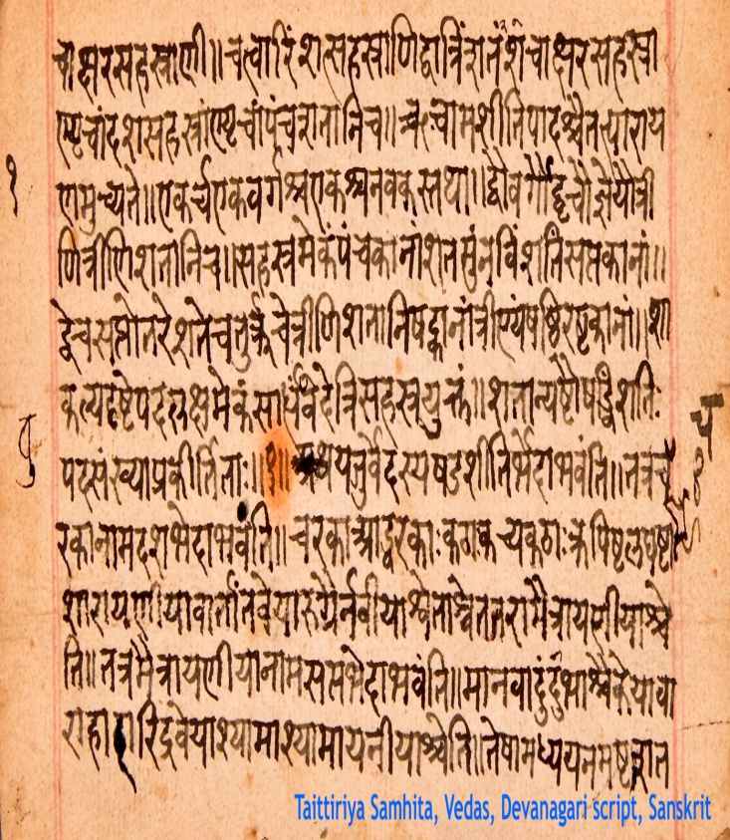
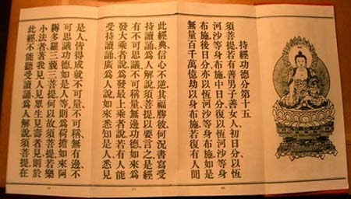
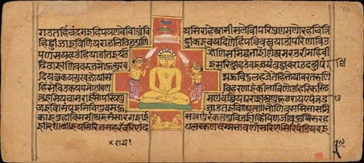
Hindu Text Buddhist Text Jain Text

Slide 13
II. ARCHAOLOGICAL SOURCES
Archaeological sources divided into 3
1. Inscriptions
2. Coins
3. Art and architecture
Inscriptions
The study of inscriptions called Epigraphy
The inscriptions provides genuine and valuable information of ancient history
It is engraved in rocks, stones, pillars, caves etc
The Ashokan edicts are the important source for Mauryan history

Slide 14
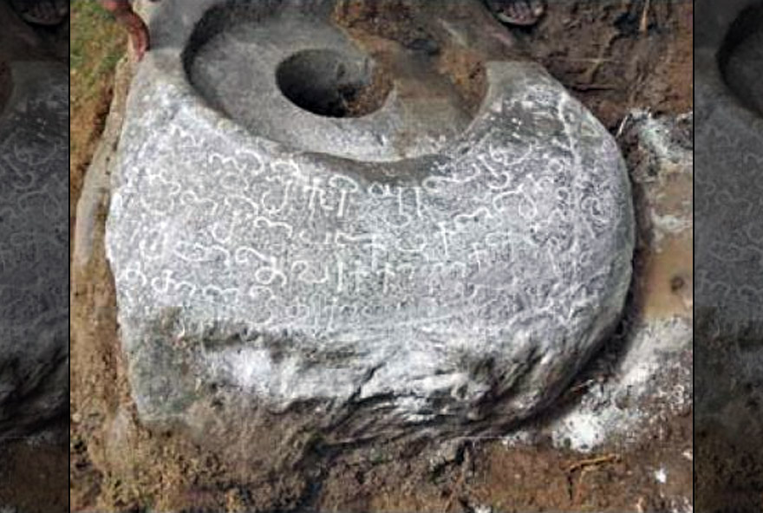
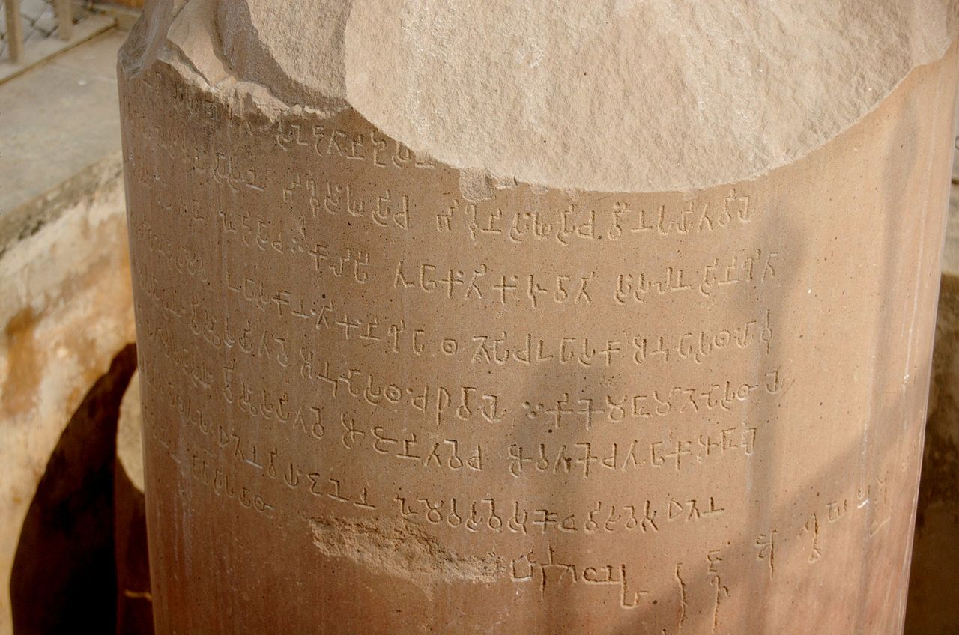
The Allahabad pillar inscription of Samudra Gupta, the Hathigumpha inscription of king Karvela are the important inscriptions.
Ashokan Inscription Tamil Inscription

Slide 15
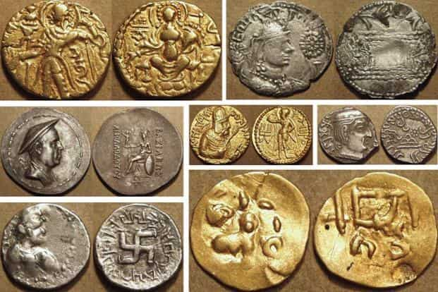
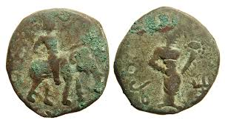
2. Coins
Study of coins called Numismatics
Coins provides knowledge on kings, queens, gods, goddess etc.
The earliest coins are in the form of Punch marked coins
Coins are available in the form of gold, silver, copper etc.
Ancient Indian Coins

Slide 16
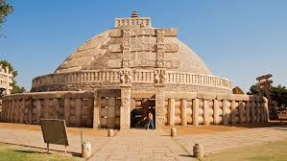
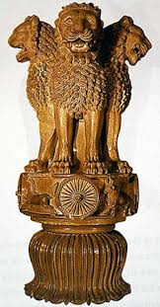
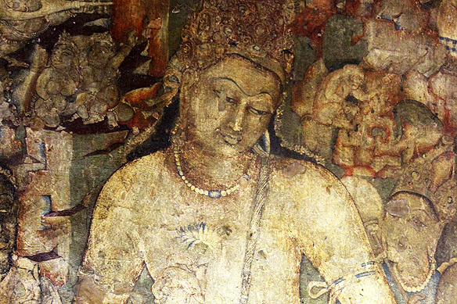
3. Art and Architecture
Architecture includes monuments like Stupas, temples, palaces etc.
Arts includes Sculpture and Paintings
The Gandhara art and Ajanta Ellora caves are examples of Sculpture and Paintings.
Stupa Lion Capital of Ashoka Ajanta Cave Painting

Slide 17
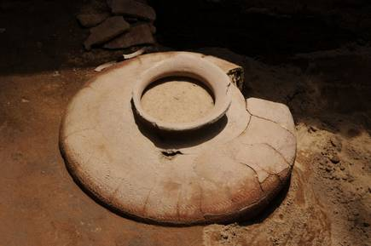
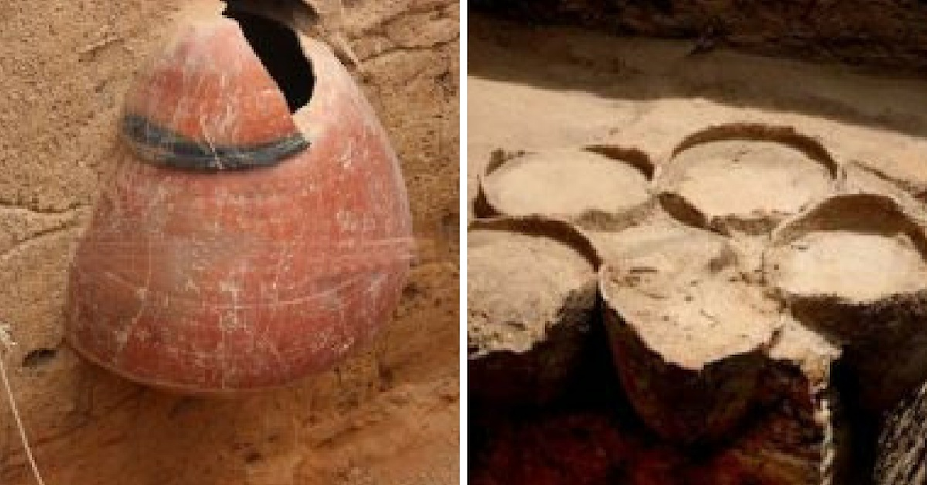
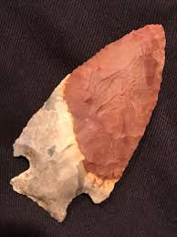
4. Material Artifacts
- Archaeological excavations
- Pottery, artifacts, ornaments etc.
Ancient Potteries Axe

Slide 18
III. FOREIGN ACCOUNTS
Foreign accounts are the accounts given by Greeks, Chinese and Arabs
1. Greek Accounts
Megasthenes wrote ‘Indica’ is an important source about Maurya’s
He was the Greek ambassador in the court of Chandragupta Maurya
Pliny’s ‘Natural History’
Ptolomy’s ‘Geography’
Periplus Eritrean Sea are some important Greek accounts

Slide 19
2. Chinese Accounts
- Fa-Hein visited India during the time of Chandra Gupta II
- Huien-Tsang called ‘the price of pilgrims’ visited during the time of Harsha Vardhana wrote ‘Si-yuki’
- Itsing travelled India between 671 to 695 A.D.
3. Arab Account
- ‘Tahkikul Hind’ of Albaruni- written in 9th century

Slide 20
Conclusion
Innumerable sources are available for studying ancient Indian history.
It throws valuable information on polity, economy, society and religion of ancient period

Slide 21
Thank You

