Slide 1
ADVENT OF EUROPEANS TO INDIA
Dr.S.Varghese Jeyaraj

Slide 2
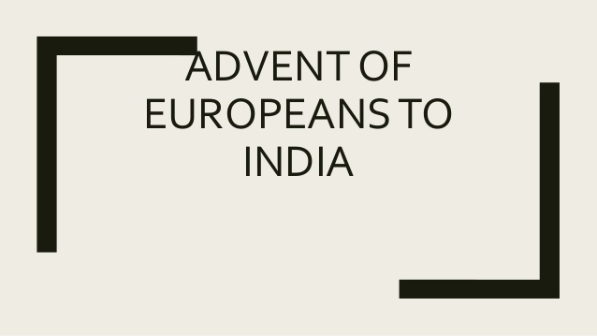

Slide 3
MAJOR EUROPEAN POWERS
Portuguese
Dutch
French
English

Slide 4
PORTUGUESE
The Portuguese found new sea route from Europe to India
Reached at at Kerala in 1948
Vasco –da-Gama
Henry, the Navigator

Slide 11
THANK YOU

