Slide 1
Graphical input & output Devices
BY
PEERMOHAMED.A MCA., SET
ASST.PROF OF INFORMATION TECHNOLOGY
HAJEE KARUTHA ROWTHER HOWDIA COLLEGE
UTHAMAPALAYAM.

Slide 2
Graphical input/output devices
Input & Output devices are the means of communication between a computer system and external world.
Graphical Input Devices
We can catagorize input devices into two with the operations they perform.
Locators
Selectors

Slide 3
Locators & Selectors
Locators
These devices provide position information to the computer.
Using locators we can indicate the positions of an object on the screen.
Eg: Mouse, Joystick, trackball, etc..

Slide 4
Selectors
These devices are used to select a particular object on the screen.
But it will not provide the information about where the item is located on screen.
Eg: Light Pen.
Considering the modes of access to the computer system.
Graphical input devices can be classified into two:
Sampled devices.
Event driven devices.

Slide 5
Sampled Devices
These devices can be sampled by computer at anytime.
The processor does not have to wait for the operations of these devices.
At anytime some locations on the screen is being identified by these devices.
All the locator devices fall in this category also.

Slide 6
Event Driven devices
The processor has to wait on the devices until some specific events happen.
Eg: keyboards, buttons, switches, light pen etc..

Slide 7
Common Input Devices
Mouse
Joystick
Trackball
Light pen
Tablet&Stylus.

Slide 8
Mouse
It is very small hand held device which is associated with all types of computer.
This is because all modern systems use graphical interfaces along with basic operating systems.
This device can rotate and move over a small placed below it.
The ball is connected to touch two wheels which are in turn connected to two potentiometers.

Slide 9
Contd..
Rotation of the ball over the surface cause the mouse pointer to move in a certain direction.
The direction of motion of the mouse pointer is determined by the changes in the potentiometer readings.
The individual potentiometer reading cause the pointer to move along with positive X-axis & Y-axis .

Slide 10
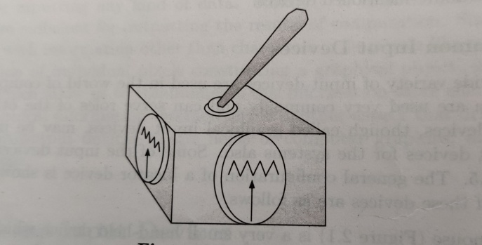
Joystick
The basic architecture of the joystick is exactly similar to that of mouse.
Here, instead of rolling a ball, a handle is used as lever to change the potentiometer settings.
It can be changed in all four directions. The device is used to play video games like driving simulators etc..

Slide 11
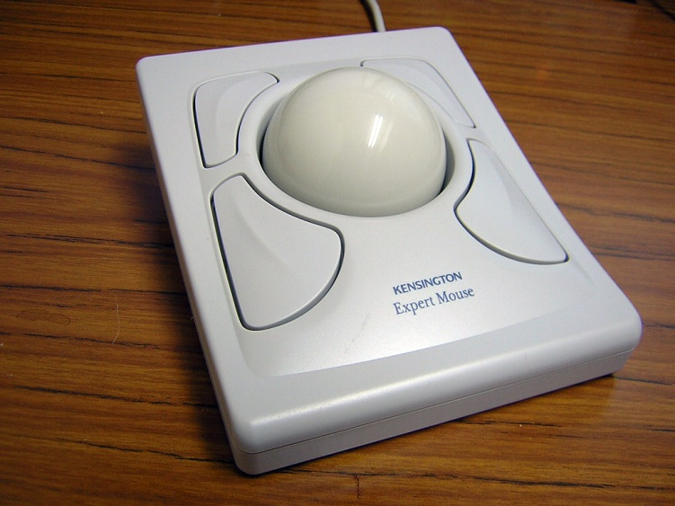
Track ball
The track ball looks like upside down mouse.
The ball is rotated by hand and amount of rotation is sensed by potentiometer.
Exactly similar to mouse.

Slide 12
Tablet and stylus
A paper drawing or a blue print can be entered into the machine using the tablet and stylus.
A tablet is a flat surface but is able to sense the position of the stylus on its surface
The stylus is a pen-like device.
We can place the blueprint over the surface and trace the figure using stylus.

Slide 13
Contd..

Slide 14
Graphical output devices
Output devices are needed to generate graphical output.
The output may be soft or hard.
In the soft form, it is displayed on a monitor like CRT or LCD panel etc..
In hard form, printed or plotted pattern is obtained.
Thus graphical output devices can be categorized as:
Computer terminals(Monitors)
Hard Copy devices(Printer/Plotters)

Slide 15
Contd..
We can also classify them depending on the primitive technology uesd, as:
Raster Scan devices
Random scan devices
Examples of raster & random scan devices.
Raster Scan devices
CRT monitors
Plasma panel/ gas discharge display
LCD panel
Dot Matrix printer.
Random Scan Devices
Storage Oscilloscope
Plotters.

Slide 16
Raster Scan Video principles
In Raster scan display systems a frame buffer is used to store intensitty information for each pixel.
The process of generating pixel information into the buffer is called scan conversion.
This is done by a display processor.
A display controller displays the content of the frame buffer on the screen.

Slide 17
Contd..
Interactive graphical systems use more then one processor which can interact with the CPU and control different operations on display devices.
The display controller scans the contents of the frame buffer and produce output on the display device.
This process of converting a rasterized picture stored on a frame buffer to the rigid display pattern is called scanning.
This scanning is done with a particular frequency.

Slide 18
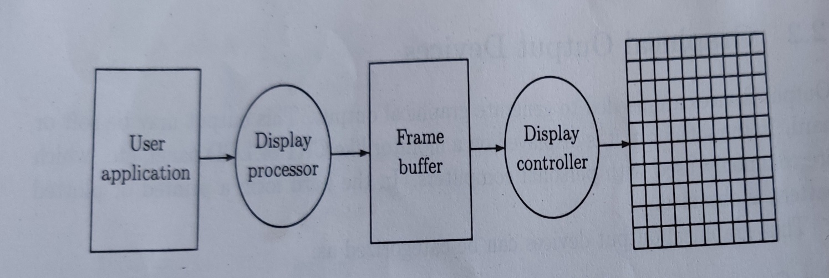
Contd..
The frequency of repetition depends on the following
Human Visual perception systems.
Electronic principles and technology used.(interlaced/non-interlaced).
Block diagram

Slide 19
Contd..
The human visual system requires a finite time to realize particular pattern.
This means that we cannot detect any change in a displayed intensity pattern, before our eyes.
We have an illusion that earlier pattern sustained for certain time period.
This period is one thenth of a second.
This phenomenon is called visual persistence.

Slide 20
Contd..
Like persistence of vision, the display devices also show one kind of limitation this is called persistence of phosphorescence.
This means that the phosphor coating on the screen has a certain persistence of glowing.
This persistence is defined as the time taken by the light emitted from the screen to decay to one tenth of its original intensity.
The above two persistence allows us to produce digital outputs on the refresh display monitors by reproducing the displayed intensity pattern on the monitor at a certain frequency.

Slide 21
Contd..
Nominal picture updation frequency is 25 frames/second.
Minimum refresh or repitition rate is twice of this i.e., 50frames/second.
Each frame is presented twice for proper visual perception.
American standard video systems uses 525 horizontal with aspect ratio of 4:3.
The rate is 30 frames /second.

Slide 22
Contd..
Each frame is divided into two fields each containing half of the picture. The fields are interlaced.
These fields are presented alternatively at a rate of 60 fields/second.
Since human eye preceives the fiels repetiton rate, this technique reduces flicker frequency.

Slide 23
Interlaced & non-interlaced

Slide 24
Non Interlaced

