Slide 1
OPERATIONS OF COMPUTER GRAPHICS
BY
PEER MOHAMED.A MCA.,SET
ASST.PROF OF INFORMATION TECHNOLOGY
HAJEE KARUTHA ROWTHER HOWDIA COLLEGE
UTHAMAPALAYAM

Slide 2
Operations of Computer Graphics
Creation of elememtary objects.
Creating Basic Shapes.
Creating Solid Objects.
Sizing and Positioning.
Projection on 2D.
Shading and Colouring.
Viewing and Clipping.
Hidden surface Elimination.
Producing Animated Views.

Slide 3
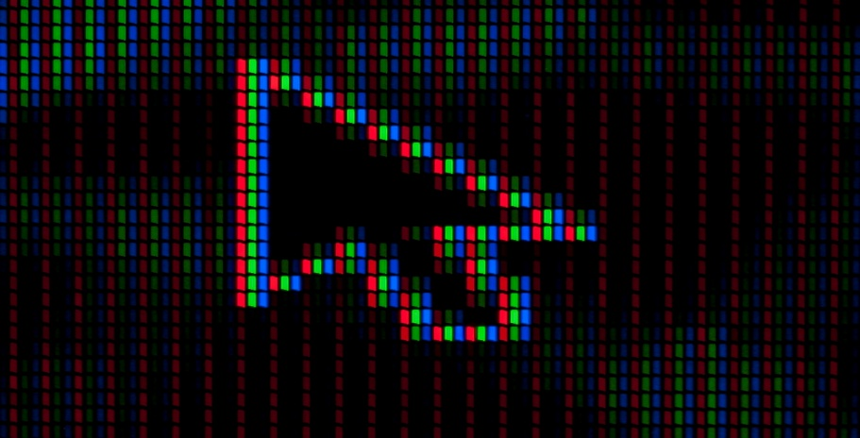
Creation of Elementary objects
The fundamental of any graphical objects is a Pixel or Picture element.
It is single isolated black or coloured dot.
A vector of size one is nothing but a dot.

Slide 4
Creating Basic Shapes
Basic shapes are components of object boundaries.
These can be defined by mathematical functions.
Examples.
Line Segment, Circle, Ellipse, Triangle etc..

Slide 5
Creating Solid Objects
Solid boundaries in 2D & 3D can be produced by combining basic shapes and elementary objects.

Slide 6
Sizing and positioning
Using geometrical transformation, objects or the parts can be resized, and their position can be changed.
Geometrical operations include translation, scaling, rotation, shearig etc.

Slide 7
Projection on 2D
Objects in real world are generally in 3D in nature on computer screen we need to produce using 2D notations.
Actually projected views on 3D objects are produced on screen.
Projection is a specific transformation that converts 3D object description ont 2D representation.

Slide 8
Shading & Colouring
To give real look to the objects rendering processes are applied.
For black & white objects this method is called shading.
For coloured object it is called colouring and rendering.

Slide 9
Viewing & Clipping
Sometimes only part of complete objects need to be viewed. This is done by viewing and clipping.
Objects can be zoomed in & out.

Slide 10
Hidden surface elimination
Real objects do not show their back surfaces.
So producing objects surface from their mathematical representations we need to eliminate the back surfaces.

Slide 11
Producing animated views
Using physics motion, graphical objects can be animated according to user requirements.
The objects can be segments helps this operation to be simulated on a computer.

Slide 12
Graphics Software package
Many Graphical software packages have bben developed which use different notations for doing the same job.
To remove the diversity of notations, some standard have been maintained.
Some standard graphics are:
CORE(Core of a graphics systems)
Developed by graphics standard planning committee of Association of computer machinery.
CORE is also termed as SIGGRAPH(Special Interest Group on Graphics)

Slide 13
Contd..
GKS(Graphics kernel systems)
It is developed by ANSI & ISO.
Both contains 2D & 3D graphics
PHIGS(Programmers Hierarchical Interactive Graphics System )
Some Commonly used graphical packages are.
Autocad
Paint
Photoshop
Coraldraw etc…

Slide 14
Requirements of a Graphical System
The objective of a graphical system is to produce high quality graphics on a display or output device in real time.
Basic requirements of such a system is as follows:
Display on required resolution
Powerful processor to perform primitive graphical operations.
Adapter card and graph driver.

