Slide 1
Overview of programming in C
BY
PEERMOHAMED.A MCA., SET
ASST.PROF OF INFORMATION TECHNOLOGY
HAJEE KARUTHA ROWTHER HOWDIA COLLEGE
UTHAMAPALAYAM

Slide 2
History of C language
C programming language was developed in 1972 by Dennis Ritchie at bell laboratories of AT&T (American Telephone & Telegraph), located in the U.S.A. Dennis Ritchie is known as the founder of the c language.
It was developed to overcome the problems of previous languages such as B, BCPL, etc. Initially, C language was developed to be used in UNIX operating system. It inherits many features of previous languages such as B and BCPL.

Slide 3
Importance of ‘C’ language
C language is a famous programming language due to its qualities. Some qualities are:
It is robust language whose rich setup of built in functions and operator can be used to write any complex program.
Program written in C are efficient due to several variety of data types and powerful operators.
The C compiler combines the capabilities of an assembly language with the feature of high level language.
Therefore it is well suited for writing both system software and business package.
There are only 32 keywords; several standard functions are available which can be used for developing program.
C is portable language; this means that C programs written for one computer system can be run on another system, with little or no modification.

Slide 4
Contd..
C language is well suited for structured programming, this requires user to think of a problems in terms of function or modules or block.
A collection of these modules make a program debugging and testing easier.
C language has its ability to extend itself. A c program is basically a collection of functions that are supported by the C library.
We can continuously add our own functions to the library with the availability of the large number of functions.
In India and abroad mostly people use C programming language because it is easy to learn and understand.

Slide 5
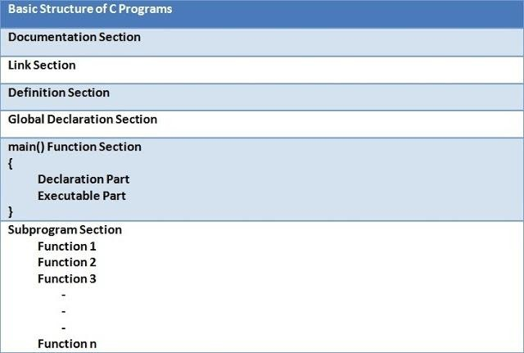
Basic Structure and programming style
Any C program is consists of 6 main sections. Below you will find brief explanation of each of them.

Slide 6
Contd..
Documentation Section:
This section consists of comment lines which include the name of programmer, the author and other details like time and date of writing the program. Documentation section helps anyone to get an overview of the program.
Link Section:
The link section consists of the header files of the functions that are used in the program. It provides instructions to the compiler to link functions from the system library.

Slide 7
Contd..
Definition Section:
All the symbolic constants are written in definition section. Macros are known as symbolic constants.
Global Declaration Section:
The global variables that can be used anywhere in the program are declared in global declaration section. This section also declares the user defined functions.

Slide 8
Contd..
main( ) Function Section:
It is necessary have one main( ) function section in every C program. This section contains two parts, declaration and executable part. The declaration part declares all the variables that are used in executable part. These two parts must be written in between the opening and closing braces. Each statement in the declaration and executable part must end with a semicolon (;). The execution of program starts at opening braces and ends at closing braces.

Slide 9
Contd..
Subprogram Section:
The subprogram section contains all the user defined functions that are used to perform a specific task. These user defined functions are called in the main() function.

