Slide 1
Raster Scan CRT Monitors
BY
PEERMOHAMED.A MCA.,SET
ASST.PROF OF INFORMATION TECHNOLOGY
HAJEE KARUTHA ROWTHER HOWDIA COLLEGE
UTHAMAPALAYAM

Slide 2
Raster Scan CRT Monitors
It is the most common and widely used graphical output device.
The major Components are:
Electron Gun
Control electrodes
Focusing Electrodes
Deflection Yoke
Phosphor Coated screen

Slide 3
Contd..
Example of Raster scan display

Slide 4
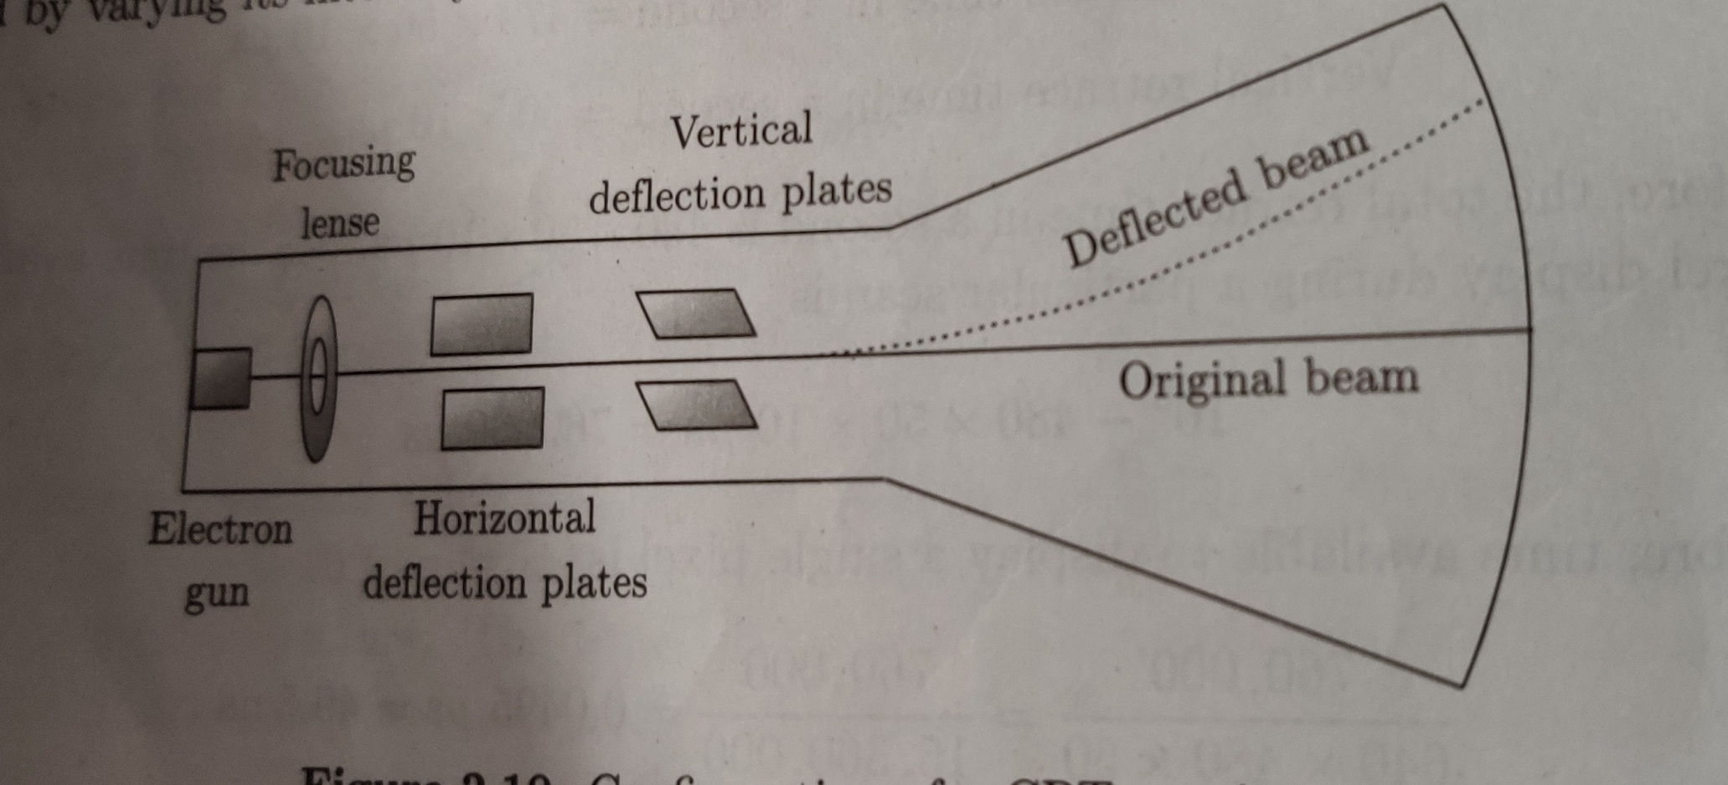
Contd..
Configuration of CRT Monitors

Slide 5
Contd..
In CRT a beam of electrons, emitted from an electrode (called the cathode or electron gun), passes through a focusing and deflection system and then strike the phosphor-coated screen.
Electromagnetic fields are used to direct and focus the beam to the particular spot on the screen.
When beam strikes the phosphor coated spot, it glows with an intensity propotional to the beam intensity of the beam itself.
The glow given off by the phosphor during exposure to the electron beam is called fluroscence.
The containing glow given off after the beam is removed is called phosphorescence and its duration is known as persistence of phosphorescence.
All phosphors have a limited life depending on time of exposure and intensity of the electron beam.
After which they are burnt out.

Slide 6
Contd..
Due to persistence of phosphorescence the CRT is refreshed frequently(50/60 times /second).
The image on the CRT may appear to flash rapidly on and off. This flashing is flicker.
Fortunately, people cannot detect visual changes before 1/30 th of a second. This is called persistence of vision.
It is due to this drawback of human visual system that TVs, movies, m onitors can satisfy our visual sense.

Slide 7
Contd..
There are two types of CRT monitors:
Interlaced
Non-interlaced
Interlaced
In Interlaced systems, the total number of scan lines divided into even and odd fields.
The electron beams scan them alternatively odd field followed by even field.
Due to high vertical resolution of the system and non ability of human visual systems detect the separation between two close scan lines, it cannot sense the one of the fields skipped during the scan.
In medium persistence phosphor, interlacing can reduce the flickering because the display is filled with 50 percentage of information approx.

Slide 8
Contd..
Over scan
The electron beam, during scanning, crosses the border of the visible screen and scans more along all four sides than that is actually needed. This is called over scan.
Blanking
During retrace from bottom-right to top-left corner of the screen the electron beam is off and actually screen is blank at that time. This event is called blanking.

Slide 9
Contd..
Spot size or Pixel size:
This indicates the resolution
Small spot means high resolution.
This depends on the cross section of electron beam and size of phosphor crystals on the screen.
For colour monitor generally 3 dots are used to constitute a pixel.
For Grey image , generally pixels are formed of a number of dots which is power of two.

Slide 10
Contd..
Aspect Ratio
It is the device’s width-height ratio.
Most standard CRTs have a display area with aspect ratio of 4:3.
In 14’’ monitor the width and height are 12’’ and 9’’ respectively.
The aspect ratio can be also e defined as the number of horizontal pixel is equal to the number of vertical pixel necessary to produce equal length line.
Our visual system is more sensitive to detect colour or intensity changes horizontally than vertically.

Slide 11
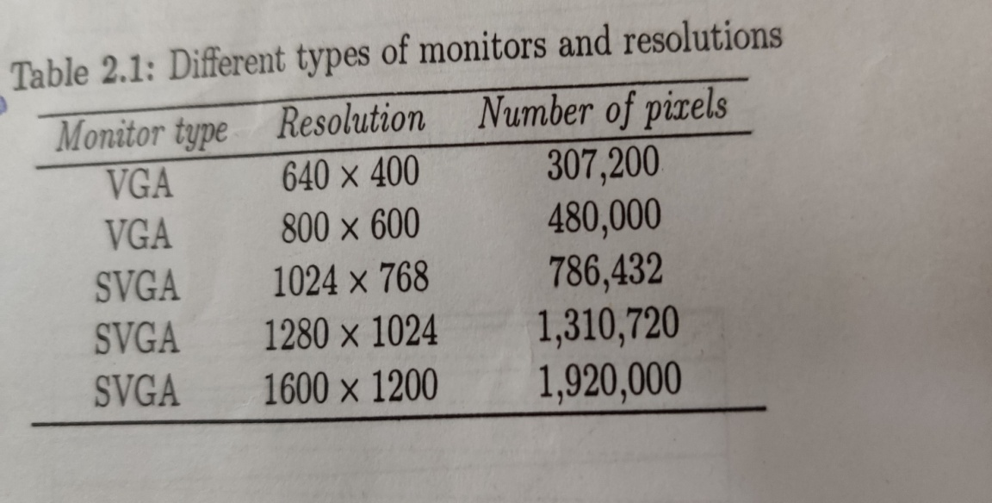
Contd..
Resolution
It is number of pixels per unit length on a scan line.
Generally it is indicated by the no. of pixels.
It can horizontal or vertical.
Resolution of 640*400 means 640pixels/horizontal & 400pixels /vertical.

