Slide 1
MEASURE OF CENTRAL TENDENCY
H HABEEB RANI
DEPARTMENT OF MATHEMATICS

Slide 2
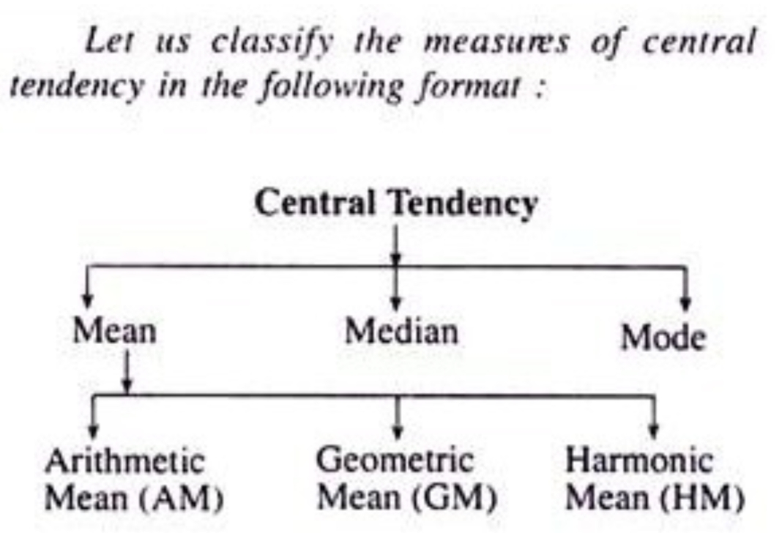
INTRODUCTION
Measure of central tendency are statistical constants which enable us to comprehend in a single effort the significance of the whole

Slide 3
ARITHMETIC MEAN
Determined by adding all the data points and dividing the total by the number of points
GROUPED DATA:
Mean=X1+X2+…….Xn/n
UNGROUPED DATA:
Mean=Σfixi/ Σfi

Slide 4
GEOMETRIC MEAN
Set of n observations x1,x2,…., xn is the nth root of their product
G=(x1 x2 …....xn)^(1/n)

Slide 5
HARMONIC MEAN
Set of n observations x1,x2……,xn is defined to be the reciprocal of the arithmetic mean of the reciprocal of the observations
H=1/1/n(1/x1+1/x2+…1/xn)

Slide 6
MEDIAN
Arrange the observations in order from smallest to largest value
If there is an odd number of observations, then the median is middle value
If there is an even number of observations, then the median is the average of two middle values
GROUPED DATA:
Median=l+(N/2-m)h/fk
Where, l=lower boundary of the median class
m=c.f above the median class
fk=frequency corresponding to the median class
h=width of the class

Slide 7
QUARTILES
It is a type of quartile
First quartile is defined as the middle number between the smallest number and the median of the data set
Second quartile is the median of the data
Third quartile is the middle value between the median and the highest value of the data set
UNGROUPED DATA:
Q1=xi+q(xi+1-xi),i=[1/4(n+1)
GROUPED DATA:
Q1=l+(N/4-m)h/fk

Slide 8
DECILES
A decile is any of the nine values that divide the sorted data into ten equal parts, so that each part represents 1/10 of the sample or population
UNGROUPED DATA:
Dk=xi+q(xi+1-xi) ,i=[k/10(n+1)]
GROUPED DATA:
Di=l+(iN/10-m)h/fk , i=1,2,…9

Slide 9
PERCENTILES
It is a measure used in statistics indicating the value below which a given percentage of observations in a group of observations falls
UNGROUPED DATA:
Pk=xi+q(xi+1-xi) , k=1,2,….99
GROUPED DATA:
Pi=l+(iN/100-m)h/100 ,i=1,2,…99

Slide 10
MODE
Value of observations which occurs most frequently that is an observation with maximum frequency
Mode=l+hf2/f1+f2

Slide 11
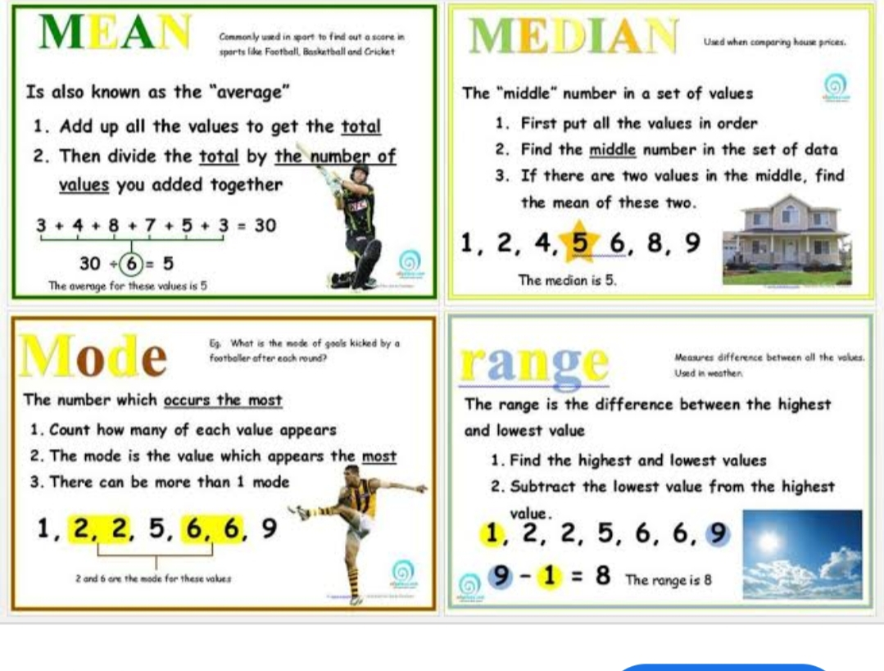
EXAMPLES

Slide 12
THANK YOU

