Slide 1
HAJEE KARUTHA ROWTHER HOWDIA COLLEGE UTHAMAPALAYAM. DEPARTMENT OF MATHEMATICS
M.VIJAYASANKARI., M.Sc., M.Ed., M.Phil., Ph.D.,

Slide 2
Topology II – M.Sc., Mathematics

Slide 3
Classifiying Sets
A subset U of X is called Open if U is in T.

Slide 4
Classifiying Sets
A subset U of X is called Open if U is in T.
A subset V of X is called Closed if the complement of V is in T.

Slide 5
Open and Closed Sets

Slide 6
Continuity
A function f from one topological space X to another Y is Continuous if f ⁻¹(U) is open in X for every open set U in Y.

Slide 7
Continuity
A function f from one topological space X to another Y is Continuous if f ⁻¹(U) is open in X for every open set U in Y.

Slide 8
Homeomorphism
f : X →Y is a homeomorphism if X and Y are topological spaces and both f and f ⁻¹ are continuous.

Slide 9
Homeomorphism
f : X →Y is a homeomorphism if X and Y are topological spaces and both f and f ⁻¹ are continuous.
Two topological spaces are the “same” or homeomorphic if there exists a homeomorphism from one space to the other.

Slide 10
Homeomorphism
f : X →Y is a homeomorphism if X and Y are topological spaces and both f and f ⁻¹ are continuous.
Two topological spaces are the “same” or homeomorphic if there exists a homeomorphism from one space to the other.
It is easier to tell that two spaces are NOT homeomorphic. Homeomoprhic spaces have certain characteristics.

Slide 11
Homeomorphic
Homeomorphic spaces can be visualized by stretching, folding, and bending one space to another. Think of topology as the ‘rubber’ subject. Just don’t pinch, break or cut.

Slide 12
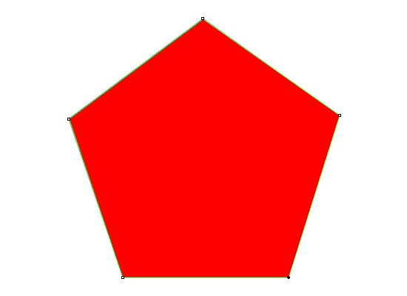
Homeomorphic
Homeomorphic spaces can be visualized by stretching, folding, and bending one space to another. Think of topology as the ‘rubber’ subject. Just don’t pinch, break or cut.

Slide 13
Homeomorphic Spaces?

