Slide 1
MENDALIAN GENETICS
Subject Name – Genetic & Subject Name – Genetic & Biostatistics
Semester : V
Pogramme : III B. Sc. Microbiology
Shobiya Banu
Assistance professor
H.K.R.H College
Uthamapalayam.

Slide 2
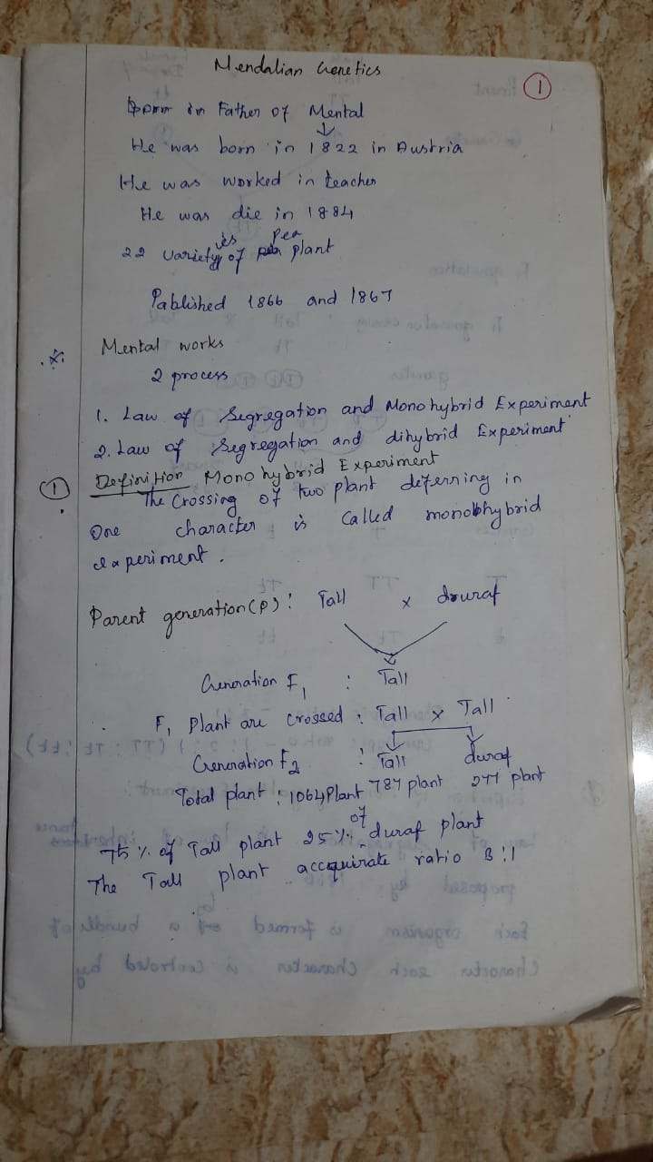

Slide 3
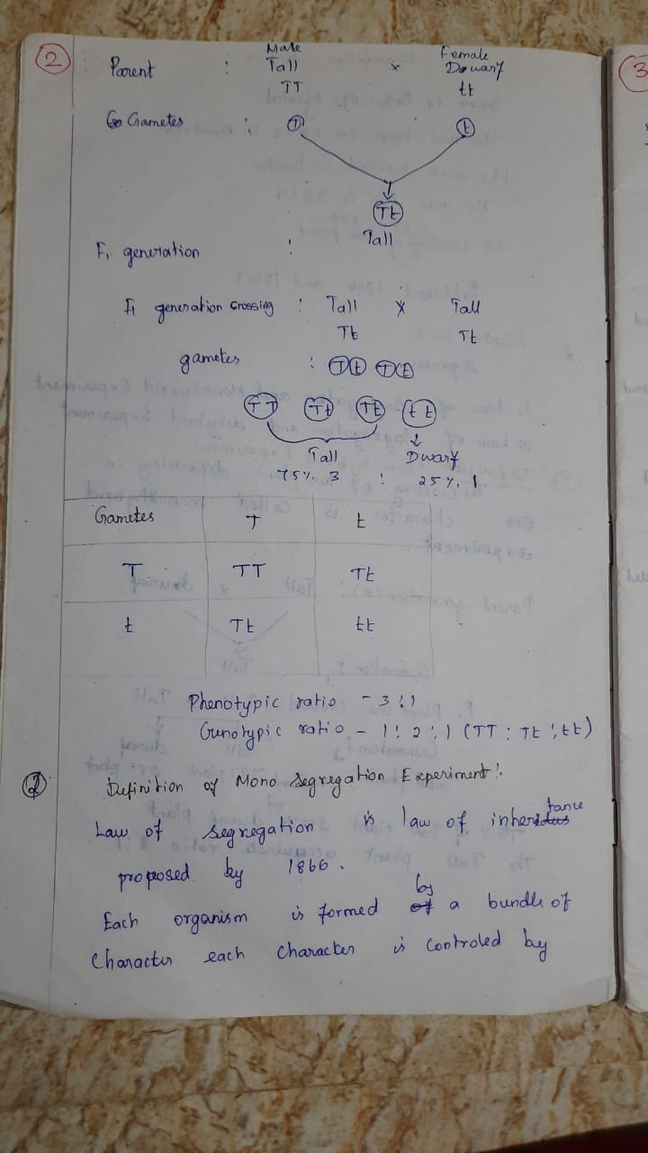

Slide 4
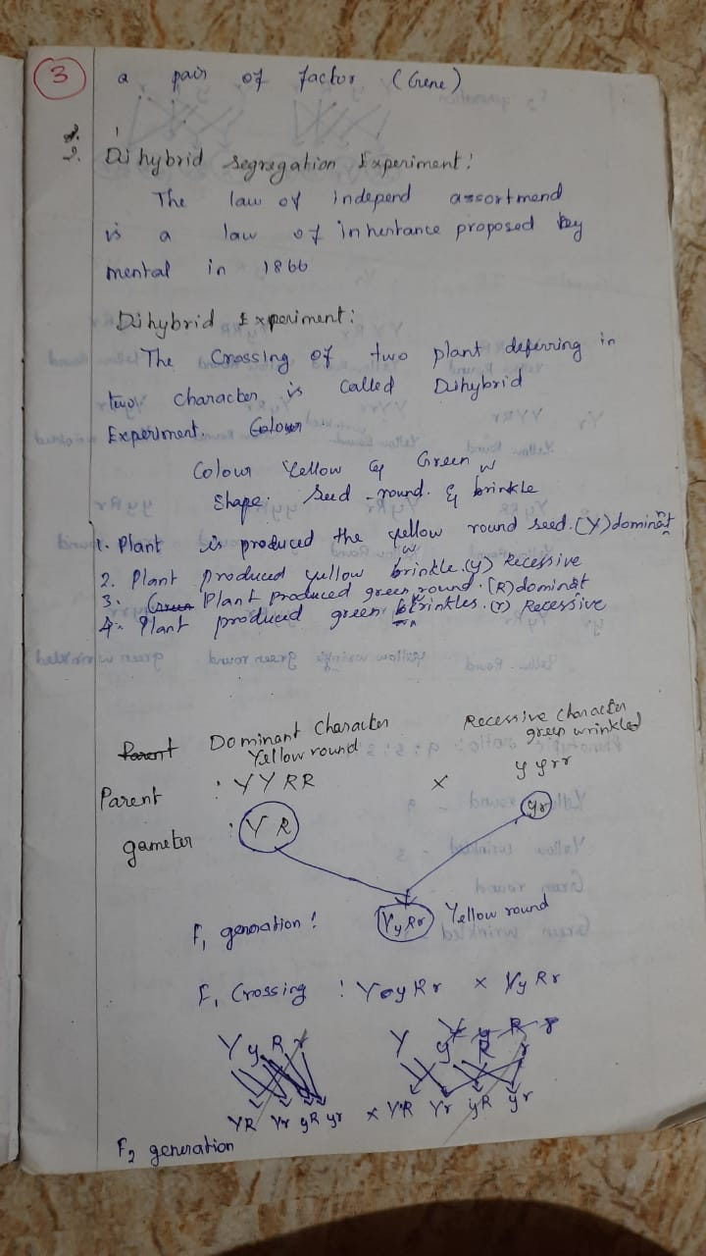

Slide 5
