Slide 1
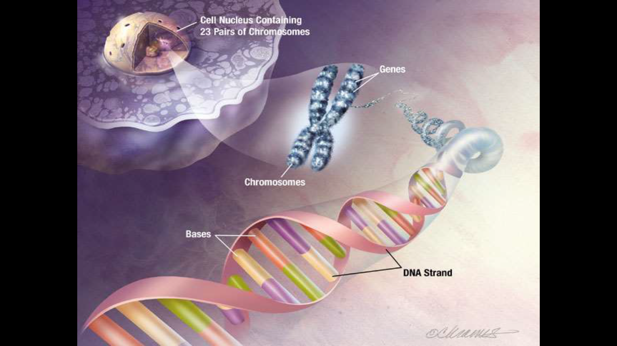
STRUCTURE OF DNA
Subject Name – MOLECULAR BIOLOGY & MICROBIAL GENETICS Subject Code –17UMBC31
Semester : III
Programme : B. Sc. Microbiology
Dr Sajith Ahamed. Mphil., PhD
Assistant Professor
Department of Microbiology
H.K.R.H.College

Slide 2
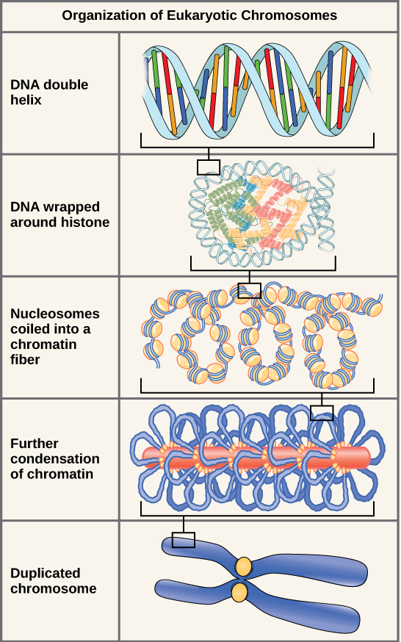

Slide 3
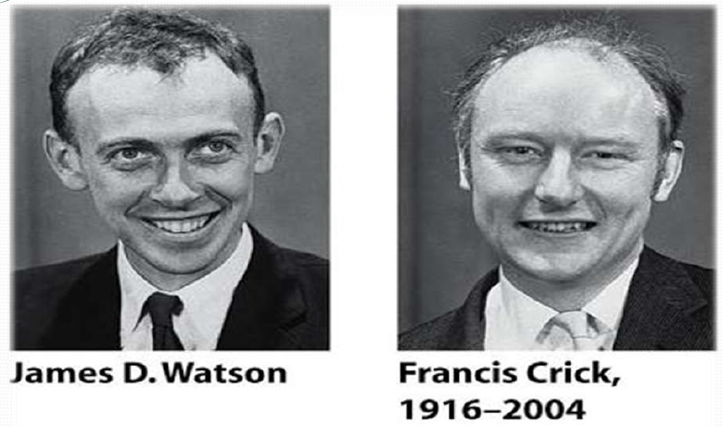

Slide 4
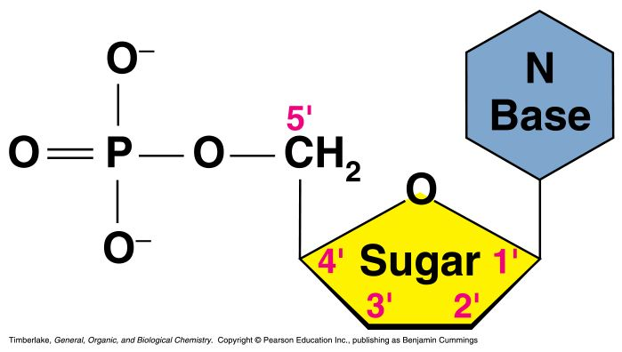
Nucleic Acids
Nucleic acids are molecules that store information for cellular growth and reproduction
There are two types of nucleic acids:
- deoxyribonucleic acid (DNA) and ribonucleic acid (RNA)
These are polymers consisting of long chains of monomers called nucleotides
A nucleotide consists of a nitrogenous base, a pentose sugar and a phosphate group:

Slide 5
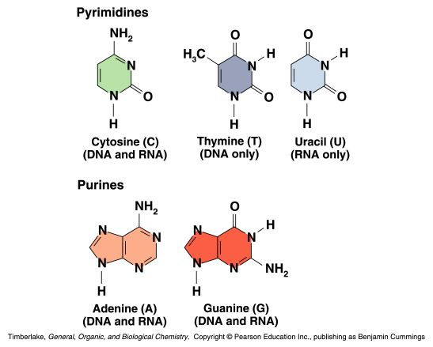
Nitrogen Bases
The nitrogen bases in nucleotides consist of two general types:
- purines: adenine (A) and guanine (G)
- pyrimidines: cytosine (C), thymine (T) and Uracil (U)

Slide 6
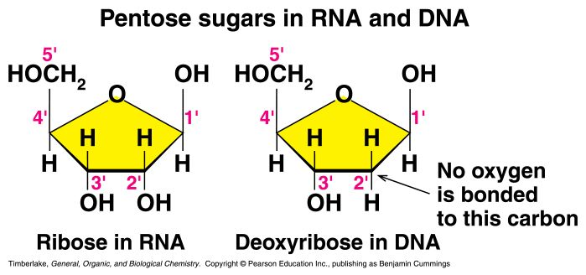
Pentose Sugars
There are two related pentose sugars:
- RNA contains ribose
- DNA contains deoxyribose
The sugars have their carbon atoms numbered with primes to distinguish them from the nitrogen bases

Slide 7
Nucleosides and Nucleotides
A nucleoside consists of a nitrogen base linked by a glycosidic bond to C1’ of a ribose or deoxyribose
Nucleosides are named by changing the the nitrogen base ending to -osine for purines and –idine for pyrimidines
A nucleotide is a nucleoside that forms a phosphate ester with the C5’ OH group of ribose or deoxyribose
Nucleotides are named using the name of the nucleoside followed by 5’-monophosphate

Slide 8
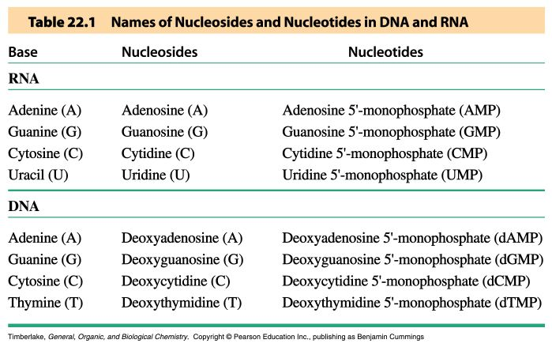
Names of Nucleosides and Nucleotides

Slide 9
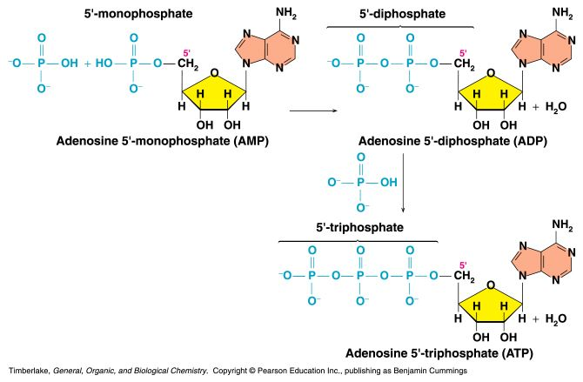
AMP, ADP and ATP
Additional phosphate groups can be added to the nucleoside 5’-monophosphates to form diphosphates and triphosphates
ATP is the major energy source for cellular activity

Slide 10
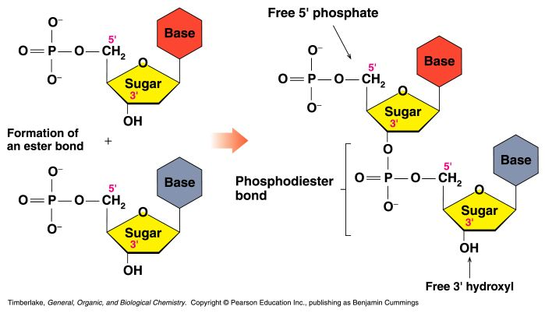
Primary Structure of Nucleic Acids
The primary structure of a nucleic acid is the nucleotide sequence
The nucleotides in nucleic acids are joined by phosphodiester bonds
The 3’-OH group of the sugar in one nucleotide forms an ester bond to the phosphate group on the 5’-carbon of the sugar of the next nucleotide

Slide 11
Reading Primary Structure
A nucleic acid polymer has a free 5’-phosphate group at one end and a free 3’-OH group at the other end
The sequence is read from the free 5’-end using the letters of the bases
This example reads
5’—A—C—G—T—3’

Slide 12
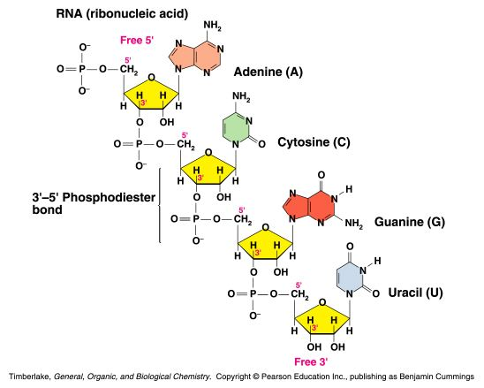
Example of RNA Primary Structure
In RNA, A, C, G, and U are linked by 3’-5’ ester bonds between ribose and phosphate

Slide 13
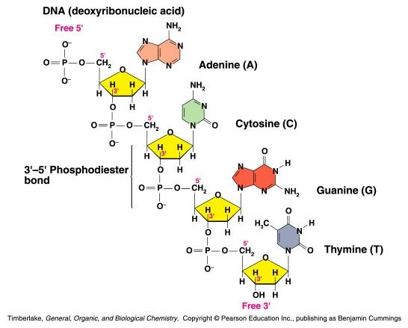
Example of DNA Primary Structure
In DNA, A, C, G, and T are linked by 3’-5’ ester bonds between deoxyribose and phosphate

Slide 14
Secondary Structure: DNA Double Helix
In DNA there are two strands of nucleotides that wind together in a double helix
- the strands run in opposite directions
- the bases are are arranged in step-like pairs
- the base pairs are held together by hydrogen bonding
The pairing of the bases from the two strands is very specific
The complimentary base pairs are A-T and G-C
- two hydrogen bonds form between A and T
- three hydrogen bonds form between G and C
Each pair consists of a purine and a pyrimidine, so they are the same width, keeping the two strands at equal distances from each other

Slide 18
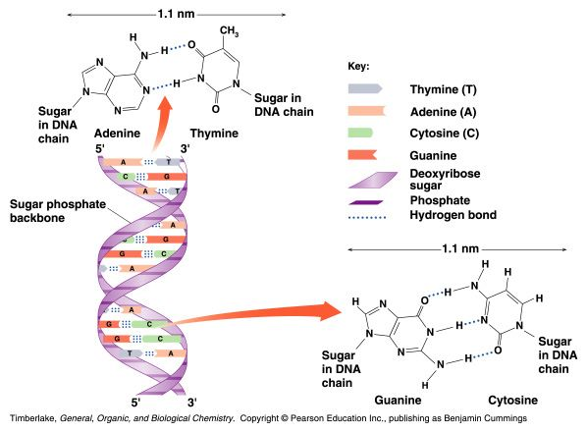
Base Pairing in the DNA Double Helix

Slide 21
Double Helix Scales
The two strand run antiparallely in opposite directions ie. they run in opposite direction 5’ to 3’ end and 3’ to 5’ end.
The two strands are interwined in clockwise direction.
The width of DNA molecule is 20 Å. The strand completes a turn every 34 Å along its length.
There are ten nucleotides per turn. The internucleotide distance is 3.4 Å.
Watson and Crick model of DNA is called B-form DNA. The chains in B-form DNA are in right handed orientation.

Slide 25
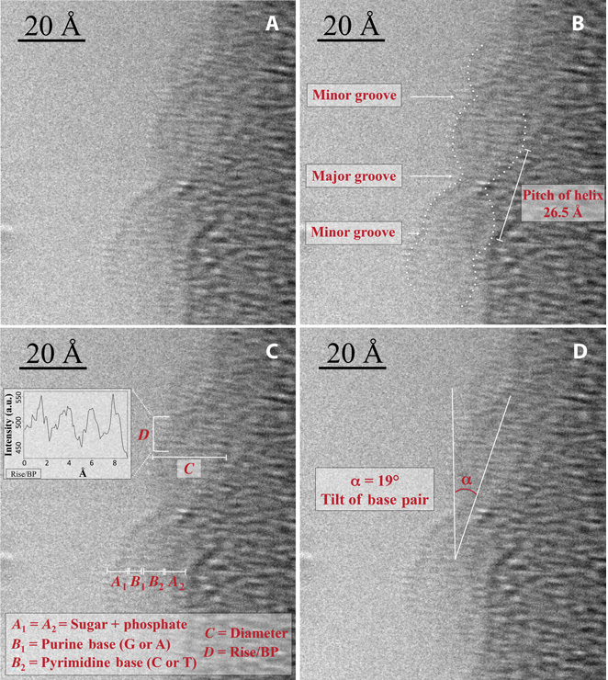

Slide 26
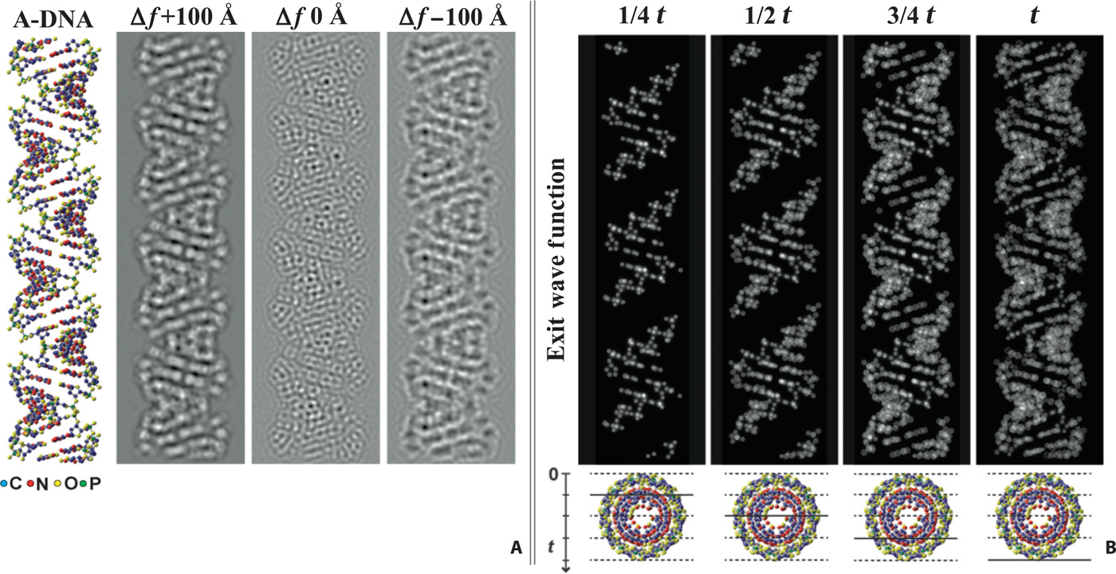

Slide 27
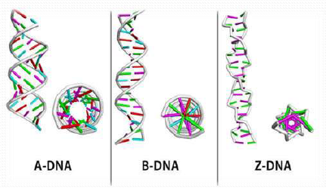

Slide 28
STRUCTURE OF THE DOUBLE HELIX
THREE MAJOR FORMS
B-DNA
A-DNA
Z-DNA
B-DNA IS BIOLOGICALLY THE MOST COMMON
RIGHT-HANDED (20 ANGSTROM (A) DIAMETER)
COMPLEMENTARY BASE-PAIRING (WATSON-CRICK)
A-T
G-C
EACH BASE PAIR HAS ~ THE SAME WIDTH
10.85 A FROM C1’ TO C1’
A-T AND G-C PAIRS ARE INTERCHANGEABLE
“PSEUDO-DYAD” AXIS OF SYMMETRY

Slide 29
GEOMETRY OF B-DNA
IDEAL B-DNA HAS 10 BASE PAIRS PER TURN
BASE THICKNESS
AROMATIC RINGS WITH 3.4 A THICKNESS TO RINGS
PITCH = 10 X 3.4 = 34 A PER COMPLETE TURN
AXIS PASSES THROUGH MIDDLE OF EACH BP
MINOR GROOVE IS NARROW
MAJOR GROOVE IS WIDE
IN CLASS EXERCISE: EXPLORE THE STRUCTURE OF B-DNA. PAY SPECIAL ATTENTION TO THE MAJOR, MINOR GROOVES

Slide 30
A-DNA
RIGHT-HANDED HELIX
WIDER AND FLATTER THAN B-DNA
11.6 BP PER TURN
PITCH OF 34 A
→ AN AXIAL HOLE
BASE PLANES ARE TILTED 20 DEGREES WITH RESPECT TO HELICAL AXIS
HELIX AXIS PASSES “ABOVE” MAJOR GROOVE
→ DEEP MAJOR AND SHALLOW MINOR GROOVE
OBSERVED UNDER DEHYDRATING CONDITIONS

Slide 31
A-DNA
WHEN RELATIVE HUMIDITY IS ~ 75%
B-DNA → A-DNA (REVERSIBLE)
MOST SELF-COMPLEMENTARY OLIGONUCLEO-
TIDES OF < 10 bp CRYSTALLIZE IN A-DNA CONF.
A-DNA HAS BEEN OBSERVED IN 2 CONTEXTS:
AT ACTIVE SITE OF DNA POLYMERASE (~ 3 bp )
GRAM (+) BACTERIA UNDERGOING SPORULATION
SASPs INDUCE B-DNA TO → A-DNA
RESISTANT TO UV-INDUCED DAMAGE
CROSS-LINKING OF PYRIMIDINE BASES

Slide 32
Z-DNA
A LEFT-HANDED HELIX
SEEN IN CONDITIONS OF HIGH SALT CONCENTRATIONS
REDUCES REPULSIONS BETWEEN CLOSEST PHOSPHATE GROUPS ON OPPOSITE STRANDS (8 A VS 12 A IN B-DNA)
IN COMPLEMENTARY POLYNUCLEOTIDES WITH ALTERNATING PURINES AND PYRIMIDINES
POLY d(GC) · POLY d(GC)
POLY d(AC) ⋅ POLY d(GT)
MIGHT ALSO BE SEEN IN DNA SEGMENTS WITH ABOVE CHARACTERISTICS

Slide 33
Z-DNA
12 W-C BASE PAIRS PER TURN
A PITCH OF 44 DEGREES
A DEEP MINOR GROOVE
NO DISCERNIBLE MAJOR GROOVE
REVERSIBLE CHANGE FROM B-DNA TO Z-DNA IN LOCALIZED REGIONS MAY ACT AS A “SWITCH” TO REGULATE GENE EXPRESSION
? TRANSIENT FORMATION BEHIND ACTIVELY TRAN-
SCRIBING RNA POLYMERASE

Slide 34
Thank you

