Slide 1
Mechanisms of Pathogenesis
Prepared by
Dr. P. Sivamanikandan
Assistant Professor of Microbiology
Hajee Karutha Rowther Howdia College(Autonomous),
Uthamapalayam-625533

Slide 2
Pathogen
Organisms that are capable of disease are known as pathogen.
Pathogenicity
The ability of an organism to cause disease is known as Pathogenicity.
Pathogenesis
The process of development of disease is known as pathogenesis.
Opportunist’s pathogens
Many microorganisms that usually form the normal flora of the body become pathogens whenever an opportunity arises.

Slide 5
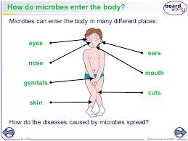

Slide 8
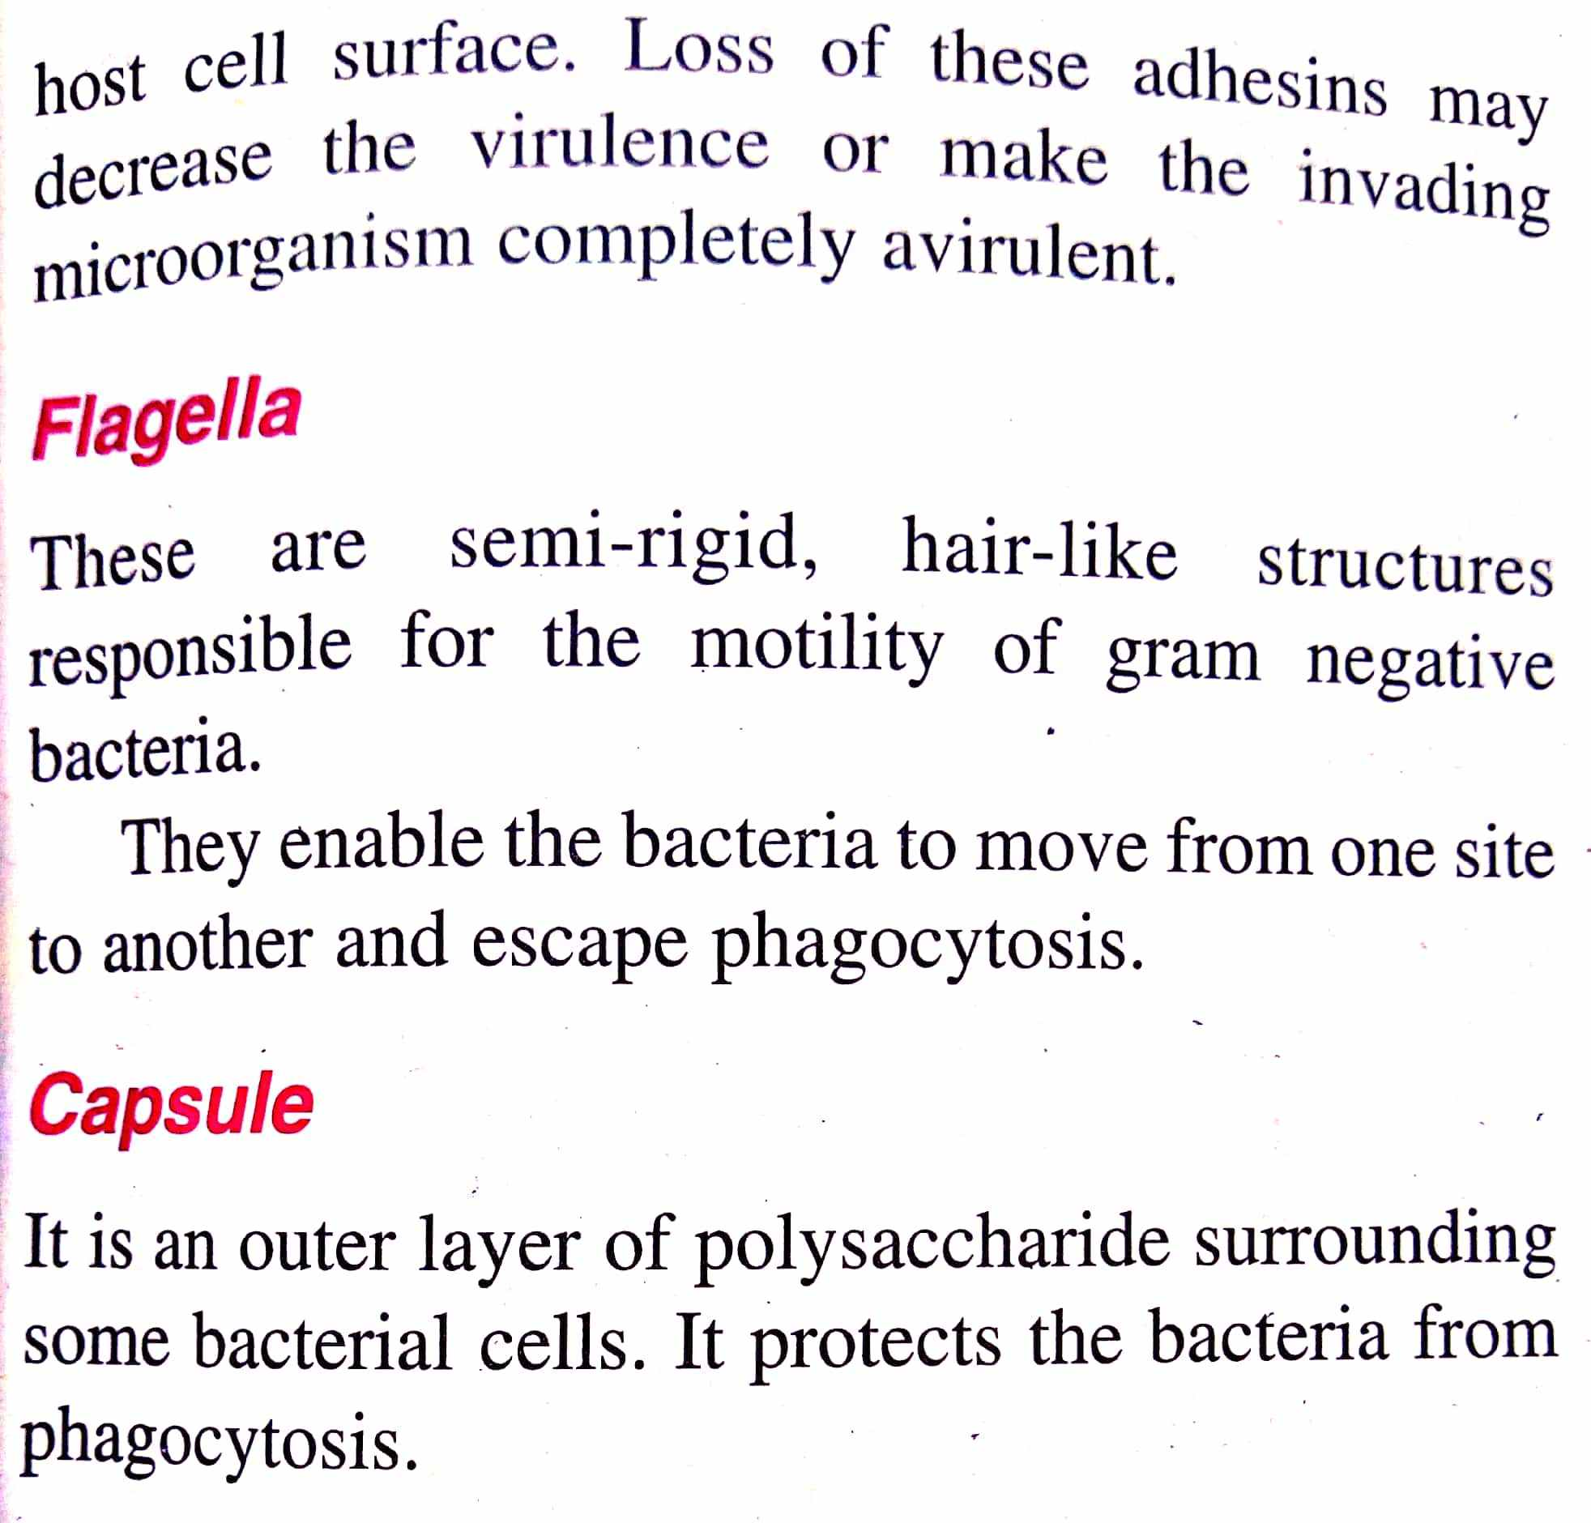

Slide 9
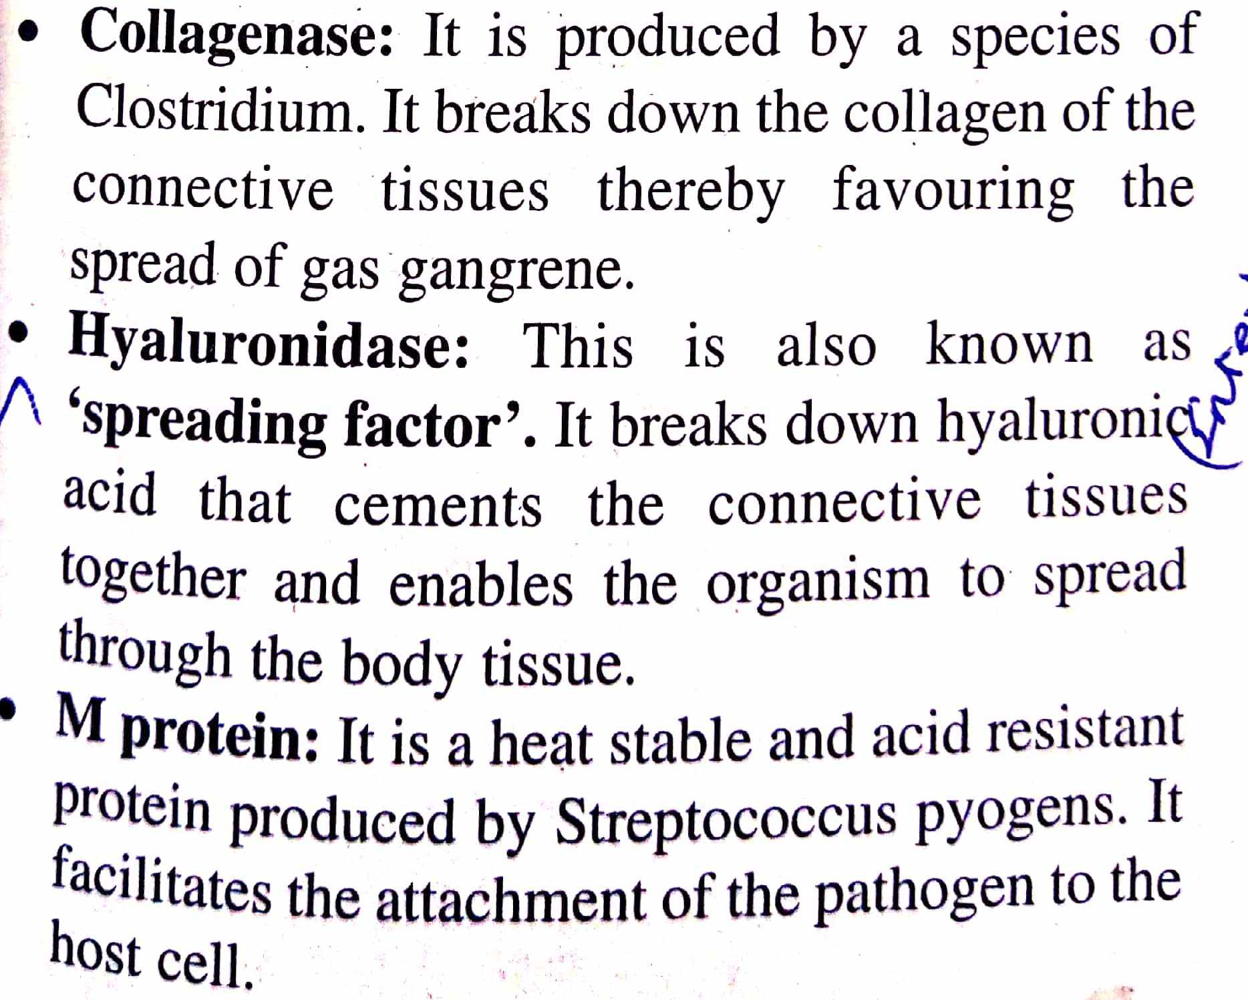

Slide 13
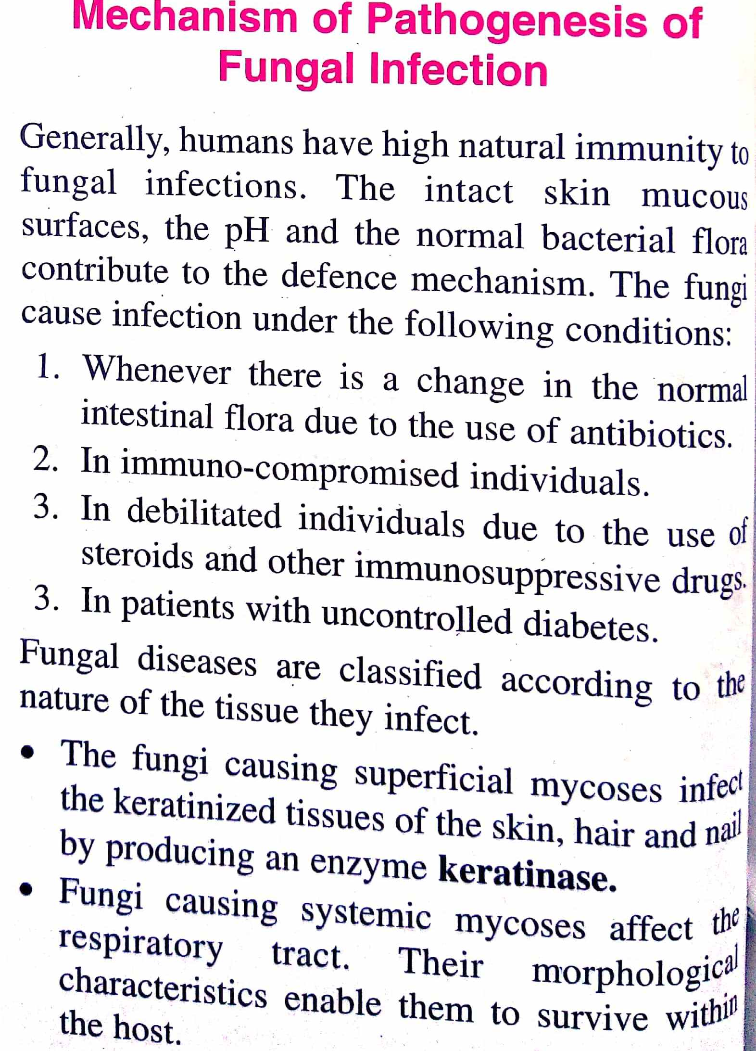

Slide 14
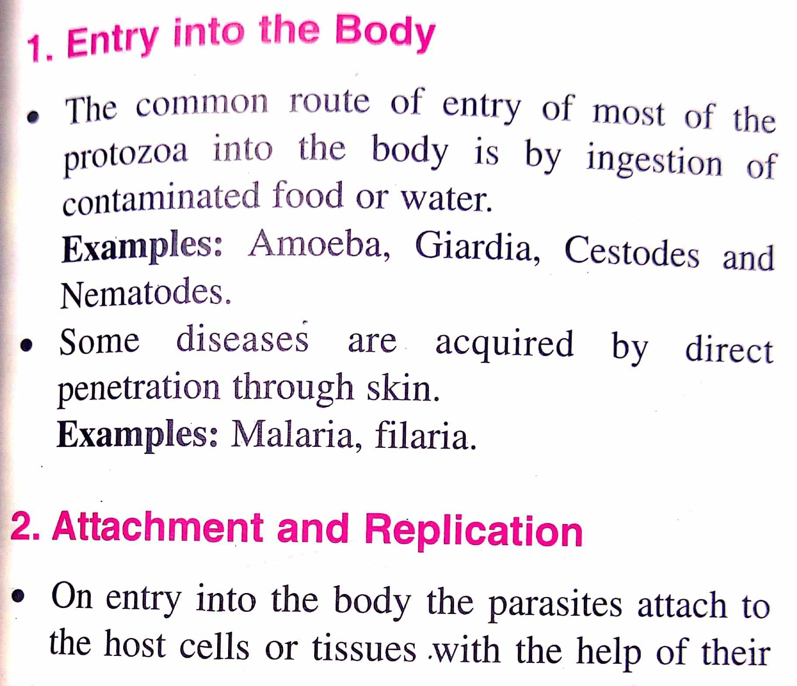

Slide 16
Thank you
By
Dr.P.Siva

Slide 17
ANY
QUESTION

