Slide 1
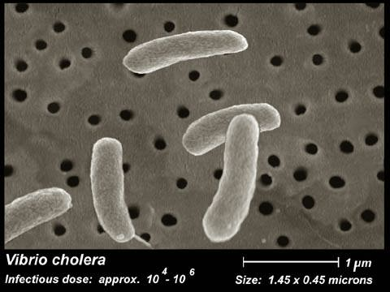
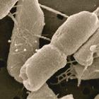
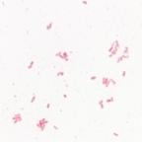
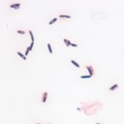
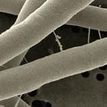
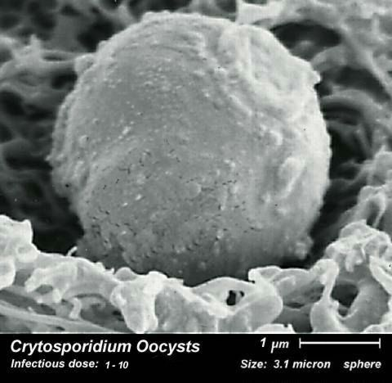
Introduction to Microbiology
Prepared by
Dr. P. Sivamanikandan
Assistant Professor of Microbiology
Hajee Karutha Rowther Howdia College(Autonomous),
Uthamapalayam-625533

Slide 2
Microbiology definition
Microbiology is a branch of science that deals with microbes.
The word microbiology is derived - “micron” means small and “biologia” means study.
Microbiology deals with the structure, physiology, reproduction, metabolism and classification of microorganisms
Microbiology is the study of very small living organisms, organisms are invisible creatures, too small to be seen with the naked eye. That can be viewed only with a microscope. They are the microorganisms. They include bacteria, virus, algae, fungi and protozoa.

Slide 3
Bacteria
Viruses
Actinomyces
Microorganisms
Protozoa
Algae
Fungi

Slide 4
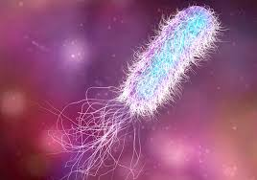
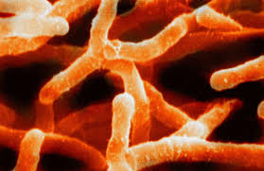
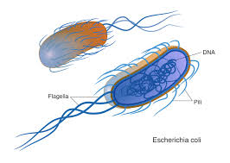
Bacteria
Actinomyctes

Slide 5
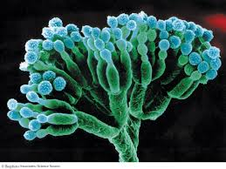
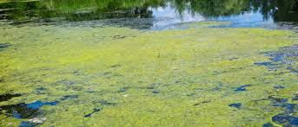
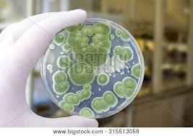
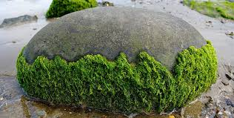
Fungi
Algae

Slide 6
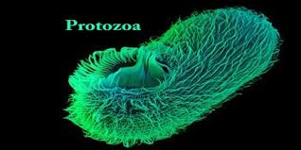
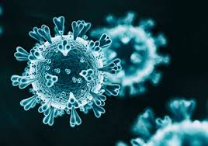
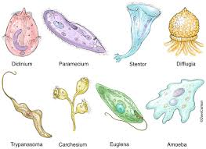
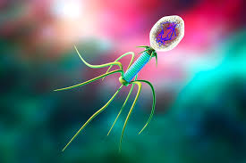
Protozoa
Virus

Slide 7
Microorganisms are widely distributed in the world, they are omnipresent.
They are present everywhere in air, water, soil, in living plants and animals, in dead matter etc.
The study of viruses is called Virology,
The study of bacteria is called Bacteriology,
The study of algae is called Phycology,
The study of fungi is called Mycology,
The study of immunity is called immunology
The study of protozoan’s is called Protozoology.

Slide 8
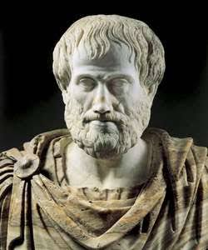
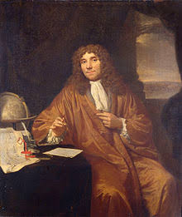
History of Microbiology

Slide 9
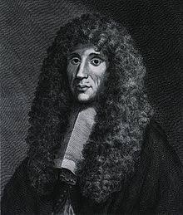
History of Microorganism | Photos
Aristotle (4thcentury) stated that living forms like flies, worms and other small creatures originated from decaying nonliving matter. This formed the basis of the principle of ‘spontaneous generation’ or ‘abiogenesis’.
Francesco Redi (1668) performed to disprove the existing idea that maggots appeared of their own exposing meat to air and warmth.
Antony von Leeuwenhoek (1674) is the father of microbiology. He assembled simple microscopes. He observed bacteria and named them as animalcules.

Slide 10
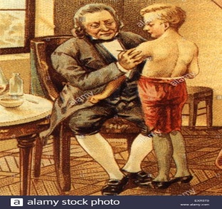
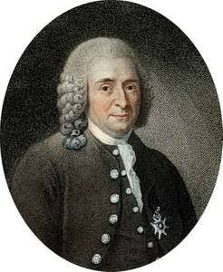
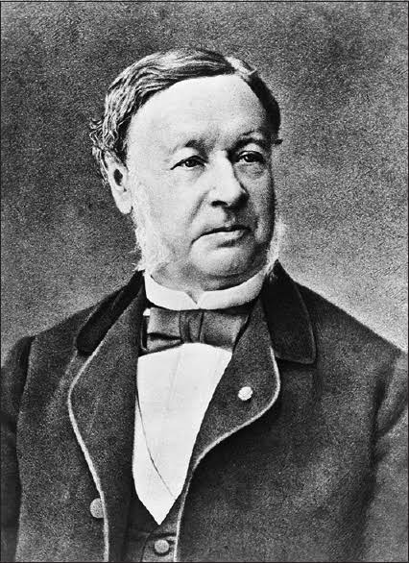
History of Microorganism | Photos
Edward Jenner (1749 - 1823) as English physician. He developed a safer method to smallpox immunization.
Carolus Linnaeus (1767) classified the microorganisms.
Theodore Schwann in 1836 demonstrated that yeast causes fermentation.
Muller (1773 and 1788) classified bacteria and coined the terms vibrio.

Slide 11
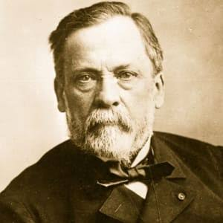
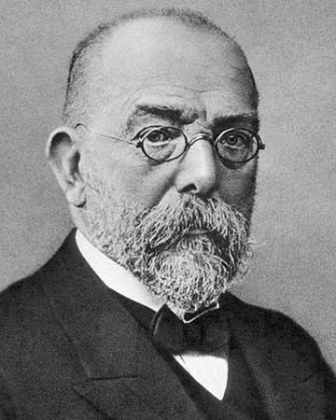
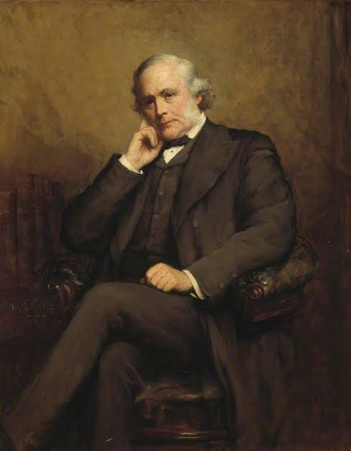
History of Microorganism | Photos
Louis Pasteur 1822-1895 - Proposed the theory of spontaneous generation of life. 1866 - Introduced the concept of pasteurization. 1885 - Discovered vaccine against rabies.
Robert Koch 1843-1910 - Discovered Bacilli. 1882 - Isolated the tubercle bacillus
Lord Lister (1827-1912) employed practical applications of bacteriology in the field of surgery. For the first time, he used surgical appliances and antiseptic dressings to save the surgical wounds from the entrance of bacteria.

Slide 12
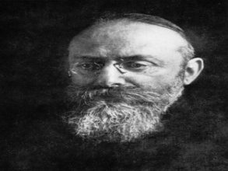
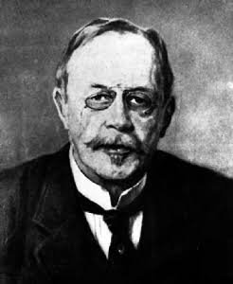
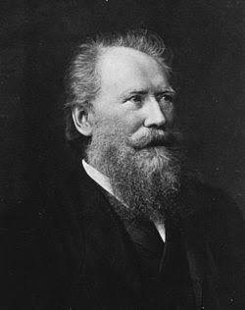
History of Microorganism | Photos
Albert Neisser (1879) discovered the Gonococcus the causative agent of gonorrhea.
Christian Gram (1884) introduced the Gram staining technique for the identification of bacteria.
Kark Joseph Eberth (1880) isolated the typhoid bacillus.

Slide 13
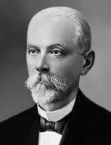
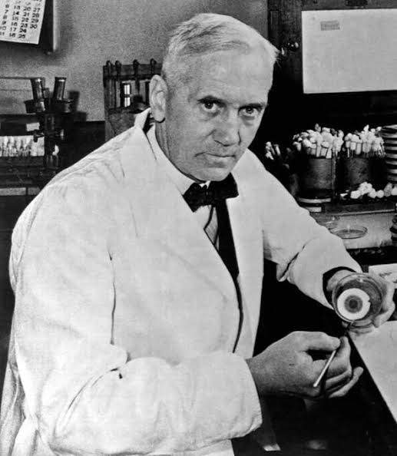
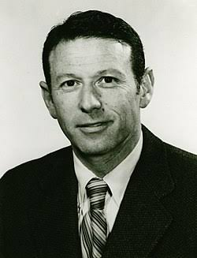
History of Microorganism | Photos
Ivanowski (1892) discovered Tobacco mosaic virus.
Sir Alexander Fleming (1929) discovered penicillin. He was called the father of antibiotics.
Paul Berg (1960) showed that human or animal DNA can be attached to bacterial DNA. It is known as Recombinant DNA or Genetic engineering.

Slide 14
Thank you
By
Dr.P.Siva

Slide 15
Any Question

