Slide 1
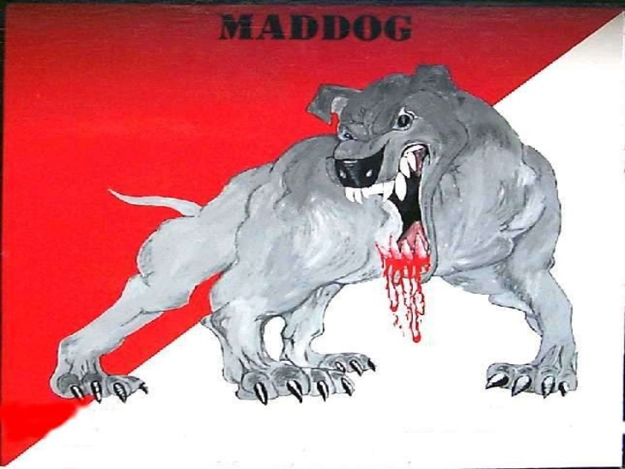
Rabies Virus
Prepared by
Dr. P. Sivamanikandan
Assistant Professor of Microbiology
Hajee Karutha Rowther Howdia College(Autonomous),
Uthamapalayam-625533

Slide 4
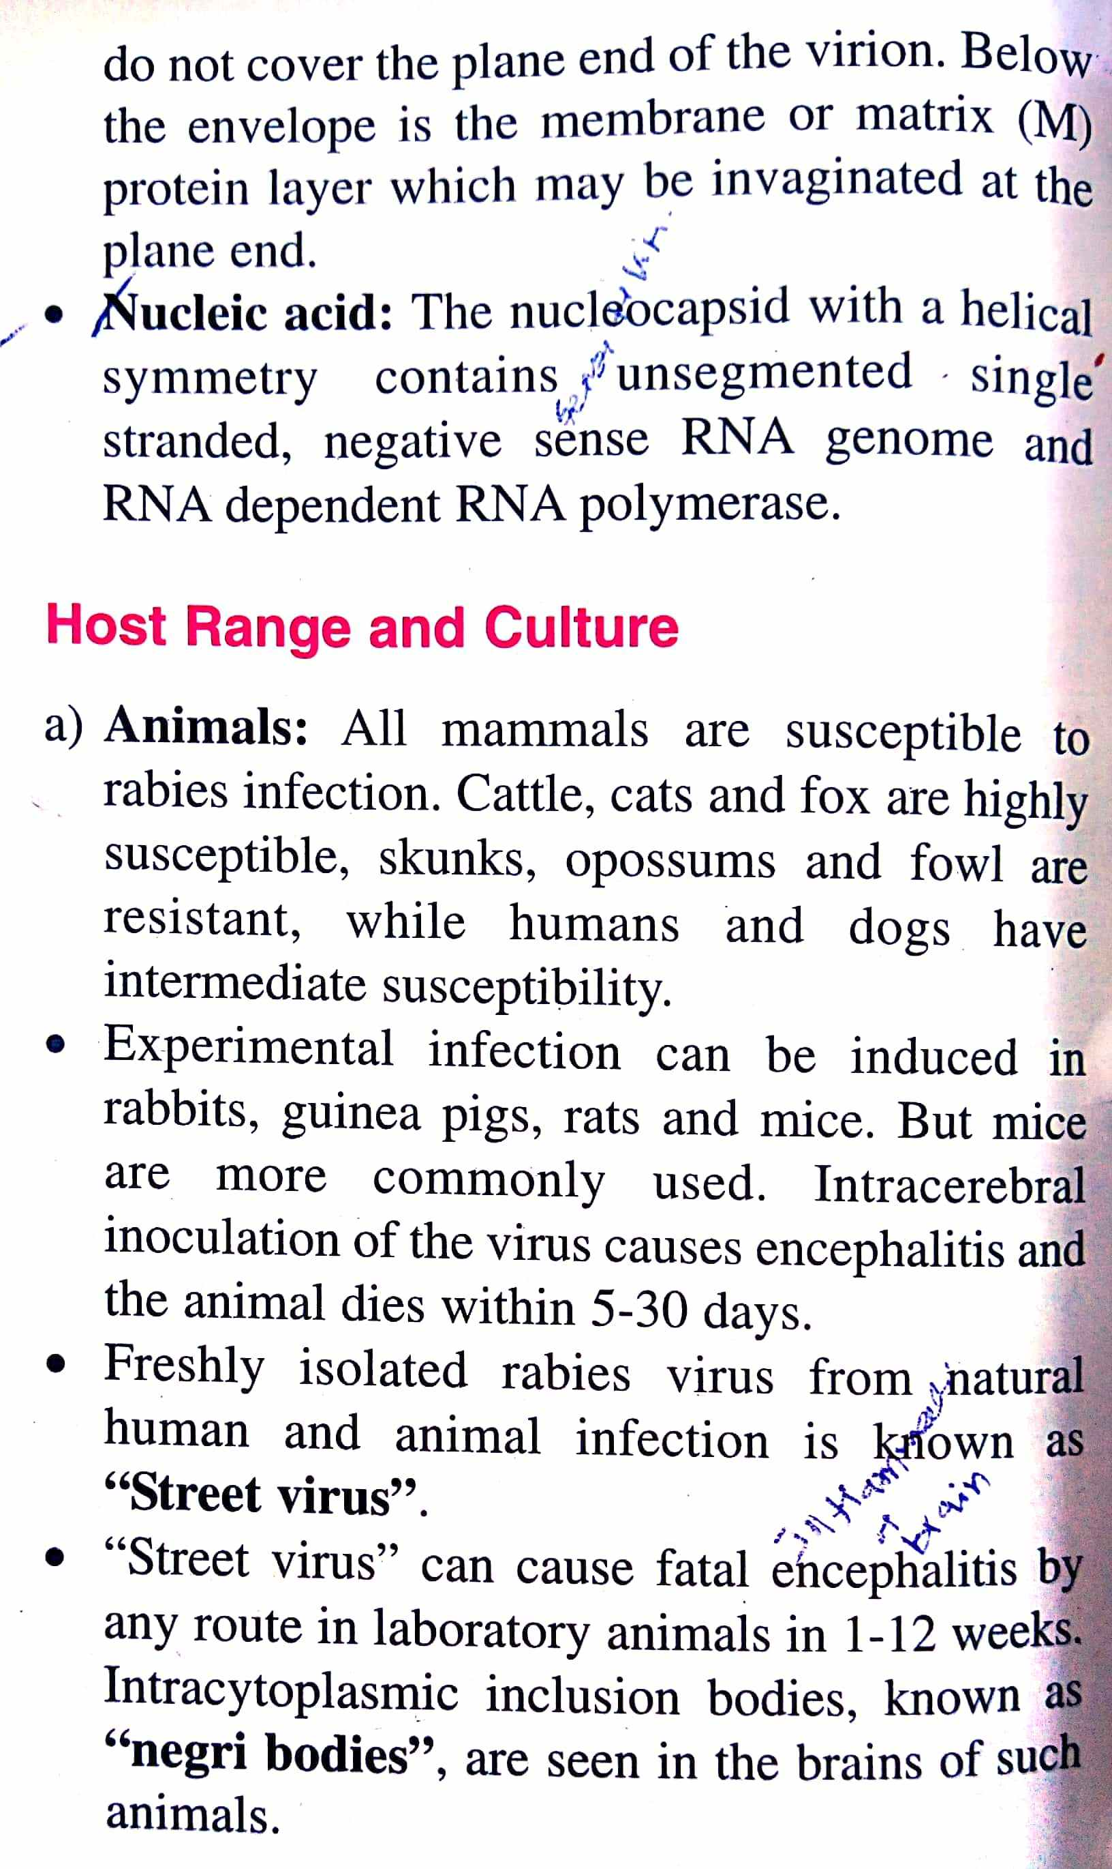
Morphology

Slide 8
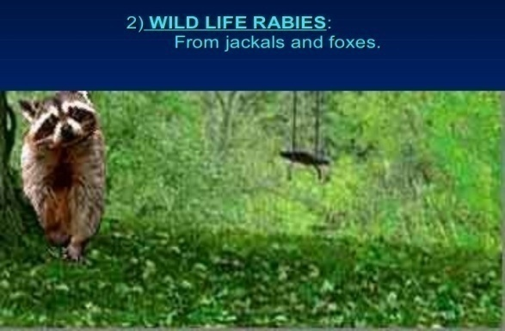

Slide 15
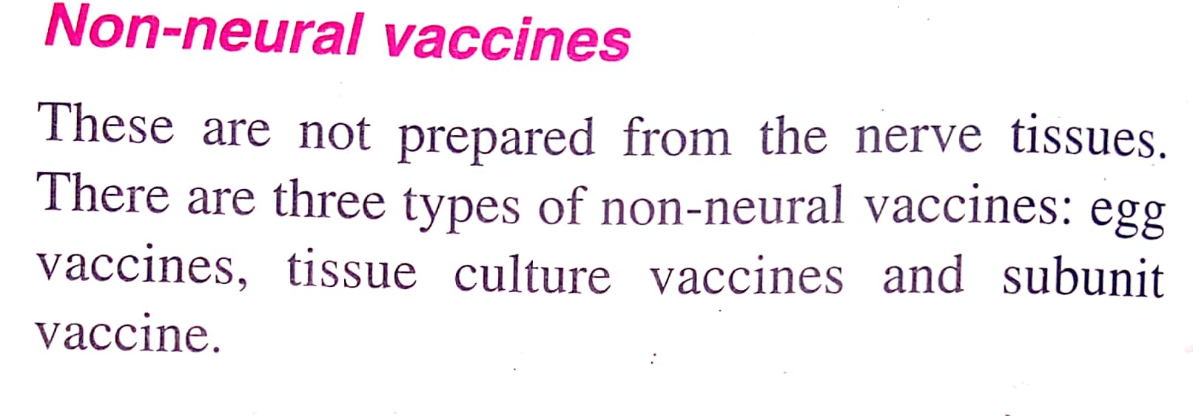
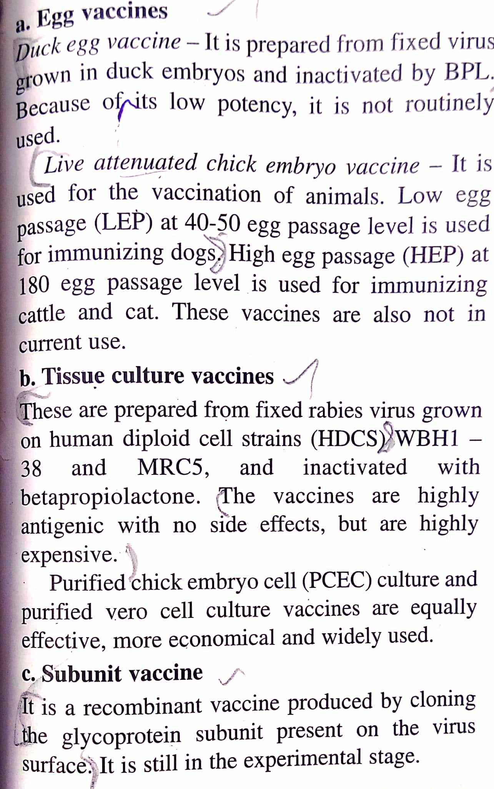

Slide 17
