Slide 1
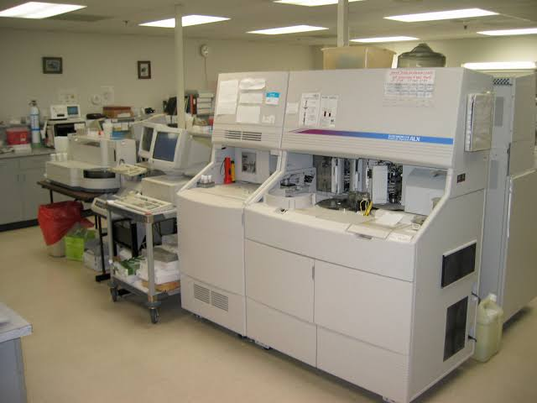
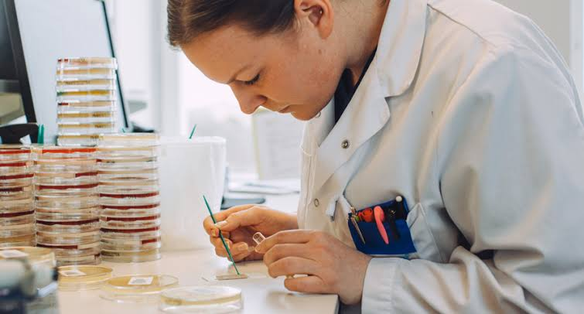
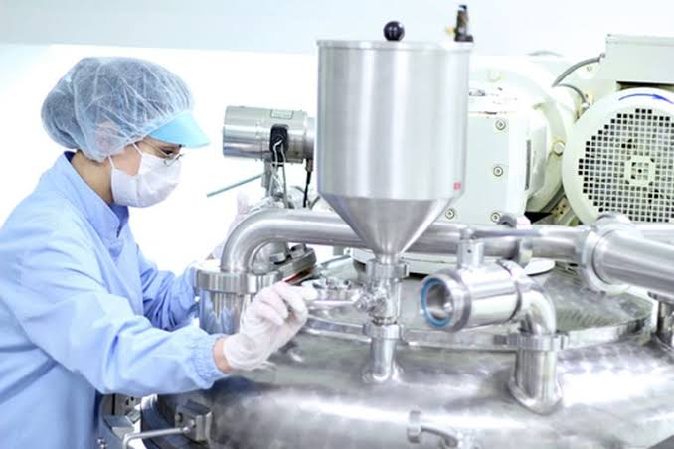
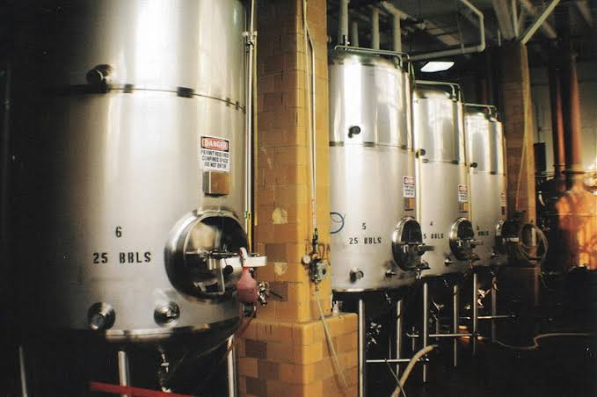
Scope of Microbiology
Prepared by
Dr. P. Sivamanikandan
Assistant Professor of Microbiology
Hajee Karutha Rowther Howdia College(Autonomous),
Uthamapalayam-625533

Slide 2
Introduction
Microbiology has an impact on Medicine, Agriculture, Food science, Ecology, Genetics, Biochemistry, Immunology and many other fields.
Microorganisms have increased great significance.
Medical Microbiology and Immunology:
Medical microbiology deals with disease producing organisms in human beings
Immunology deals with the defense the body set up against the pathogens, the disease causing microorganisms, and the factors to clarify resistance to disease.

Slide 3
Microbes in Medicines
Antibiotics are substances produced by bacteria used to inhibit the growth of closely related organisms.
For example the antibiotic penicillin is produced by Penicillium notatum, Streptomycin is produced by Streptomyces griseus.
Most of the microorganisms are used to produce vaccines.
For example Small pox, Cholera vaccines, etc.
Most of the vaccines are produced using
recombinant DNA technology using various microbes.

Slide 4
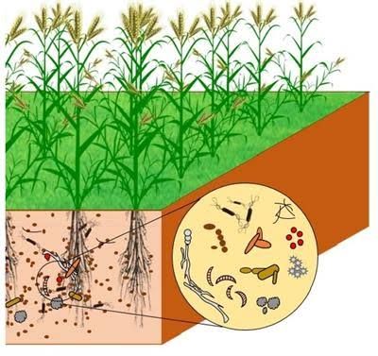
Soil Microbiology:
Soil microbiology deals with the microorganisms present in the soil.
The most important function of soil microorganisms is to decompose various types of organic matter and the process of mineralization of various organic elements.
They are found in association with plants in symbiotic relationships and maintain the soil fertility

Slide 5
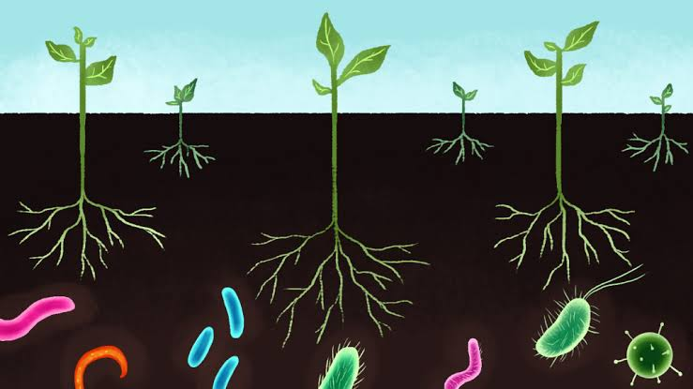
Mineralization of organic carbon, nitrogen, phosphorus and sulphur via own cyclic alterations by soil microorganisms makes for reuse by plants and other organisms.
Certain microbes increase the fertility of soil by converting atmospheric nitrogen into ammonia, nitrites and nitrates.
This is brought about by microbes like Rhizobium, Nitrobacter, Blue green algae, nostoc and anabaena

Slide 6
Microbes in Food production
In food industries microorganisms are used for the fermentation process in wine making, preservation, and in several other food processing and the manufacture of dairy products such as yogurt and cheese.
The microbial cultures also provide the flavor and aroma for food products.
Microbes especially yeasts (Saccharomyces cerevisiae) have been used in the production of beverages like wine, beer, whisky, brandy or rum.

Slide 7
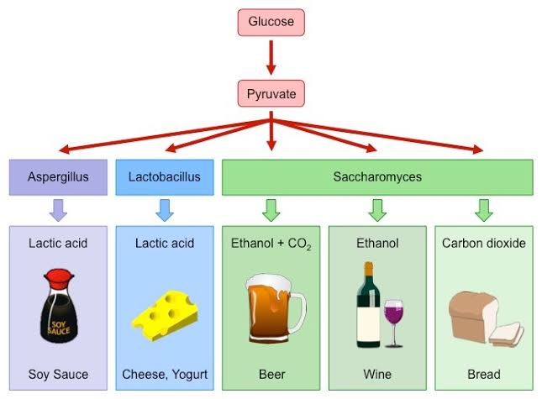
Cheese and Yoghurt is produced by the growth of microorganisms such as Streptococcus lactis and Streptococcus thermophilus.
The blue mold Pencillium roqueforti provides both the flavor and colour of cheese.

Slide 8
Industrial Microbiology:
Industrial microbiology is that branch of microbiology it deals with the utility of microorganisms in industrial production of medicines, food supplements,
alcohols, beverages, organic acids,
vitamins, enzymes etc.
The most significant industrial
use of microorganisms was the production of antibiotics.
The commercially beneficial activities of a large number of bacteria, yeasts, molds, and algae are being exploited to be obtaining the valuable products.

Slide 9
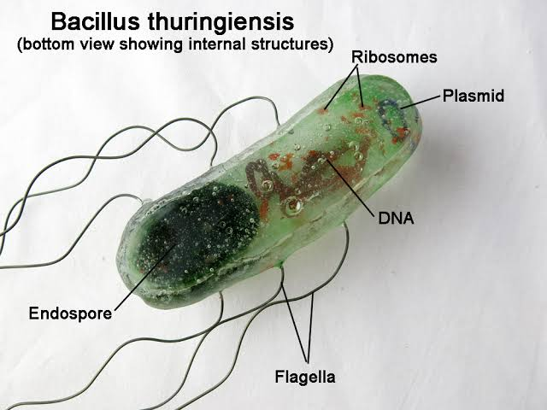
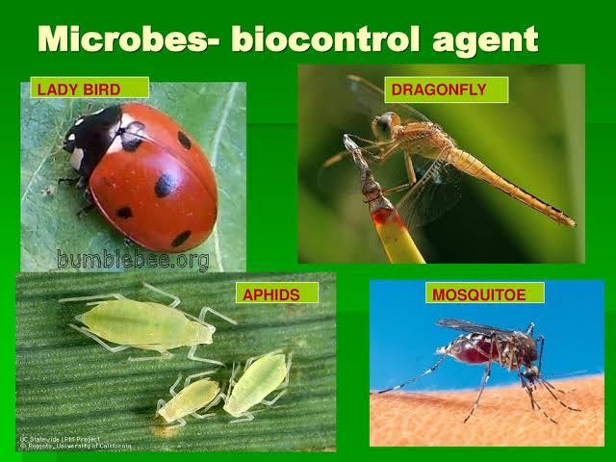
Microbes in Biocontrol agent
Bacillus thuringiensis (Bt) is an insecticide with unusual properties that make it useful for pest control in certain situations.
Bt is a naturally occurring bacterium common
in soils throughout the world. Several strains can
infect and kill insects.
Microbes in pesticide
Certain microbes like bacteria, fungi, viruses, protozoa and nematodes infect insects and kill them.
They may be called microbial pesticides
and are used as bio pesticides.

Slide 10
Microbes and Genetic engineering
Genetic engineering technique involves the use of microorganisms. By genetic engineering technique, recombinant DNA is produced.
Insulin synthesizing genes are transferred from vertebrates to microbes and insulin is synthesized on a large scale.
Applying this technique nitrogen fixing genes (Nif genes) is transferred from nitrogen fixing bacteria to cultivated plants.
Biomining
Microbes are now used in extracting valuable metals like uranium from rocks. Pseudomonades are used to absorb heavy metals.

Slide 11
Thank you
By
Dr.P.Siva

Slide 12
ANY
QUESTION

