Slide 1
TITLE OF THE COURSE: AGRICULTURE & ENVIRONMENTAL MICROBIOLOGY TOPIC: CITRUS CANKER HANDLED BY: RM.LAKSHMANAN ASSOCIATE PROFESSOR & HEAD DEPARTMENT OF MICROBIOLOGY HAJEE KARUTHA ROWTHER HOWDIA COLLEGE(AUTONOMOUS), UTHAMAPALAYAM

Slide 2
CITRUS CANKER
Contents
Introduction
Causal organism
Symptoms
Control measures

Slide 3
Citrus canker is a serious bacterial disease of commercial varieties of citrus, and relatives, caused by the bacterium Xanthomonas citri.
The disease affects the leaves, twigs and fruit causing the leaves to drop and fruit to fall to the ground before it ripens.
Citrus canker has resulted in heavy economic losses to citrus industries across the globe, due to damage to trees, reduced fruit production and access to export markets and increased cost of management.

Slide 4
CAUSAL ORGANISM
X. citri is part of the Xanthomonas genus of phytopathogenic bacteria that inhabit the phyllosphere of citrus plants species and crops and produce the citrus canker disease.
Colonies of X. citri are circular, convex, mucoid, and shiny. The bacteria are gram-negative, rod-shaped, motile aerobic and nonsporeforming.
This bacterium thrives in warm, moist conditions and disease development is optimal at 30 ̊C. It oozes out from diseased plant parts where there is ample free moisture and easily spreads to cause new infections.

Slide 5
The natural transmission mode is through wind and rains that spread the disease over short distances by splashing it onto other plants.
The primary way citrus canker spreads across locations is that human activities can move infected materials (budwood and fruit) from one place to another.
The disease also spreads from tree to tree through mechanical contact with pruning and other equipment.

Slide 6
SYMPTOMS
The bacterium grows and multiplies in diseased plant parts—all aboveground parts of the citrus tree are susceptible. Citrus canker causes premature leaf and fruit drop, twig dieback, general decline, and blemished fruit .
Blister-like lesions on leaves and fruit start small and expand as the disease progresses. These lesions may darken to tan or black and develop a water-soaked margin with a yellow halo surrounding it.

Slide 7
The center of the lesion on leaves as well as on stems and twigs can appear raised and corky or scabby , surrounded by a water-soaked margin.
Mature lesions on older symptomatic leaves may have a shot-hole look and these lesions eventually die and fall out

Slide 8
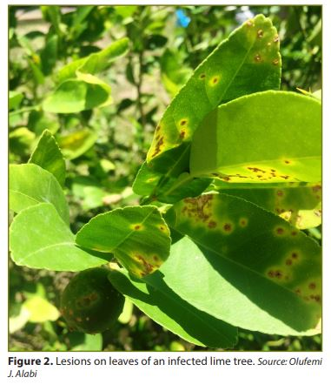

Slide 9
CONTROL MEASURES
Since there is no cure for the bacterium, prevention is the best approach to managing citrus canker.
Use of good sanitation practices to reduce potential disease spread. Practice general cleanliness and use alcohol-based sanitizers, bleach solution, and antibacterial soap solutions to decontaminate equipment and tools and reduce the risks associated with human and mechanical transmission of the disease.

Slide 10
Disposal of infected tree and plant material by burning.
Removal and destruction of diseased plants to eliminate potential bacteria for future infections.
Monitoring nearby citrus plants
Streptomycin sulphate 500-1000 ppm; or Phytomycin 2500 ppm or Copper oxychloride 0.2% at fortnight intervals.

