Slide 1
TITLE OF THE COURSE: AGRICULTURE& ENVIRONMENTAL MICROBIOLOGY TOPIC: MYCORRHIZA HANDLED BY: RM.LAKSHMANAN ASSOCIATE PROFESSOR & HEAD DEPARTMENT OF MICROBIOLOGY
HAJEE KARUTHA ROWTHER HOWDIA COLLEGE(AUTONOMOUS), UTHAMAPALAYAM

Slide 2
MYCORRHIZA

Slide 3
Contents
MYCORRHIZA
HISTORY
ABOUT MYCORRHIZAL FUNGI
TYPES OF MYCORRHIZA
ECTOMYCORRHIZA
ENDOMYCORRHIZA
FUNCTIONS OF MYCORRHIZA
BENEFITS OF MYCORRHIZAL ASSOCIATION

Slide 4
Mycorrhiza
Mycorrhizas are mutualistic symbiotic relationships between fungi and plant roots.
This relationship is predominantly mutualistic, that is, both partners get benefit from each other.
Mycorrhizas occur in a specialised plant organ where intimate contact results from synchronised plant-fungus development.

Slide 5
More than 90% of all plant families studied in both agricultural and natural environments form mycorrhizal associations and they are essential for plant nutrition.
Mycorrhizas are found in a wide range of habitats, including deserts, lowland tropical rainforests, high latitudes and altitudes, and aquatic ecosystems.
Mycorrhizas are found in all plant species that are economically important to man.

Slide 6
HISTORY OF MYCORRHIZA
The term 'mycorrhiza' was first used by Professor A. B. Frank in the 1880's.
Frank was the first person to describe the symbiotic relationship between trees and fungi, which he named 'mykorhiza'.
The word comes from the Greek mykes and rhiza, the combination meaning fungus-root.

Slide 7
ABOUT MYCORRHIZAL FUNGI
Mycorrhizal fungi are a major component of the soil microflora in many ecosystems.
These specialized fungi colonize plant roots and extend far into the soil.
Mycorrhizal fungi increase the surface absorbing area of roots 100 to a 1,000 times, thereby greatly improving the ability of the plant to access soil resources.

Slide 8
Plants and mycorrhizal fungi operate as a single working unit in nature.
The plant performs photosynthesis and other above-ground functions, and the fungi handle underground nutrition-gathering and protect the roots.

Slide 9
Types of Mycorrhiza
Mycorrhizas were traditionally classified into the two types ectomycorrhiza and endomycorrhiza.
Classification basis- on the location of the fungal hyphae in relation to the root tissues of the plant.

Slide 10
Ectomycorrhiza
Ecto means outside the root.
Ectomycorrhizas (ECM) are associations where fungi form pseudoparenchymatous sheath between root cells.
Ectomycorrhizal fungi are mainly Basidiomycota and include common woodland mushrooms, such as Amanita spp.

Slide 11
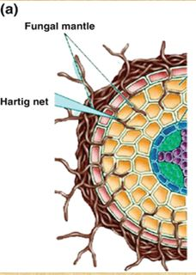
ECTOMYCORRHIZA

Slide 12
Endomycorrhiza
The endomycorrhizae penetrate the living cells of the root cortex.
In this type the fungal structure is almost entirely within the host root mycorrhizas consist of coils of hyphae within roots of orchidaceous plants.

Slide 13
VESICULAR ARBUSCULAR MYCORRHIZA
The predominant type of endomycorrhiza is Vesicular-Arbuscular Mycorrhizas (VAM ).
Vesicular-Arbuscular Mycorrhizas (VAM ) are associations where fungal hyphae produce arbuscules, and vesicles within root cortex cells.

Slide 14
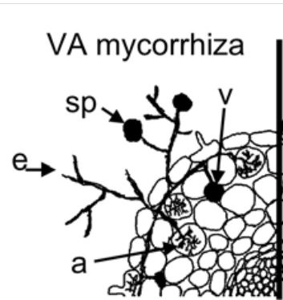

Slide 15
Functions of mycorrhiza
The major advantage that a mycorrhizal association confers to plant and fungus is the enhanced supply of nutrients (carbon, phosphorous and nitrogen )that would not normally available to plant roots.
Mineral nutrients such as potassium, calcium, copper, zinc and iron are also assimilated more quickly and in greater amounts by mycorrhizal plants.
The mycorrhizal fungi also aids in soil aggregation, which can increase water filtration and gas exchange within the soil.
They offer protection to plants and provides increased root surface area.

Slide 16
24Benefits to fungi-
Plants transfer metabolites to fungus.
While aiding plants in the uptake of nutrients and water, the plants give ten to twenty percent of the carbon they obtain from photosynthesis to the fungus.
Mycorrhizal infection enhances plant growth, by increasing nutrient uptake in up to three ways.
By increasing the surface area of absorption within the soil.
By mobilising sparingly-available nutrient sources from unavailable compound.
By excreting chelating compounds or ectoenzymes.

Slide 17
Benefits of mycorrhizal association
Mycorrhizae create a symbiotic relationship between a plant and a fungus where both organisms benefit from the interaction.
Both the plant and fungi get benefit in different ways - Mycorrhizae create a connection between the roots of a plant and with the soil around them, which allows the fungus to uptake nutrients beneficial for plants.
Mycorrhizal interaction can lead to an increase in the growth of the plant.

