Slide 1
Representation of data
Subject Name - Genetics and biostatistics
Subject Code – 17UMBA51
Semester – V
Programme- B.Sc Microbiology
Ms.Musbira banu. M
Assistant professor
Department of Microbiology
HKRH College

Slide 2
Representation of data

Slide 3
INTRODUCTION
Once data has been collected, it has to be classified and organized in such a way that it becomes easily readable and interpretable, that is, converted to information.
Before the calculation of descriptive statistics, it is sometimes a good idea to present data as tables, charts, diagrams or graphs.
Most people find ‘pictures’ much more helpful than ‘numbers’ in the sense that, in their opinion, they present data more meaningfully.
In this course, we will consider the various possible types of presentation of data and justification for their use in given situations.

Slide 4
Method of representation
Two method:
Diagrammatical representation
1. Bar diagram
2. Pie chart
Graphical representation

Slide 5
Bar diagram
The bar chart is one of the most common methods of presenting data in a visual form.
Its main purpose is to display quantities in the form of bars.
A bar chart consists of a set of bars whose heights are proportional to the frequencies that they represent.
Note that the figure may be drawn horizontally or vertically. There are different types of bar charts, depending on the number of variables and the type of information to be displayed.

Slide 6
Types of bar diagram
1.Simple bar chart
2.Multiple bar chart
3.Component Bar chart

Slide 7
Simple bar chart
The simple bar chart is used for the case of one variable only.
our variable is age. Example
Age of the students (Variables) | Number of students (Frequency)
19 | 14
20 | 23
21 | 134
22 | 149
23 | 71
24 | 8

Slide 8
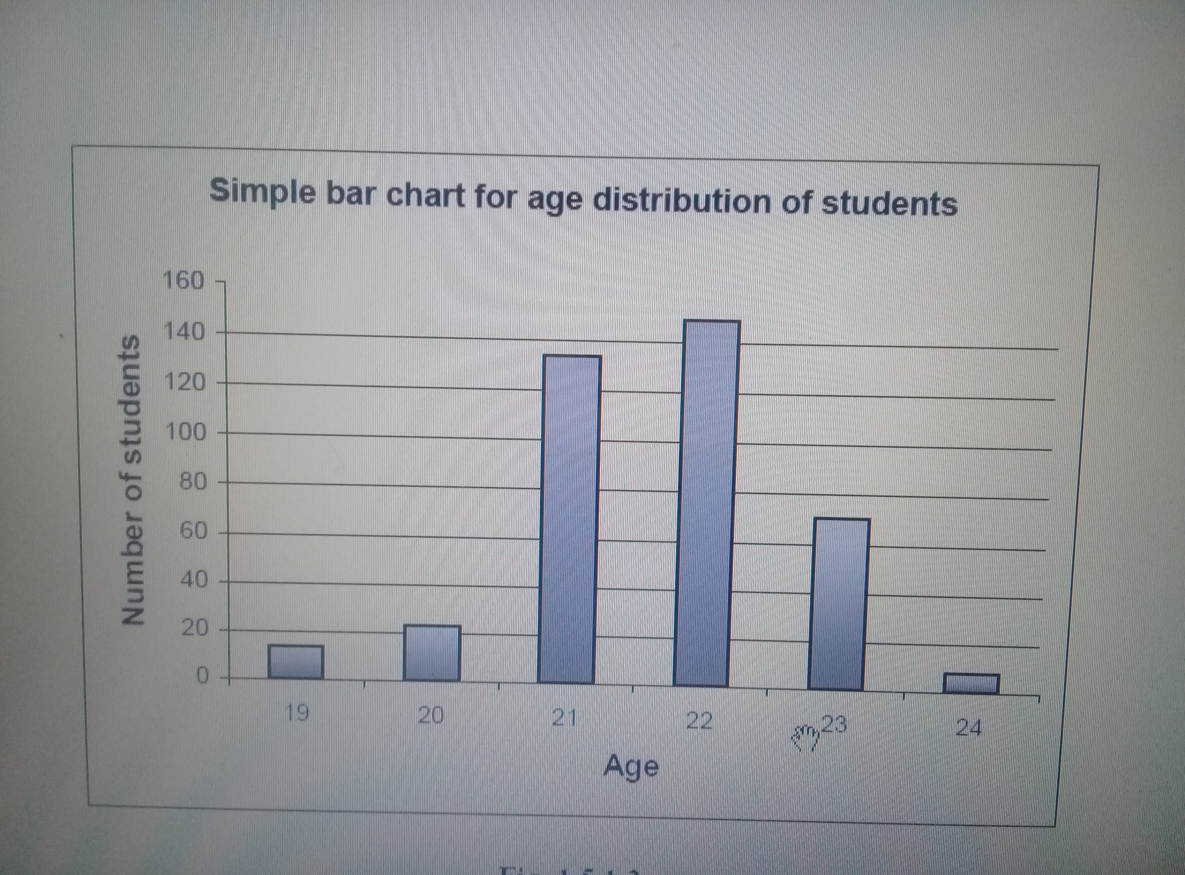

Slide 9
Multiple bar chart
The multiple bar chart is an extension of a simple bar chart .
when there are quantities of several variables to be displayed.
The bars representing the quantities for the different variables are piled next to one another for each attribute.

Slide 10
Example,
UNISA 2004 results for first-year DCDMBS students
 |  | Course
Result | B.A | B.COM | B.SC
Pass | 37 | 25 | 33
Supp | 5 | 10 | 4
Fail | 11 | 8 | 27

Slide 11
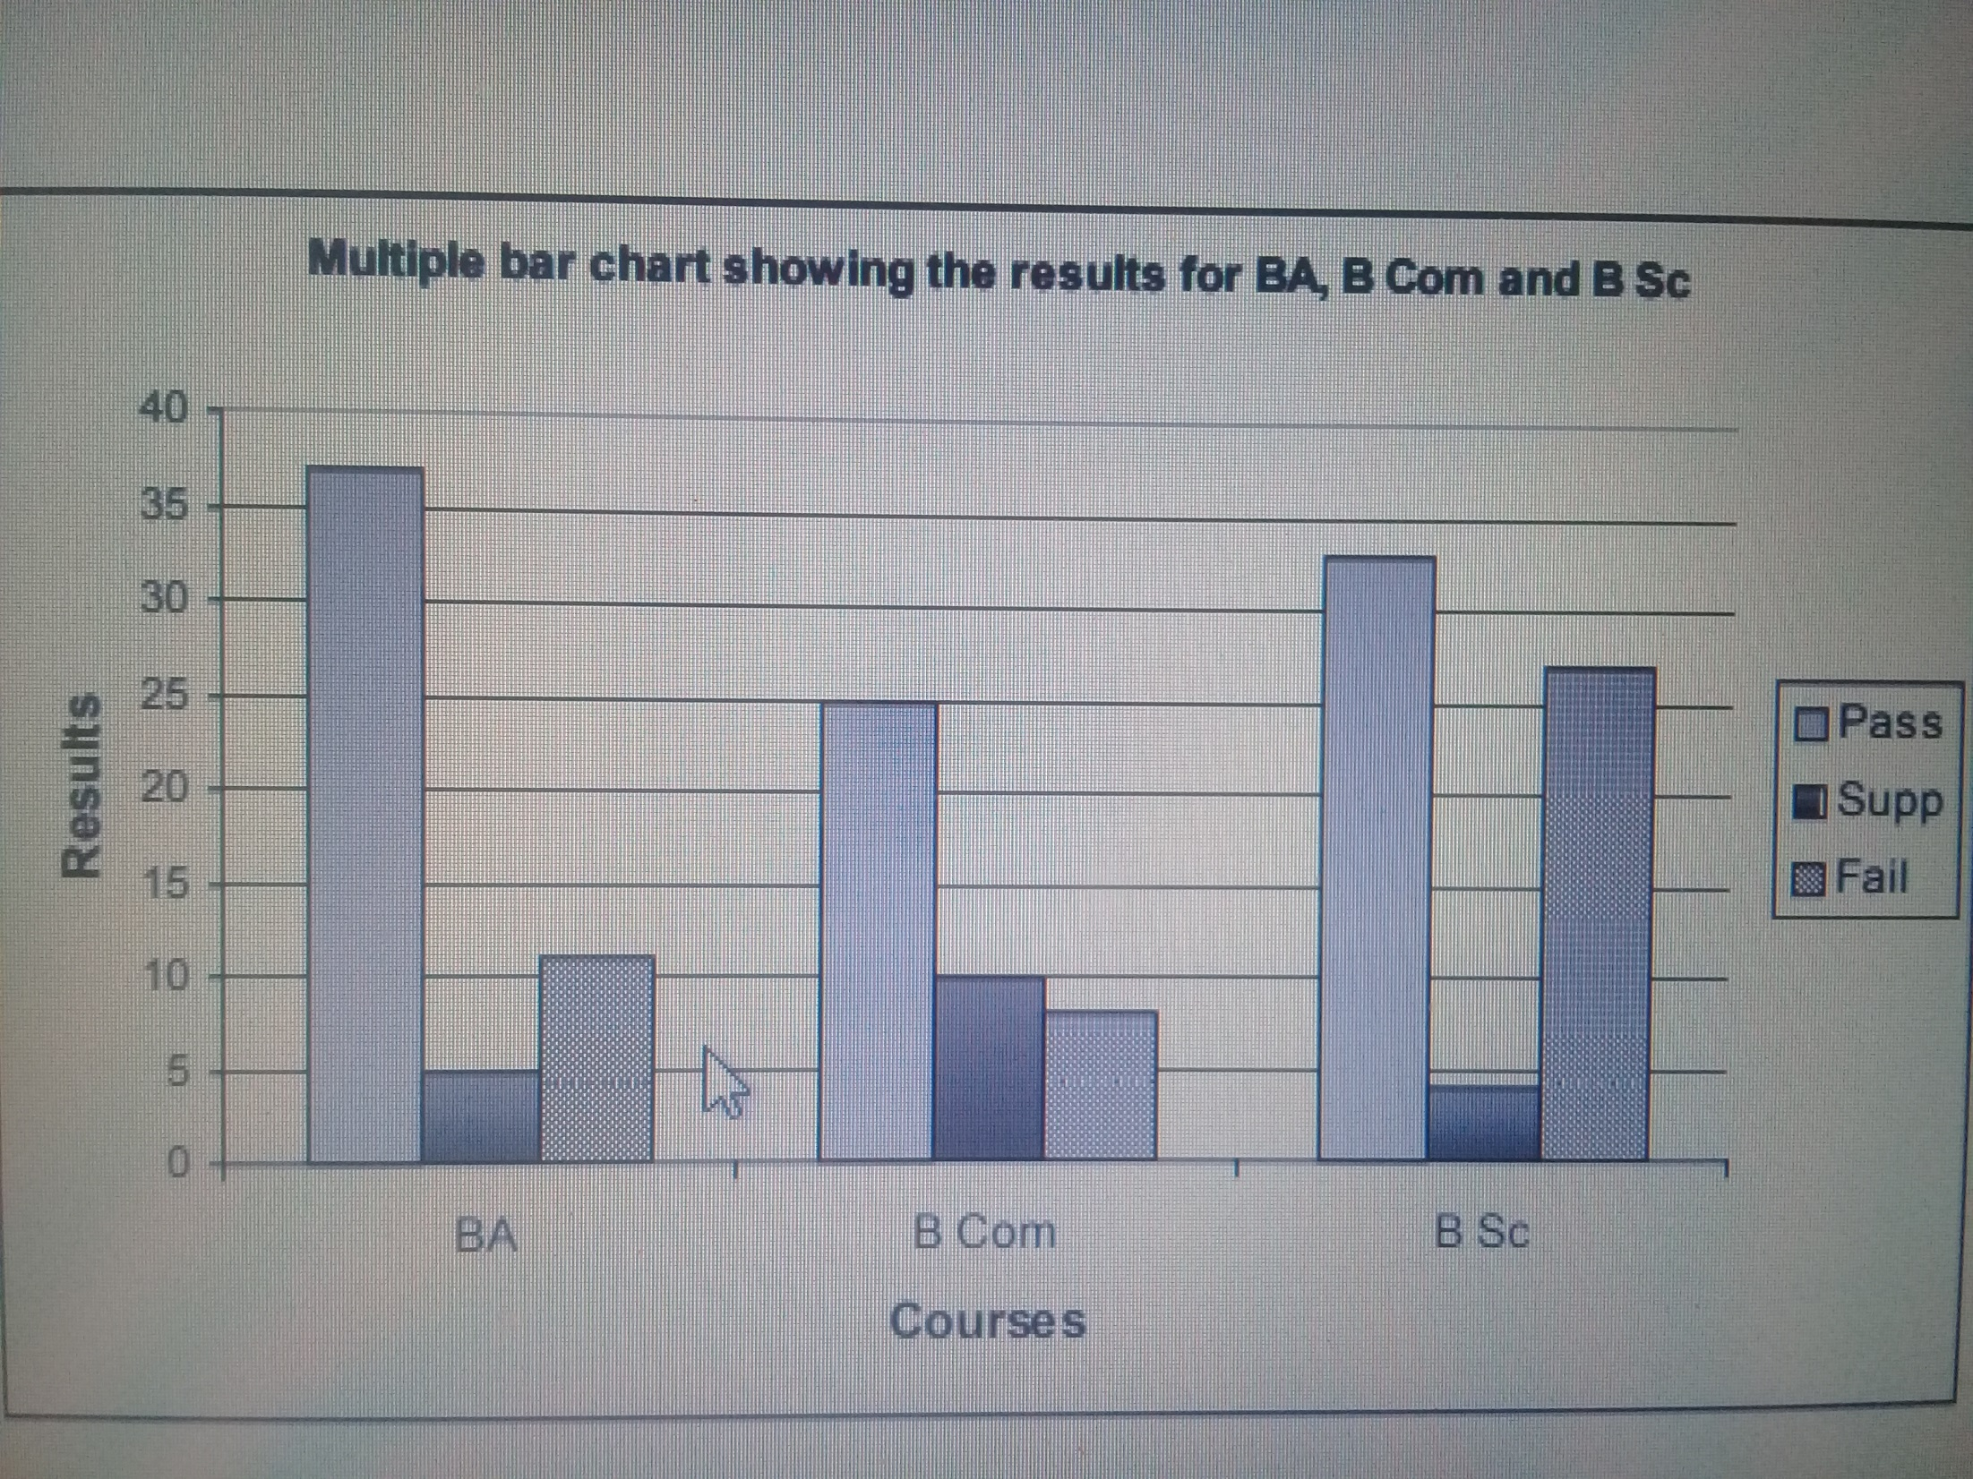

Slide 12
Component bar chart
In this type of bar chart, the components (quantities) of each variable are piled on top of one another.
Example//////
RESULT |  | Course
 | B.A | B.COM | B.SC
PASS | 37 | 25 | 33
SUPP | 5 | 10 | 4
FAIL | 11 | 8 | 27

Slide 13
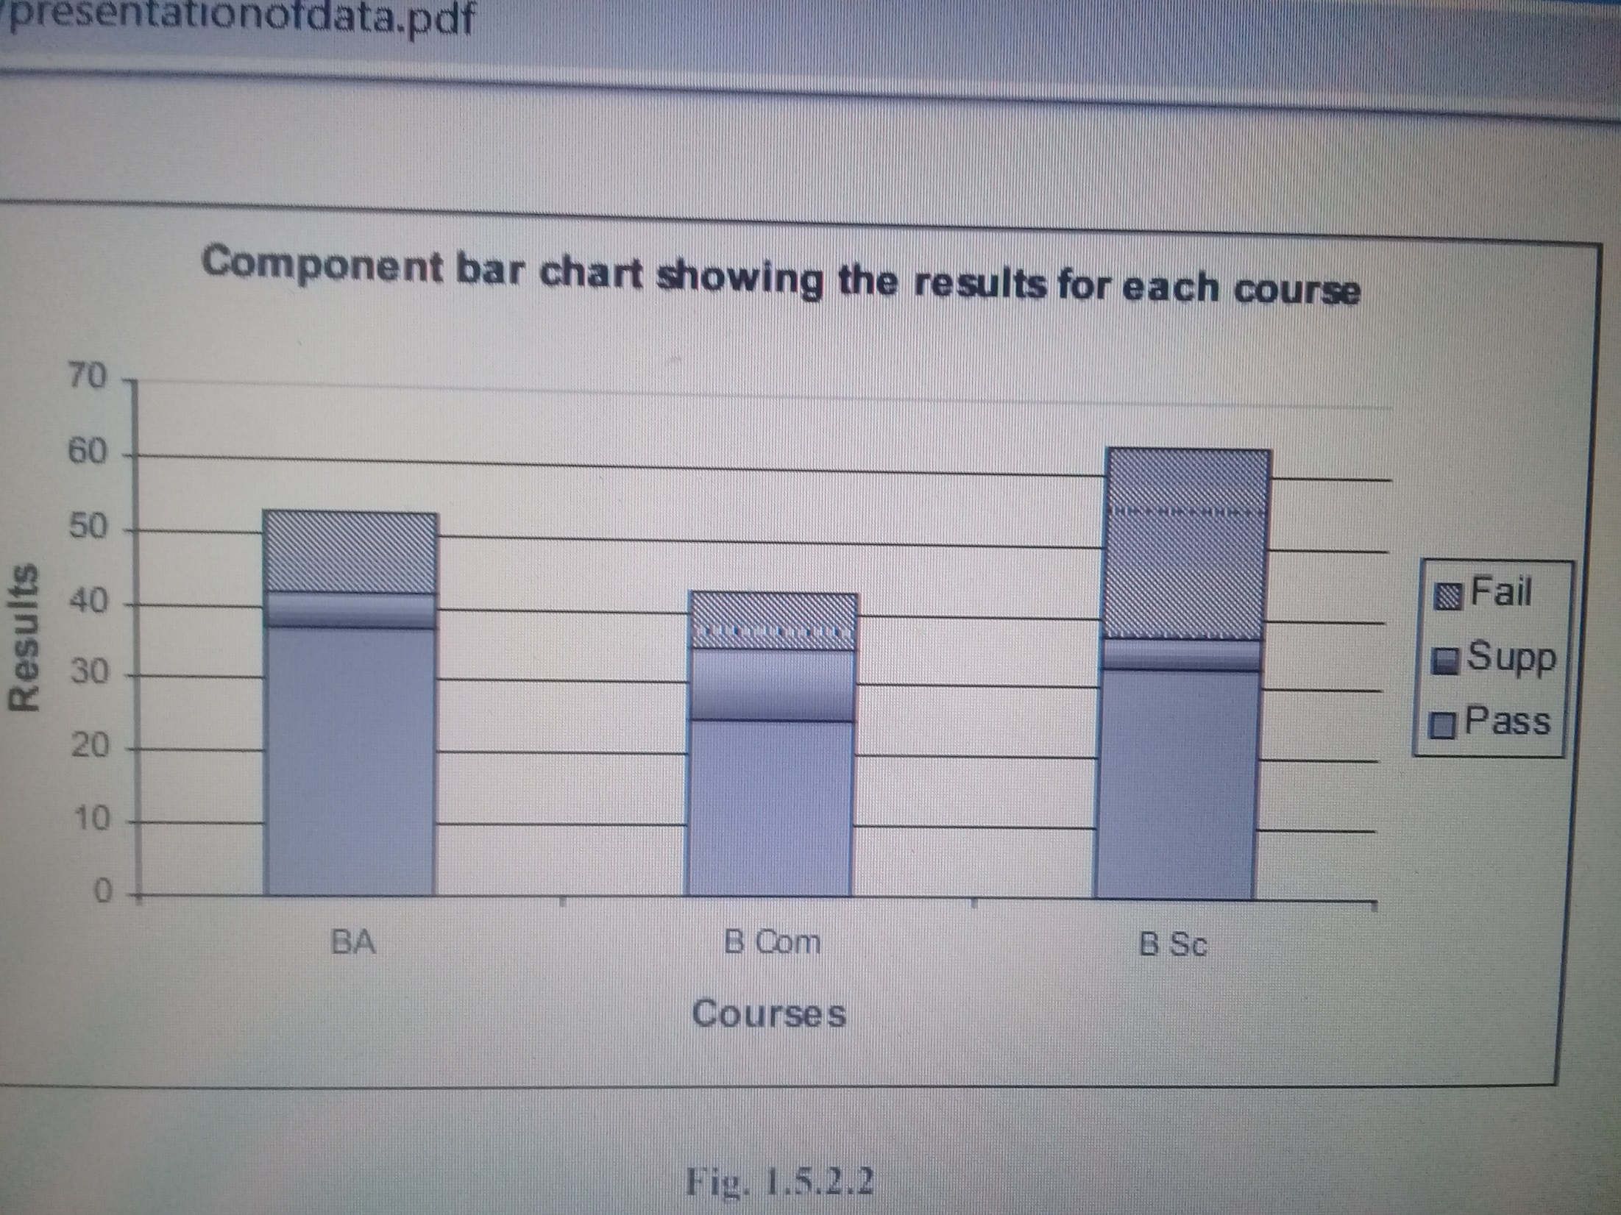

Slide 14
PIE CHARTS
A pie chart or circular diagram is one which essentially displays the relative figures (proportions or percentages) of classes or strata of a given sample or population.
It only shows the relative sizes of classes.
It involves calculation of angles of sectors and drawing them accurately.
It is sometimes difficult to compare sectors sizes accurately by eye.

Slide 15
TYPES OF PIE CHART
1.Simple pie chart
2.Enhanced pie chart

Slide 16
Simple pie chart
Example Using the same data from BAR CHART but this time, including the total number of students enrolled for BA, B Com and B. Sc, we shall now display the distribution of students for these three courses the population.
RESULT |  | COURSE
 | B.A | B.COM | B.SC
PASS | 37 | 25 | 33
SUPP | 5 | 10 | 4
FAIL | 11 | 8 | 27
TOTAL | 53 | 43 | 64

Slide 17
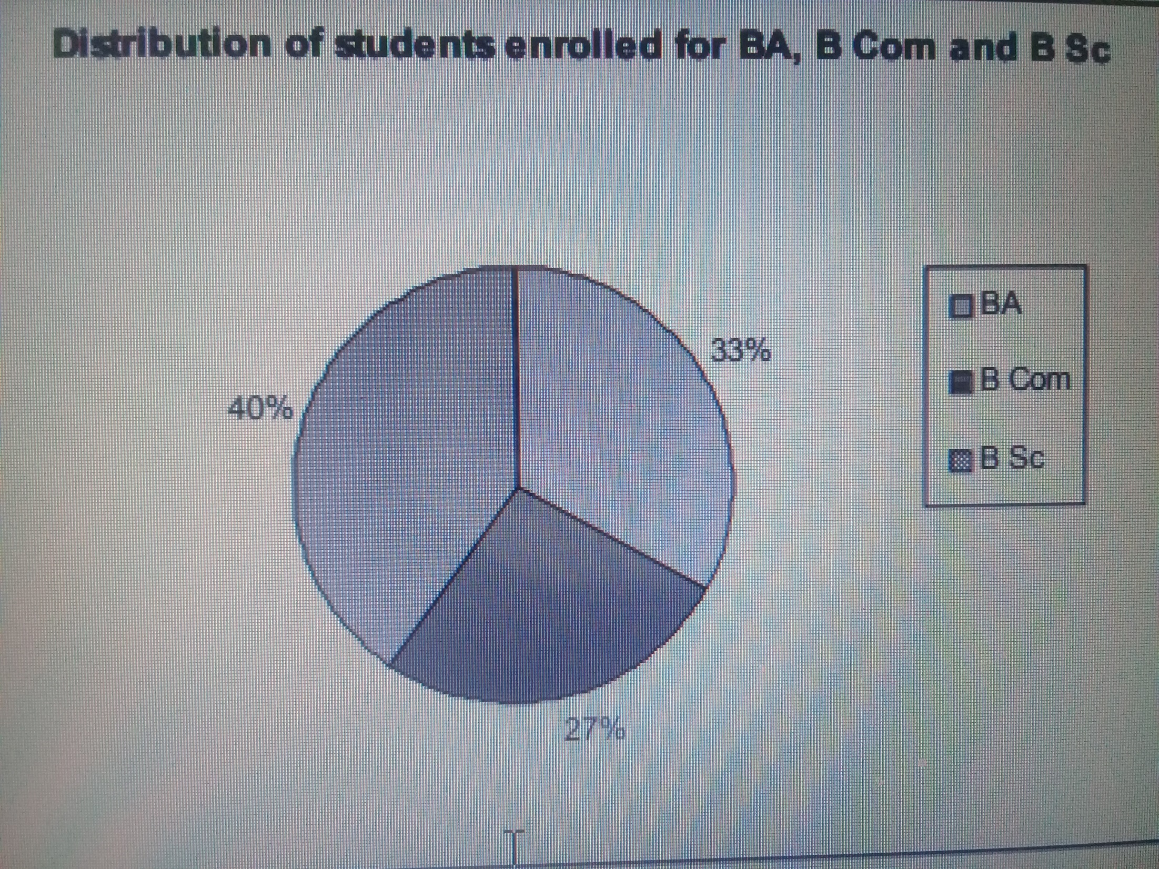

Slide 18
Enhanced pie chart
This is just an enhancement (as the name says itself) of a simple pie chart in order to lay emphasis on particular sector.
Example Again, using the same data from BAR CHART TABLE but this time, including the total number of students enrolled for BA, B Com and B Sc, we shall now display the distribution of students for these three courses the population.

Slide 19
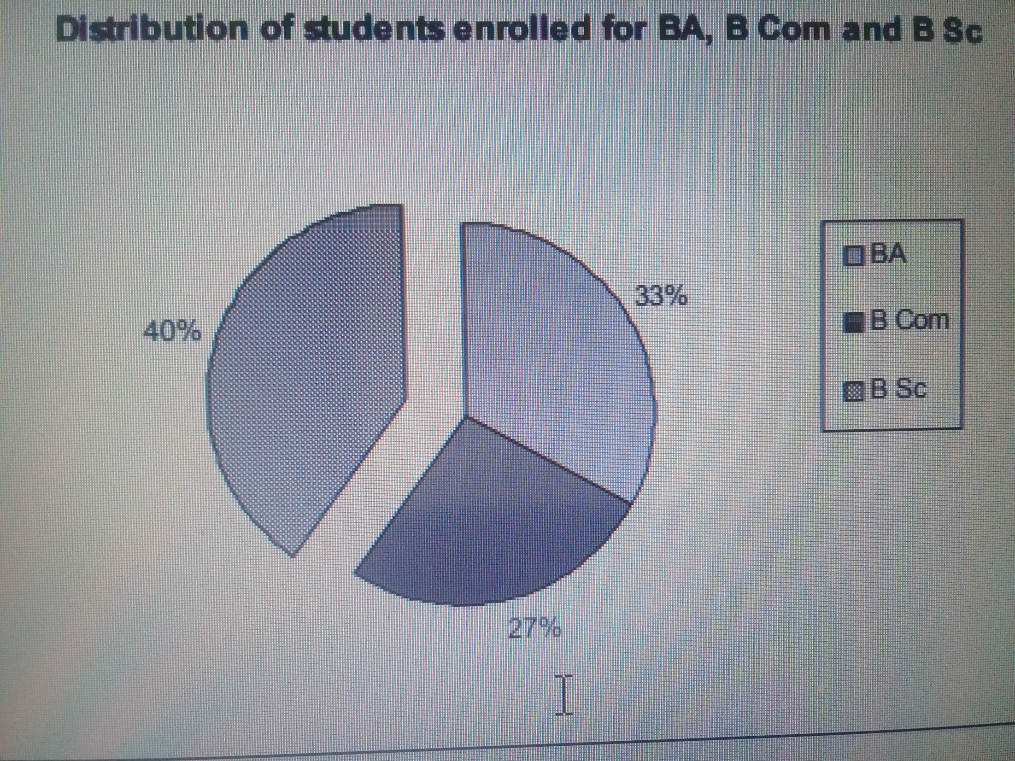

Slide 20
Graphical representation
There are three methods as will follow,
1.Histogram
2. Frequency curve
3. Cumulative frequency curve

Slide 21
Histogram
Out of several methods of presenting a frequency distribution graphically, the histogram is the most popular and widely used in practice.
A histogram is a set of vertical bars whose areas are proportional to the frequencies of the classes that they represent.

Slide 22
The histogram should be clearly distinguished from the bar chart. The most striking physical difference between these two diagrams is that, unlike the bar chart, there are no ‘gaps’ between successive rectangles of a histogram

Slide 23
Types of histogram
bimodal distribution: In a bimodal distribution, there are two peaks. In a bimodal distribution, the data should be separated and analyzed as separate normal distributions.

Slide 24
Right-skewed Distribution: A right-skewed distribution is also called a positively skewed distribution. In a right-skewed distribution, a large number of data values occur on the left side with a fewer number of data values on the right side. A right-skewed distribution usually occurs when the data has a range boundary on the left-hand side of the histogram. For example, a boundary of 0.

Slide 25
left-skewed distribution: A left-skewed distribution is also called a negatively skewed distribution.

Slide 26
Random distribution: A random distribution lacks an apparent pattern and has several peaks. In a random distribution histogram, it can be the case that different data properties were combined. Therefore, the data should be separated and analyzed separately.

Slide 27
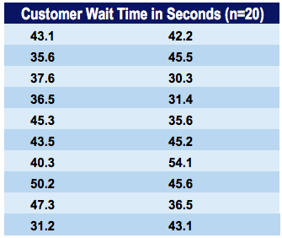
Example of a Histogram
Jeff is the branch manager at a local bank. Recently, Jeff’s been receiving customer feedback saying that the wait times for a client to be served by a customer service representative are too long. Jeff decides to observe and write down the time spent by each customer on waiting. Here are his findings from observing and writing down the wait times spent by 20 customers:

Slide 28
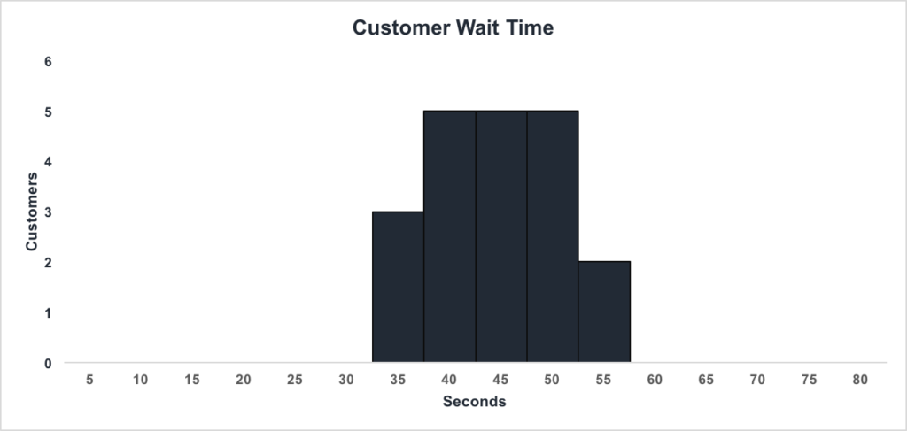
We can see that:
There are 3 customers waiting between 1 and 35 seconds
There are 5 customers waiting between 1 and 40 seconds
There are 5 customers waiting between 1 and 45 seconds
There are 5 customers waiting between 1 and 50 seconds
There are 2 customers waiting between 1 and 55 seconds

Slide 29
Frequency curve
A frequency-curve is a smooth curve for which the total area is taken to be unity. It is a limiting form of a histogram or frequency polygon.
The frequency-curve for a distribution can be obtained by drawing a smooth and free hand curve through the mid-points of the upper sides of the rectangles forming the histogram.

Slide 30
Types of frequency curves
There exist four types of frequency-curves namely
(a) Bell-shaped curve
(b) U-shaped curve
(c) J-shaped curve
(d) Mixed curve.
This all types according to the result of the graphical curve…

Slide 31
Example
Class intervals | 0-10 | 10-20 | 20-30 | 30-40 | 40-50 | 50-60 | 60-70 | 70-80
Frequency | 7 | 11 | 17 | 25 | 21 | 19 | 9 | 5

Slide 32
Cumulative frequency curve
A curve that represents the cumulative frequency distribution of grouped data on a graph is called a Cumulative Frequency Curve or an Ogive.
Representing cumulative frequency data on a graph is the most efficient way to understand the data and derive results.

Slide 33
In the graph, put the lower limit on the x-axis
Mark the cumulative frequency on the y-axis.
Plot the points (x,y) using lower limits (x) and their corresponding Cumulative frequency (y)
Join the points by a smooth freehand curve. It looks like an upside down S.

Slide 34
EXAMPLE
VARIABLES (X) | FEQUENCY | CUMULATIVE FREQUENCY
1 | 3 | 3
2 | 16 | 3+16=19
3 | 27 | 19+27=46
4 | 29 | 46+29=75
5 | 31 | 75+31=106
6 | 37 | 106+37=143
7 | 42 | 143+42=185
TOTAL | 185

Slide 36
THANK YOU

