Slide 1
Yeast
Subject Name – General Biology
Subject Code – 17UMBA31
Semester – IV
Programme- B.Sc Microbiology
Ms.Musbira banu. M
Assistant professor
Department of Microbiology
HKRH College

Slide 2
Yeast

Slide 3
INTRODUCTION
Yeasts are eukaryotic, single- celled microorganisms
classified as members of the fungus kingdom.
The first yeast originated hundreds of millions of years ago, and at least 1,500 species are currently recognized
Yeasts are unicellular organisms that evolved from multicellular
some species having the ability to develop multicellular characteristics by forming strings of connected budding cells known as pseudohyphae or false hyphae.
Yeast sizes vary greatly, depending on species and environment, typically measuring 3–4 µm in diameter, although some yeasts can grow to 40 µm in size

Slide 4
GENERAL CHARACTERS
yeast specie Saccharomyces cerevisiae
converts
carbohydrates
to
carbon dioxide and alcohols
process known as
fermentation.
The products of this reaction have been used in baking and the production of alcoholic beverages

Slide 5
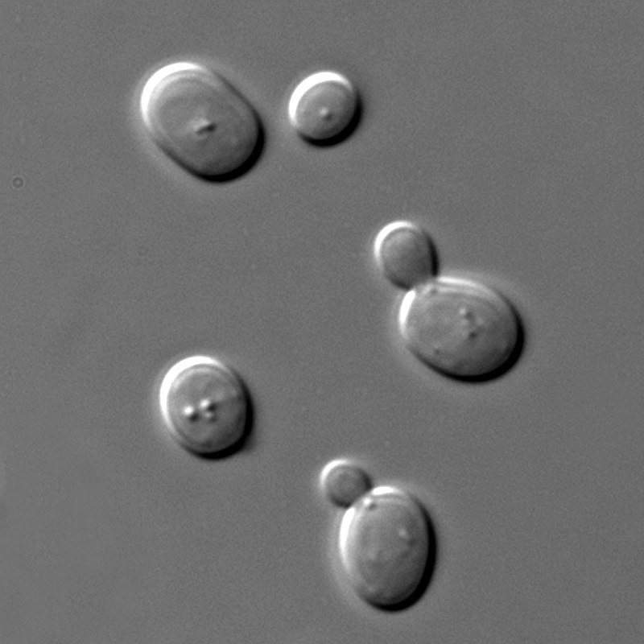
Other species of yeasts,
such as Candida albicans, are opportunistic pathogens
The term "yeast" is often taken as a synonym for Saccharomyces cerevisiae,

Slide 6
STRUCTURE OF YEAST

Slide 7
Vegetative Structure of Yeast

Slide 8
Antony Von Leeuwenhoek (1680) was the first to describe the yeast cells. Its thallus is unicellular and non-mycelial
Generally, the shape of cells may vary from circular, spherical, oval, elliptical, elongated, rectangular, dumb-bell shaped to triangular.
The cells are hyaline (colourless) but its colonies appear white, cream-coloured or light brown.
The cell wall is double layered, thin, delicate and flexible. It is composed of two complex polysaccharides, mannan (30%) and glucan (30-40%) with smaller quantities of protein (6-8%), lipid (8.5 – 10-5%) and chitin (2%). Cellulose is absent.
Electron microscopic studies of ultra-thin sections of S. cerevisiae and of S. octosporus show that the nucleus is surrounded by a nuclear membrane and is distinct from the vacuole.

Slide 9
Nutrition of yeast
Yeast is heterotrophic and saprophytic in nature.
Its protoplasm secretes two types of enzymes:
(i) Invertase:
Hydrolyses cane sugar to dextrose or inner sugar, which diffuses into cytoplasm through semipermeable membrane. It is used as a food.
(ii) Zymase:
Converts rest of the sugars into CO₂ and alcohol by a process known as fermentation. Energy released in this process is used up by cell in various processes going on within the cell.

Slide 10
Reproduction in Yeast:
Yeast reproduces are two methods like,,,
1. Vegetative reproduces,
2.Asexual reproduces and
3.Sexual reproduces methods.
Vegetative Reproduction:
It takes place by two methods i.e.,
(i) Budding and
(ii) Fission.

Slide 11
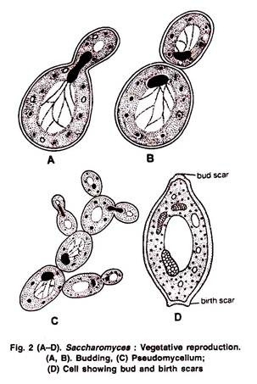
(i) Budding
This is the most common method of reproduction in the yeasts and takes place in favourable environmental conditions.
In this process the protoplasm of the cell, covered by a thin membrane, pushes out of the cell wall in the form of a bud and forms a daughter cell.
The bud enlarges and receives the mitochondria which migrate from the parent mother cell much before the nucleus.
nucleus also elongates and divides
into two, and one of the daughter nculei
passes into the bud

Slide 12
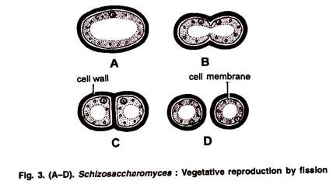
(ii) Fission:
Yeasts are also called fission yeasts because they reproduce by fission e.g., Schizosaccharomyces octosporus.
Yeast cells undergo fission by transverse division . The parent cell elongates, the nucleus divides and a transverse wall (septum) develops centripetally.
i.e., from periphery towards center, thus separating the two daughter uninucleate cells
The transverse wall thickens and then splits into two layers for each daughter cell before they separate.

Slide 13
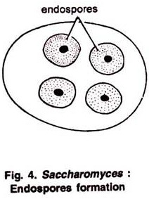
Asexual Reproduction:
Under starved conditions, the nucleus of the yeast cell divides mitotically into four nuclei.
Cytoplasm gathers around the nucleus and each develops a thick wall. This structure is called endospore .
The endospores are capable of tiding over unfavorable period and under favourable conditions they again give rise to yeast cells.

Slide 14
Sexual Reproduction:
Yeasts reproduce sexually when conditions are un-favourable for vegetative reproduction.
The sexual reproduction is very simple and the sexual reproductive organs
i.e., the antheridia and oogonia are absent.
Yeasts may be homo-or heterothallic and the sexual union takes place either between two somatic cells or between two ascospores which assume the function of copulating gametangia.
Three phenomena characteristic of the sexual process namely, 1.Plasmogamy, (union of cytoplasmic material)
2.Karyogamy (union of nuclear material), and 3.Meiosis take place either between two somatic cells or between two gametangia,
produce a zygotic cell. This zygotic cell act as an ascus and produces 4 to 8 ascospores.

Slide 15
Three types of life cycles:
(i) Haplobiontic life cycle e.g., Schizosaccharomyces octosporus.
(ii) Diplobiontic life cycle e.g., Saccharomycodes ludwigii.
(iii) Haplo-diplobiontic life cycle e.g., Saccharomyces cerevisiae.
Haplobiontic life cycle:
The cells of Schizosaccharomyces octosporus are haploid (x), and diploid (2x) phase is very short in the life cycle.
The diploid phase is represented only by the zygotic cell. The cells are uninucleate, elongated, homothallic and act as gametangium at maturity

Slide 17
(ii) Diplobiontic life cycle
The cells of Saccharomycodes ludwigii are diploid (2x), and haploid (x) phase is represented only by ascospores eventually enlarges to function as an ascus
During sexual reproduction the diploid nucleus divides meiotically forming 4 haploid ascospores . Two adjacent ascospores of opposite mating type (‘+’ and ‘-‘) fuse (plasmogamy and karyogamy) within the ascus and form a diploid cell.

Slide 19
(iii) Haplo-Diplobiontic Life Cycle:
This type of life cycle is represented by Saccharomyces cerevisiae.
In this life cycle both haploid (x) and diploid (2x) phases are of fairly long duration because both the haploid and diploid cells are capable of multiplication by budding (Fig. 7 B, G).
There are two types of somatic cells in S. cerevisae called ‘Dwarf strain’ and ‘large strain’ cells.

Slide 21
THANK YOU

