Slide 1
Unit II
Dr. T.K.THIRUMALAISAMY
Associate Professor
P.G. Department of Physics
H.K.R.H.College
Uthamapalayam
Ecology and Ecosystem concepts

Slide 2
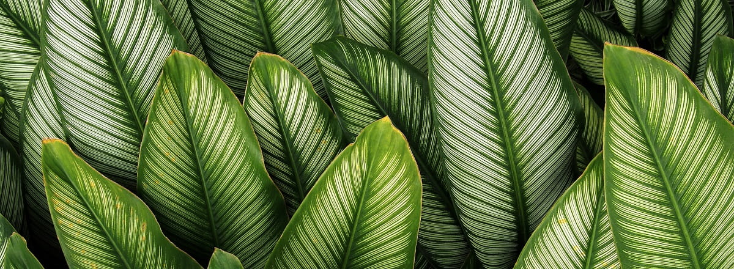
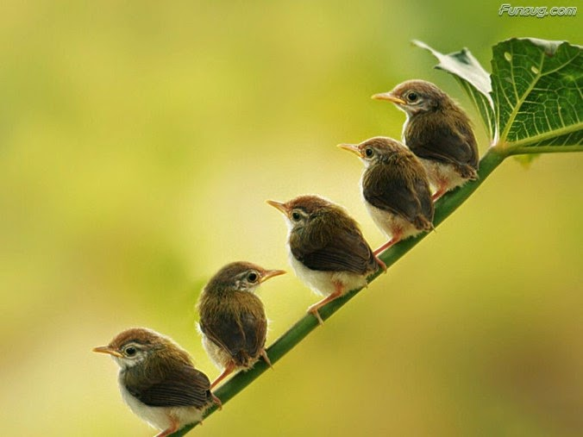
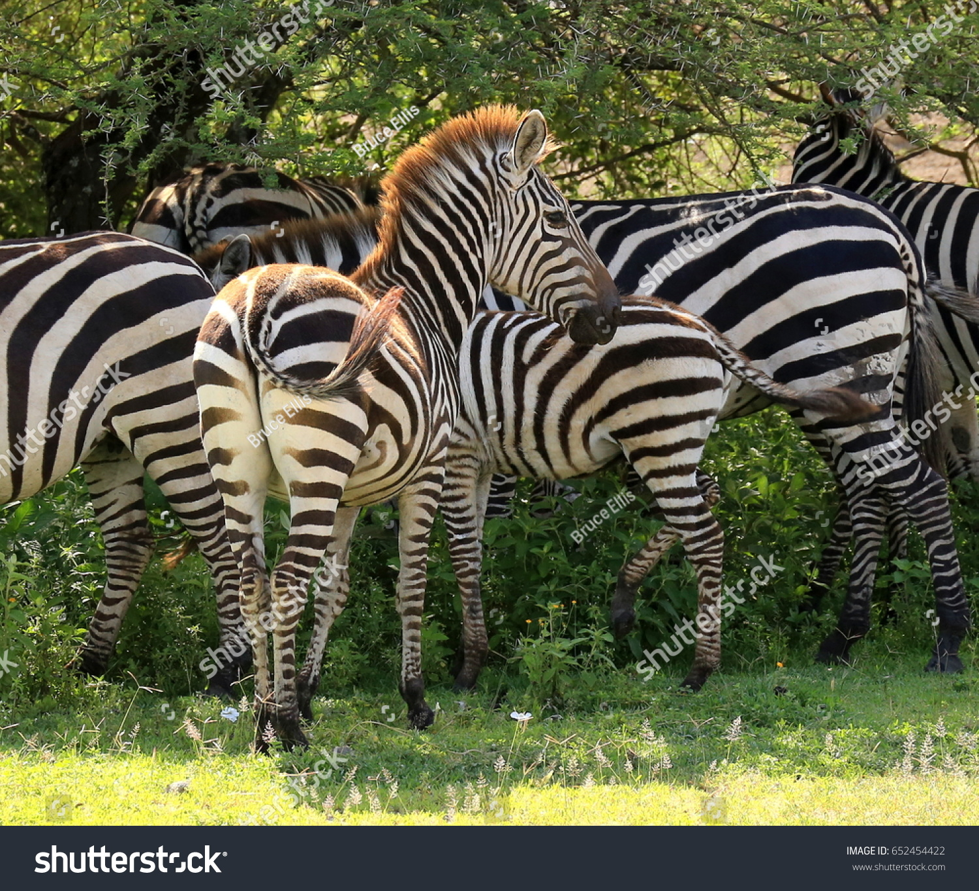
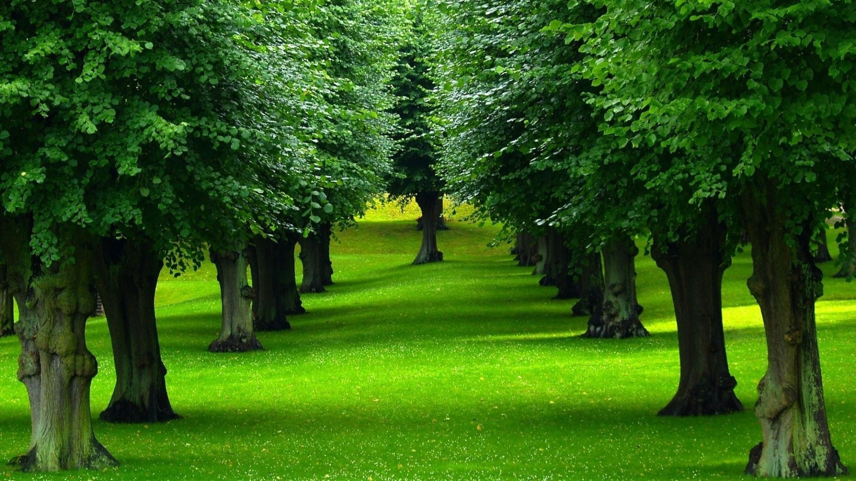
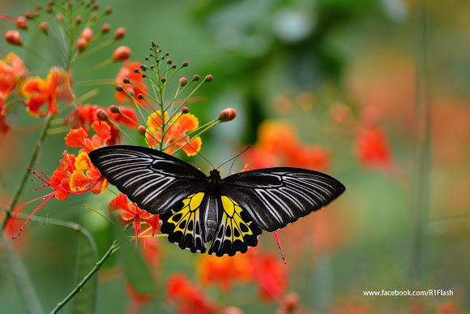

Slide 3
The structure of an ecosystem consists of abiotic and biotic components.

Slide 4
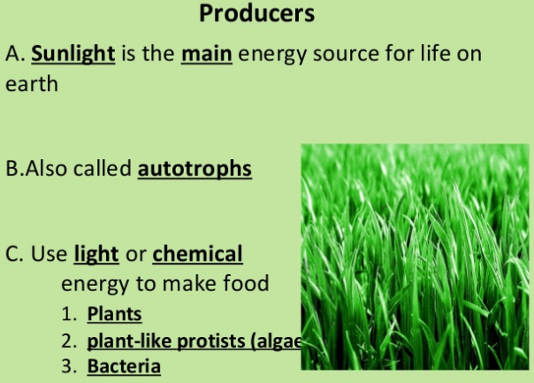

Slide 13
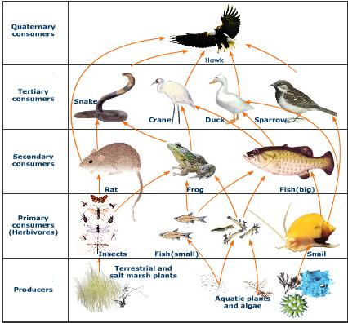

Slide 14
Producers | Decomposers
Primary consumers (Herbivores)
Secondary consumers (Carnivores)
Tertiary consumers (Carnivores)

Slide 15
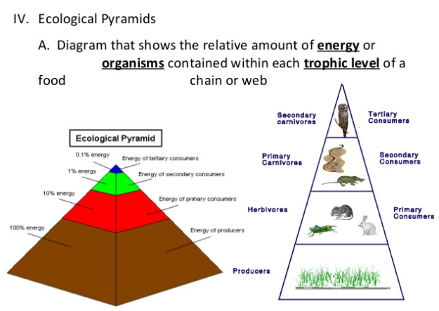

Slide 16
THANK YOU

