Slide 1
BIOSTATISTICS CENREAL TENDENCIES: MEAN.MEDIAN & MODE
Dr. K. Arifa banu, Assistant Professor of Zoology Hajee Karutha Rowther Howdia College, Uthamapalayam

Slide 2
AVERAGES
Mean, median, and mode are three kinds of “averages”. There are many Averages in statistics, but these are, the three most common

Slide 3
ARITHMATIC MEAN
The “mean” is the “average” you’re used to, where you add up all the numbers and then divide by the number of numbers.
Types
Individual
Discrete
Continuous Series

Slide 4
Individual series
It refers to the average of a set of values.
To find the mean is sum of all the values in the set divided by total number of values in the set.
Mean = Sum of all values/total number of values
Example 1: The set S = { 5,10,15,20,30}, Mean of set S = 5+10+15+20+30/5 = 80/5 = 16

Slide 5
Discrete series
Discrete series means where frequencies of a variable are given but the variable is without class intervals.
Weight (X) inGram | 20 | 22 | 25 | 27 | 30 | 32 | 40
Frequency(f) | 20 | 28 | 30 | 18 | 19 | 15 | 10

Slide 6
Steps
Each frequency(f) is multiplied by the variable(x)
Taking the total ∑fx
Dividing total by total number of frequencies
Symbolically,
X = ∑fx/N
Where
f = frequency,
X = the value of the variable
N = the sum of frequency or N = ∑f

Slide 7
Mean - Discrete
Weight In Gram (X) | Frequency (f) | fx
20 | 20 | 400
22 | 28 | 616
25 | 30 | 750
27 | 18 | 486
30 | 19 | 570
32 | 15 | 480
40 | 10 | 400
Total | N(or)∑f=140 | ∑fX =3702

Slide 8
Calculation
X = ∑fx/N
X = 3702 / 140 = 26.44

Slide 9
Mean – Continuous series
In Continuous series the variable in the form of class interval. Income of persons in thousands
Income (x) | 10-20 | 20-30 | 30-40 | 40-50 | 50-60 | 60-70
No.of persons(f) | 4 | 7 | 16 | 20 | 15 | 8

Slide 10
Steps
i) 10-20, 20-30 … etc. are class intervals.
(ii) 3, 7, 11, 9, 6 is known as their respective frequencies.
(iii) In 20-30, 30-40…. etc. 20 is the lower and 30 the upper limit of 20-30 class interval.
(iv) Adding both the limits and taking their average, we get midpoint of the class interval. The mid-value of 20-30 is ; 20+30/2 = 25. It is often denoted by m or X.
When we take mid points of class Intervals, it can be denoted by X, m or M X can be found by three methods.

Slide 11
calculation
Income(x) | Mid value(m) | No. of Persons(f) | fm
10-20 | 15 | 4 | 60
20- 30 | 25 | 7 | 175
30 -40 | 35 | 16 | 560
40 -50 | 45 | 20 | 900
50- 60 | 55 | 15 | 825
60 - 70 | 65 | 8 | 520
 |  | ∑f (or)N = 70 | ∑fm = 3040

Slide 12
calculation
X = ∑fm/N
X = 3040 / 70 = 43.43

Slide 13
problems
The number of trees planted by Eco-club of a school in different years is given below.
year 2005 2006 2007 2008 2009 2010
Number of50 220 350 400 300 380
Trees to be
Planted

Slide 14
MEDIAN-individual
Median signifies the middle value in a sorted list of numbers.
To calculate median, the data has to be sorted in ascending or descending order.
Eg: 1. Find the median of the data set { 2,4,4,3,8,67,23 }
Eg : 2. Find the median of the data set
{ 11,22,33,55,66,99 }

Slide 15
Solution
Eg: 1
First Arranged the Data set { 2,4,4,3,8,67,23 } in ascending(or) descending order = {2,3,4,4,8,23,67}.
The list contains 7 terms, thus 4th term of the list will be the median, so the median is 4.

Slide 16
Solution
Eg:2
Arrange the data set { 11,22,33,55,66,99 }
The list contains 6 terms, hence the average of the third and fourth term will be the median.
Median = (33+55)/2 = 44.

Slide 17
Other categories
The given sequence is 4,6,8,10,12,14….296
Median = First term + Last term/2
For this sequence, Median = 4+296/2 = 150.
There can be more than one mode in a series. For example, in the set = {2,4,4,6,8,9,9}, both 4 and 9 are the Modes as their frequency of occurrence is more than other values.

Slide 18
Discrete series - Median
Items | 14 | 36 | 45 | 70 | 105 | 145
Frequency | 2 | 5 | 1 | 3 | 12 | 9

Slide 19
Steps
M=Value of (N+1)th item
2
Value of (6+1)th item 2
Value of 3.5th item
Value of (3rd item + 4th item) = (45 + 70)=57.5
2

Slide 20
Median- Continuous
Seconds Frequency
51 – 55 2
56 – 60 7
61 – 65 8
66 – 70 4
The median is the middle value, which in our case is the 11th one, which is in the 61 - 65 group:
We can say "the median group is 61 - 65"
L + (n/2) − BG × w

Slide 21
But if we want an estimated Median value we need to look more closely at the 61 - 65 group.
We call it "61 - 65", but it really includes values from 60.5 up to (but not including) 65.5.
Why? Well, the values are in whole seconds, so a real time of 60.5 is measured as 61. Likewise 64.4 is measured as 65.
At 60.5 we already have 9 runners, and by the next boundary at 65.5 we have 17 runners. By drawing a straight line in between we can pick out where the median frequency of n/2 runners is:

Slide 22
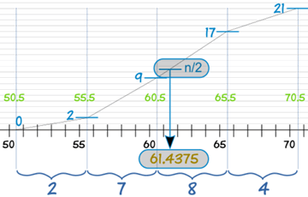

Slide 23
Estimated Median = L + (n/2) − BG × w
where:
L is the lower class boundary of the group containing the median
n is the total number of values
B is the cumulative frequency of the groups before the median group
G is the frequency of the median group
w is the group width

Slide 24
For our example:
L = 60.5
n = 21
B = 2 + 7 = 9
G = 8
w = 5
Estimated Median= L + (n/2) − BG × w
= 60.5 + (21/2) − 98 × 5
= 60.5 + 0.9375
= 61.4375

Slide 25
Mode
“The mode is the value occurring most frequently in a series of items and around which the other items are distributed most densely.” —Zizek

Slide 26
Finding mode
The terms are arranged in any order. Ascending or Descending.
If each term of the series is occurring once, then there is no mode, otherwise the value that occurs Maximum Times is known as Mode.
Mode is often denoted by Z.

Slide 28
Mode - Discrete Series
Finding of mode only by Inspection Method only.
Here that variable is the Mode where the frequency is highest.; But this method is applicable only if
(1) There is a gradual rise or fall in the sequence of frequencies.
(2) The highest frequency and the next highest frequency are not too close
(3) Maximum frequency is not repeated.

Slide 29
Example
X | 4 | 7 | 11 | 16 | 25
f | 3 | 9 | 14 | 21 | 13

Slide 30
Solution:
In the above given series highest frequency is 21 and variable corresponding to i this frequency is 16. Thus Mode (Z) is 16.

Slide 31
Solution:
In the above given series highest frequency is 21 and variable corresponding to i this frequency is 16. Thus Mode (Z) is 16.
*But, however sometimes it becomes impossible to locate Mode by inspection as concentration of frequencies is not in a unique manner or fashion as desired for this method.
For such a distribution we have to prepare (1) grouping Table and (data: ) Analysis Table:

Slide 32
(1) Grouping Table: It has Six Steps as given below.
(1) Frequencies are taken.
(2) Frequencies are added in two(s).
(3) Leaving first item, frequencies are added in two(s)
(4) Frequencies are added in threes.
(5) Leaving first frequency, frequencies are added in three (s)
(6) Leaving first two frequencies, frequencies are added in three (s).
In each case, take maximum total and put it in a circle or a box to distinguish it from others.

Slide 33
(2) Analysis Table:
It has following steps:
Step I. Note highest total in each column.
Step II. Note the variable and/or variable in each column corresponding to that total.
Step III. Check if that total is of individual term or more (2 or 3) terms.
Step IV. If the total consists of 2 or more frequencies, all such variables have to be marked as V or x
Step V. Count a/ or x marks in each column.
Step VI. Variable with maximum √ or x marks denotes mode.

Slide 34
Example problem
X | 5 | 10 | 15 | 20 | 25 | 30 | 35 | 40 | 45
f | 1 | 3 | 4 | 9 | 11 | 12 | 3 | 2 | 2

Slide 35
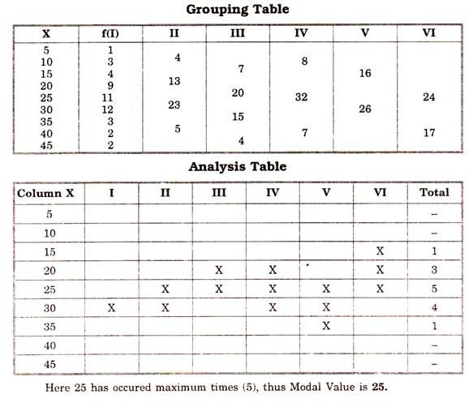

Slide 36
