Slide 1
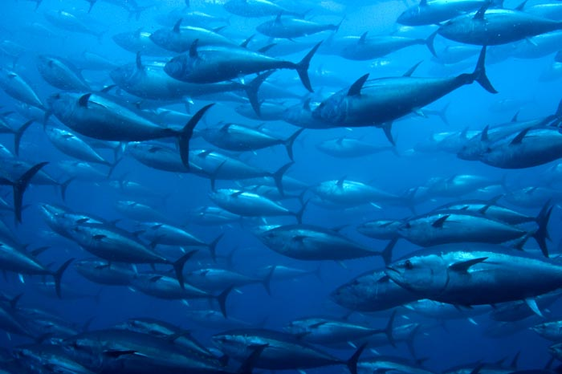
FISH MIGRATION
Dr. M. ASHIQ UR RAHMAN
Assistant Professor of Zoology
Hajee Karutha Rowther Howdia College
Uthamapalayam - 625533

Slide 2
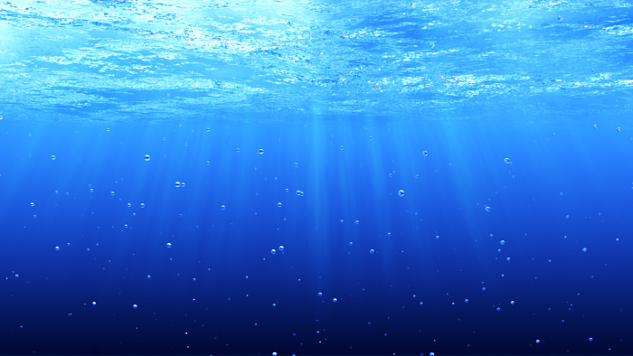
Basic Terms
Migration is the movement of large number of animals from one place to another for feeding, reproduction or to escape weather extremes.
Shoaling:- When large no. of fishes come together and move socially, it is called as shoaling, Eg. Tuna, Anchovies.
Schooling:-Migrating fishes exhibit high degree of coordination in their movements and carry out synchronized maneuvers to produce different types of shapes. This is called schooling.eg. Forage fishes

Slide 3
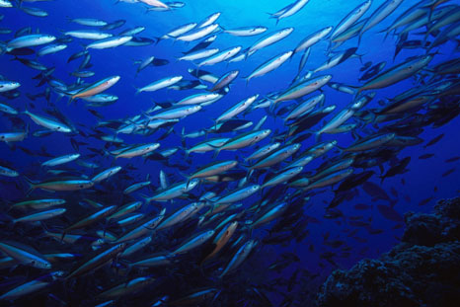

Slide 4
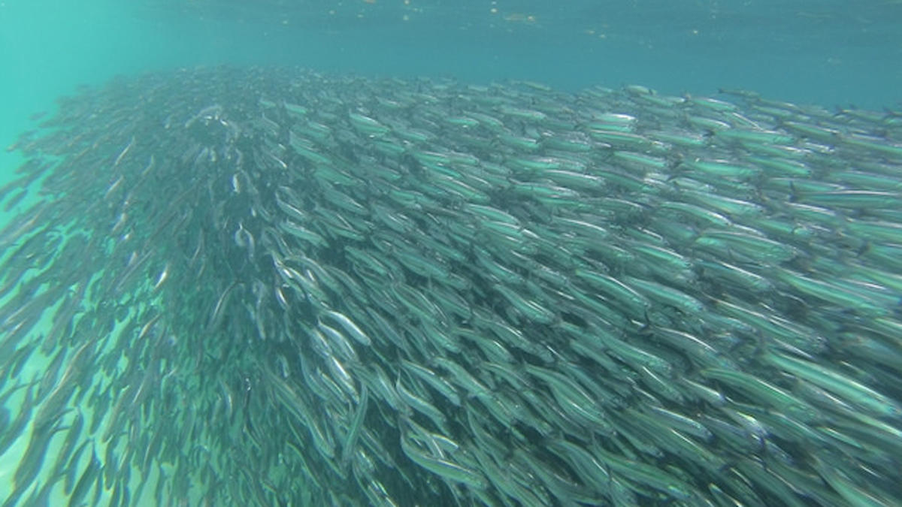

Slide 5
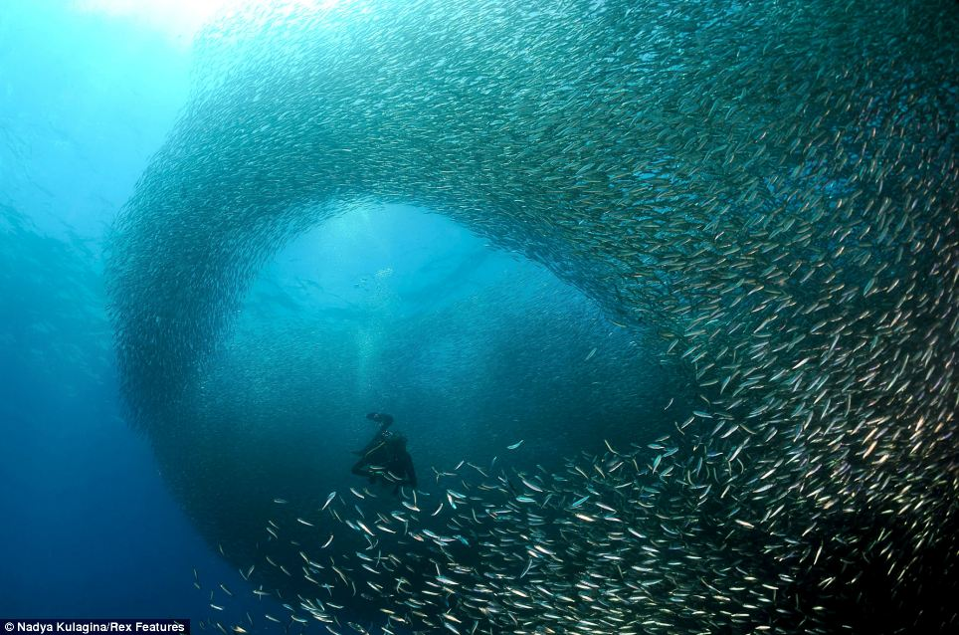

Slide 6
MiGRATION OF FISHES
Long journeys taken by fishes from one place to another and back.
Reasons for migration
Sexual maturity
Hormones
Instinct
Predators and competition
Scarcity of food
Abiotic factors like light, temperature, pH, water currents, etc.

Slide 7
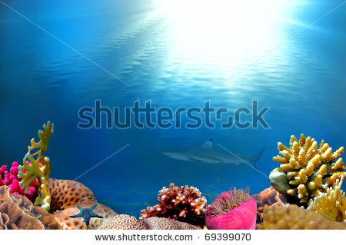
Fishes live in two different types of aquatic habitats:-
Freshwater Habitat
Marine Habitat

Slide 8
Types of migration
Latitudinal migration – north (spring) and south (autumn).
(ii) Oceanodromous migration – from native place to a far off place. Eg. Tunas, mackerels, etc.
(iii) Potamodromous migration – long movement within fresh water. Eg. Carps, trouts.
(iv) Catadromous migration – from fresh water to sea water for spawning (fresh water fishes). Eg. Eels.
(v) Anadromous migration – from sea water to fresh water (marine fishes). Eg. Salmons, Indian shad.

Slide 9
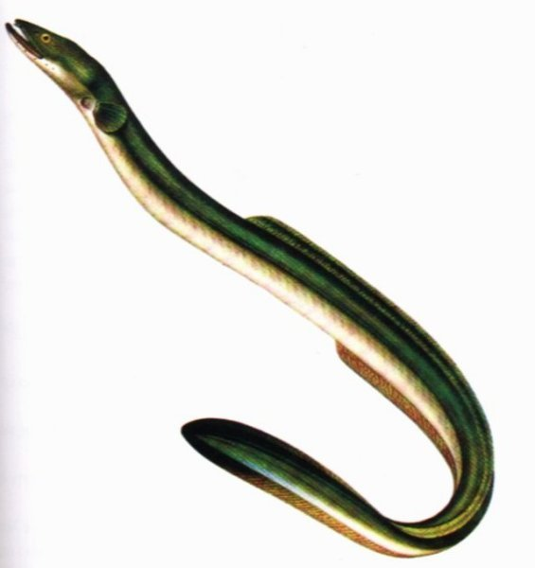
TYPE OF FISH MIGRATION
Tunas (oceanodromous migration within sea)
Sword fish (latitudinal migration )
Hilsa hilsa (anadromous migration
Sea water to F.W)
Carp & Trout(potamodroumous)
Eel (catadromous migration
F.W. to sea water )

Slide 10
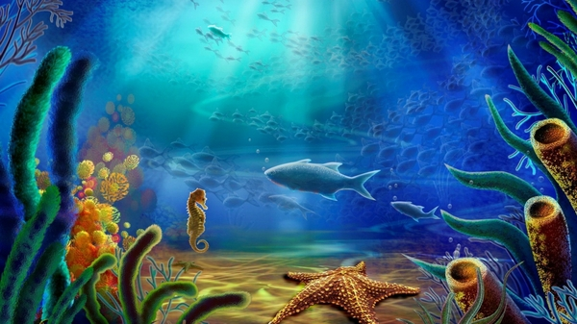
FISH MIGRATION
ON THE BASIS OF HABITAT CHANGE
POTAMODROMOUS
OCEANODROMOUS
DIADROMOUS
CATADROMOUS
FROM FRESH WATER TO SEA WATER
ANADROMOUS
FROM SEA WATER TO FRESH WATER

Slide 11
Different types of fish migration on the basis of habitat:
Potamodromous Migration:-When fishes migrate from one freshwater habitat to another in search of food or spawning, it is called as potamodromous migration.
Fishes also migrate to lay eggs in places where oxygen concentration in water is more and where there is abundance of food for juveniles when they hatch from eggs.
Example:- Common Asian Carps

Slide 12
Oceanodromous Migration:- This migration is from sea water to sea water.
Example:-There are about 12,000 marine species that regularly migrate within sea like herrings, sardines, mackerels, cods, roaches and tunas.
Diadromous migration:- When fishes can migrate from fresh water to sea water or from sea water to fresh water, it is called diadromous migration.
It involves 120 species of fishes that are capable of overcoming osmotic barriers and migrate in these habitats.

Slide 13
Diadromous Migration is of two types:
1.Catadromous Migration
2.Anadromous Migration

Slide 14
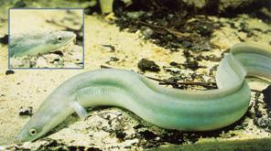
Catadromous Migration:- This type of migration involves movement of large number of fishes from fresh water to sea water, generally for spawning as happens in the case of Anguilla(eels).
Before migration the following changes take place in their bodies:
They deposit large amount of fat in their
bodies which serves as reserve food
during the long journey.
Color changes from yellow to metallic
silvery grey.
Digestive tract shrinks and feeding stops.
Eyes are enlarged and vision sharpens.
Other sensory organs also become sensitive.
Skin becomes respiratory.
Gonads get matured and enlarged.
They become restless and develop strong
urge to migrate in groups.

Slide 15
Eel migration (Catadromous migration)
Four phases of life of Eel:
Adult yellow coloured eel (in rivers).
Silver grey coloured eel (ready for migration).
Pelagic larval phase (Leptocephali).
Metamorphosis of pelagic larval phase to Elver’s larva.

Slide 16
4 PHASES IN L.H OF EEL
Adult yellow eel
Silver grey eel ready for migration
Larval phase of eel
Metamorphosis Elver’s larva

Slide 17
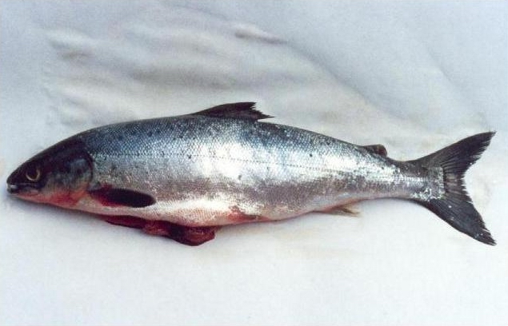
Anadromous Migration:- It involves migration of fishes from sea water to fresh water.
Example:- Salmon and trout
To maintain homeostasis, freshwater species have special adaptations for retaining ions and getting rid of excess water.
They actively take in ions across their gills and skin, a process that requires energy.
To get rid of excess water they excrete nitrogenous waste products in great quantities in the form of highly diluted urine.

Slide 18
Salmon migration (Anadromous migration)
Marine fish, migrates to fresh water for breeding.
In winter, pair of salmon migrates from sea water to fresh water and stop feeding.
Then, sexual dimorphism appears and they spawn.
After hatching, larval fish feed and migrate back to sea.
Other anadromous fishes : acipenser, hilsa, alosa.
Fishes showing seasonal migration
Thunners (Tuna fish) in Mediterranean sea.
Scomber (mackerel fish) in north Atlantic sea.
Clupea (herring fish) in colder parts of Atlantic ocean.

Slide 19
Petromyzon (sea-lamprey) migration (Anadromous migration)
They inhabit coastal waters of north America, Europe, West Africa and Japan.
They ascend rivers in spring or early summer.
A pair seeks clear, moderately fast flowing water, and builds a nest there.
A single female can lay 236,000 eggs.
Eggs hatch in about 3 weeks.
Larval life extends from 5-8 year.
Reaching the sea, they take to parasitic life.

Slide 20
SEA-LAMPREY (ANADROMOUS MIGRATION)
Ammocete larvae in fresh water
Adult lamprey attached to trout fish in sea water

Slide 21
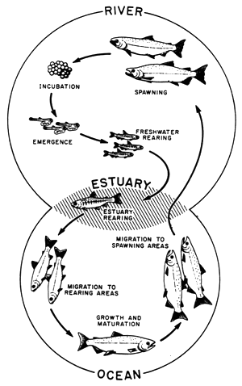
DIADROMOUS MIGRATION
Catadromous
Migration
Anadromous
Migration

Slide 22
Other important facts
Forage fish (prey fish) are small fish which are preyed upon by large predators for food.
They migrate in schooling manner. Their schools become immense shoals which are concentrated fuel resources for the great marine predators.

Slide 23
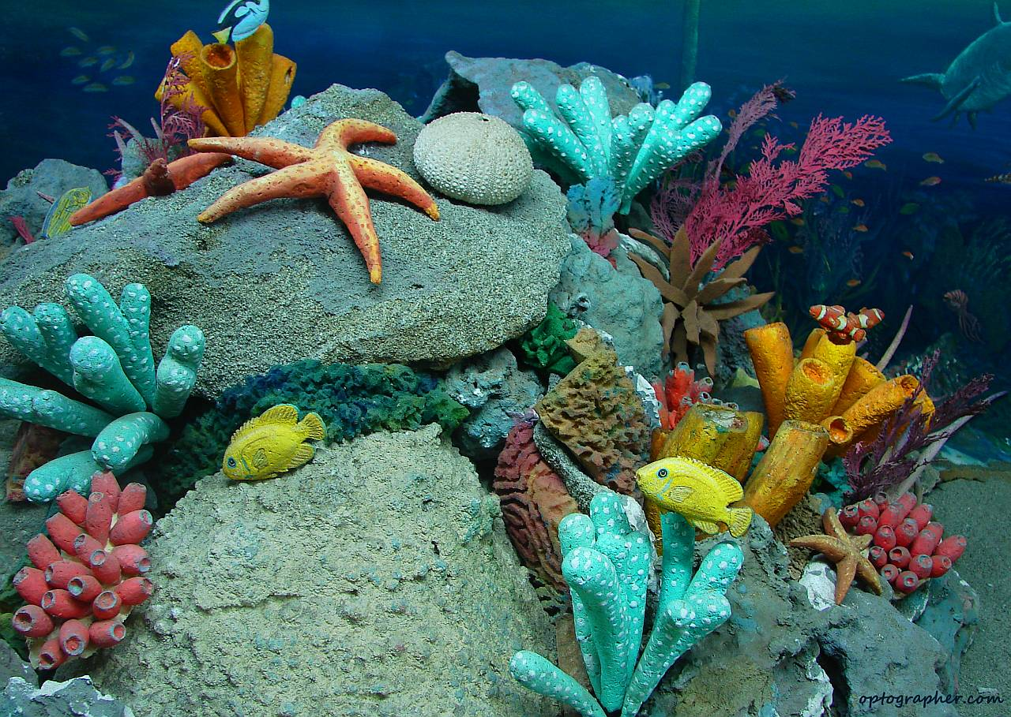
Significance of fish migration Spawning To achieve better growth rates Greater reproductive success Temporal and spatial aggregations of fishes. To escape temperature extremes.
Spawning
To achieve better growth rates
Greater reproductive success by moving between areas.
Temporal and spatial aggregations of fish.
To escape temperature extremes.

Slide 24
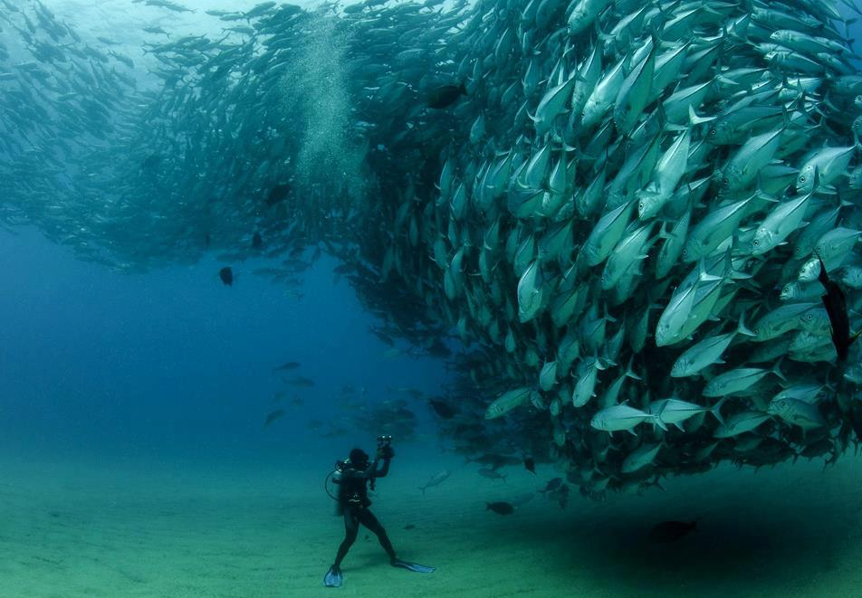
Thank you…

