Slide 1
INDUCED BREEDING IN FISHES
Dr.M.Ashiq ur Rahman
Assistant professor department of zoology hajee karutha rowther howdia college uthamapalayam

Slide 2
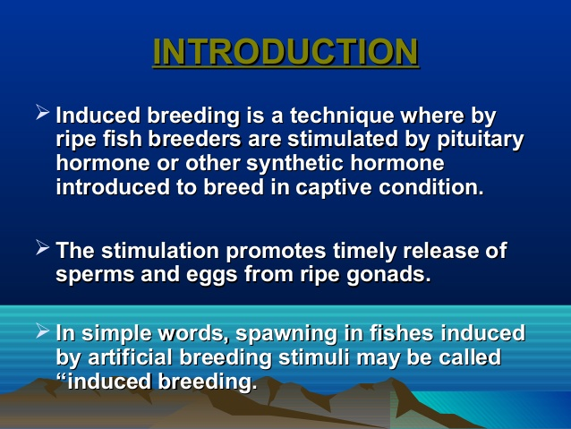

Slide 3
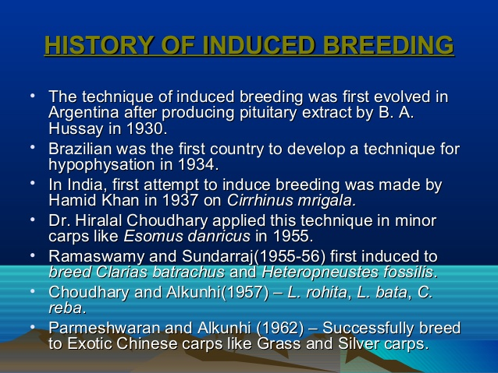

Slide 4
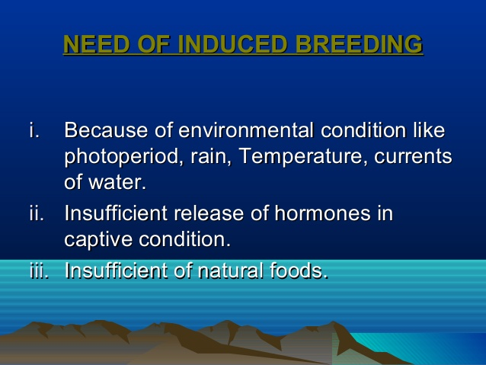

Slide 6
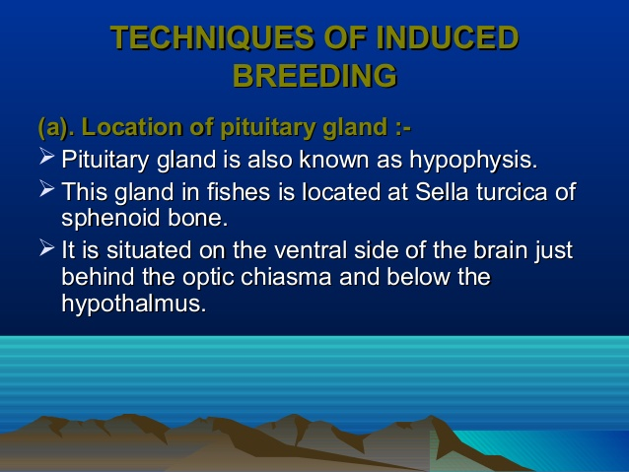

Slide 7
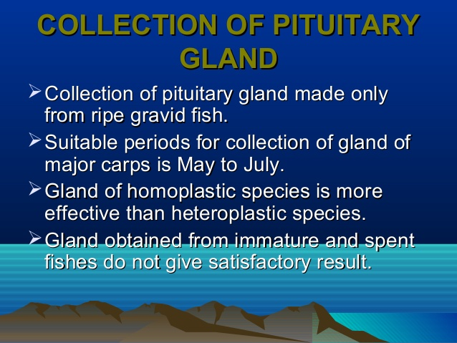

Slide 8
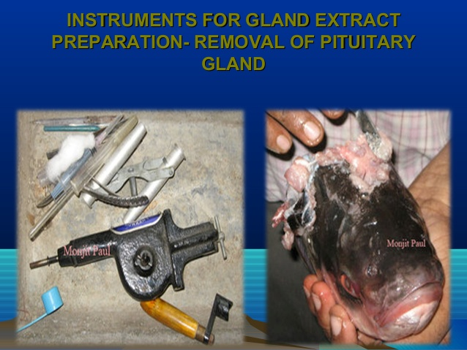

Slide 9
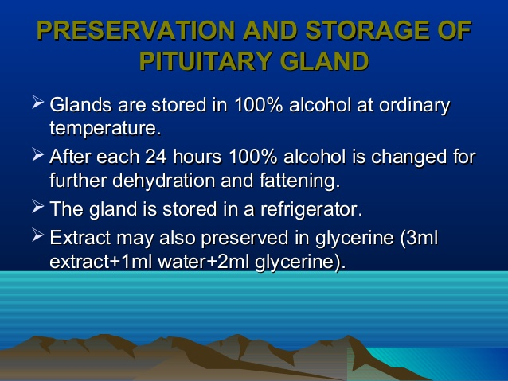

Slide 10
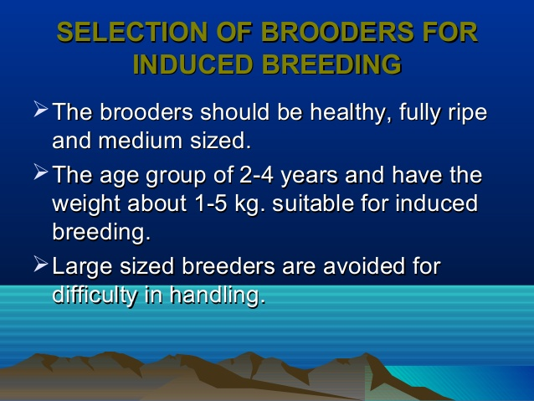

Slide 11
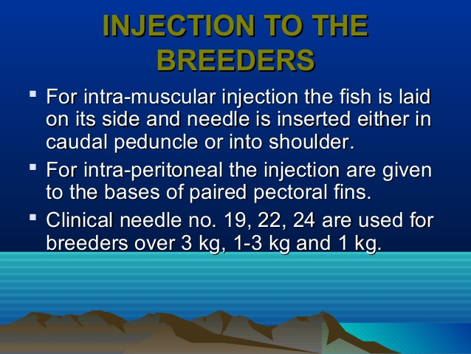

Slide 12
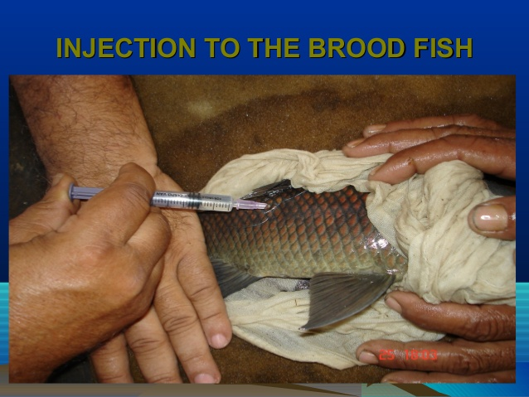

Slide 13
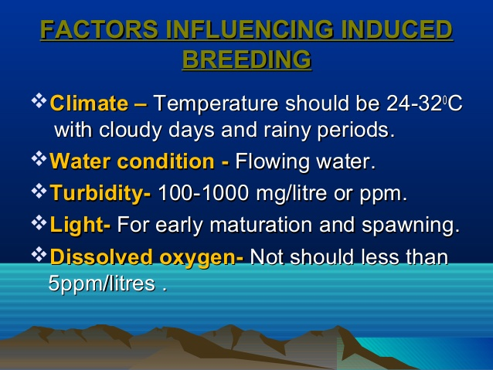

Slide 14
Thank You
References:
Aquaculture – Saras Publication – Dr. N. Arumugam
http://fisheryscience.blogspot.com/2008/11/induced-breeding.html
http://www.yourarticlelibrary.com/fish/applied-fisheries/induced-breeding-of-fish-subject-matter-steps-and-advantages-fishes/88534

