Slide 1
SHORT STORIES IN ARABIC
- BY KAMIL KELANI

Slide 2
SHORT STORIES IN ARABIC
-Compiled by Prof.M.seyid abdul kadher

Slide 3
WHAT IS TO BE LEARNT?
The four stories are:
‫نعمان ‪1.‬‬
‫حذاء الطنبورى ‪2.‬‬
‫عمارة ‪3.‬‬
‫حٌى بن يقظان ‪4.‬‬

Slide 4
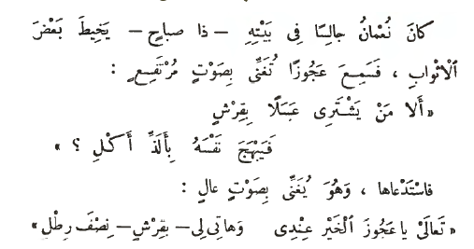
‫ قصة شجاعة نعمان‬- Story of the Bravery of Nauman
‫‪ 1‬بائعة العسل
‬
1. NAUMAN AND THE HONEY SELLER
One fine morning Nauman was sitting at home, sewing some of his clothes when he heard an old woman singing loudly: “Who will buy my honey for one Qarsh so that he enjoys its delicious taste!”
Nauman called her and said: “O good old woman come to me and give me half a pound of honey for a Qarsh.”
Once he had bought the honey he put it on a loaf of bread and left it on the side planning to eat it after he had finished his work.

Slide 5
قصة شجاعة نعمان‬- Story of the Bravery of Nauman
2. NAUMAN’S ANGER
After a short time he saw the flies swarming around the loaf of bread. He started thrashing them around angrily and said“Who invited you to my food O brave flies? Woe to you if you come back to it!”
But the flies kept coming towards the loaf which made Nauman even angrier and he said in a threatening voice: “You must be punished for coming uninvited!”

Slide 6
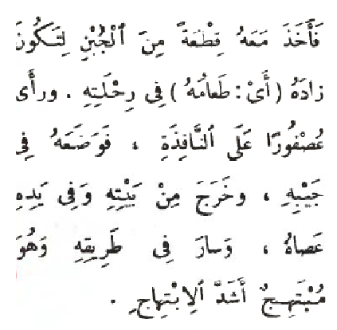
قصة شجاعة نعمان‬ - Story of the Bravery of Nauman
3. SEVEN VICTIMS
His anger went on increasing and he hit the flies killing seven of them. As soon as he saw that he puffed up with happiness and cried out:
“What a rare show of bravery! One strike killed seven! People must know about it so that they talk about this victorious feat.”
So he embroidered this statement over his belt. “One strike kills seven!”
From that moment Nauman decided to embark upon a journey away from his town so that he spread the news of his victory to other towns. He took a piece of cheese with him on this journey as a provision. When he saw a bird over the window he took it and put it in his pocket.
As he left his home he had a cane in his hands and delight written all over his face.

Slide 7
قصة شجاعة نعمان‬ - Story of the Bravery of Nauman
4. IN THE COMPANY OF A GIANT
Nauman continued onward in his journey without any sense of direction till he reached one of the forests wherehe saw a giant of enormous proportions whom he greeted.
The giant looked down upon him with humiliation and asked him mockingly:
“Where are you from O the weak one and what has brought you here?”
Nauman replied smilingly:
“Look at this belt and read what is written over it. This will tell you who I am!”

Slide 8
قصة شجاعة نعمان‬ - Story of the Bravery of Nauman
The giant wondered at his courage and decided to test
Nauman’s strength and size him up against himself. He
took hold of a hard stone and crushed it. He then asked
Nauman to do likewise. Nauman asked him mockingly if
this was the extent of his strength and then took out the
piece of cheese from his pocket pretending to the giant
that this was a hard stone. He squeezed it till water came
out of it and said sarcastically:
“Do you have the strength to squeeze a stone till water
comes out of it?”

Slide 9
قصة شجاعة نعمان‬ - Story of the Bravery of Nauman
The giant got enraged, took another stone and threw it up. It disappeared into the air and then came down to the earth. Nauman took out the bird from his pocket and threw it up in the air. The bird flew away till it disappeared out of sight and never returned. Nauman said sarcastically:
“Your stone came back to the earth but mine will never come back.”

Slide 10
قصة شجاعة نعمان‬ - Story of the Bravery of Nauman
The giant was quite impressed with Nauman’s strength and expertise and went along with him till they both came to a big tree lying on the ground. He asked Nauman to help him carry it. Nauman asked him to hold it by its trunk and then jumped himself sitting among its branches. He started laughing and singing pretending that he was helping the giant carry it.

Slide 11
قصة شجاعة نعمان‬ - Story of the Bravery of Nauman
5. IN THE GIANT’S HOME
After carrying the tree for a long time, the giant decided to put it down. Nauman jumped and said to him mockingly:
“What’s the matter with you? You are panting and here I am not in the least tired!”
The giant was even more enraged and decided to kill him. He invited Nauman to his home with a show of love and disguised sincerity. When the dinner time came, both ate and then went to bed.

Slide 12
قصة شجاعة نعمان‬ - Story of the Bravery of Nauman
6. THE GIANT’S SCHEME
Nauman could sense with his intellect that the giant wanted to kill him so he hid under the bed. After a while the giant entered the room with his brother, holding a strong stick in his hand. His brother had a sharp knife with him. They both started to hit the bed thinking that Nauman was sleeping under it. They left having believed that they had killed him. Noman then slipped away quietly from beneath the bed and went towards the forest in the morning. When the giant and his brother saw him their fear increased tremendously and they ran away thinking that he was a ghost.

Slide 13
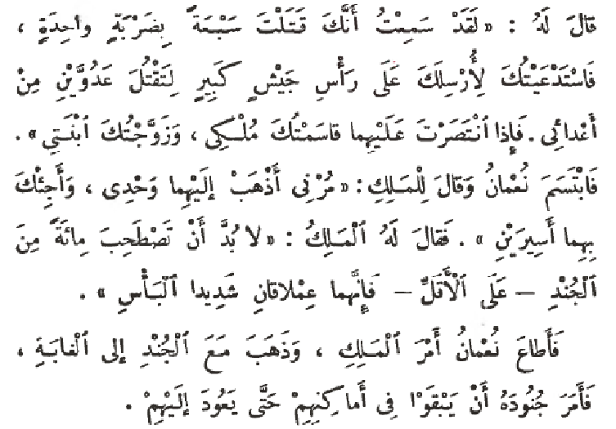
قصة شجاعة نعمان‬ - Story of the Bravery of Nauman
7. IN THE KING’S PRESENCE
Nauman continued on his journey till he reached the king’s palace where sweet slumber overcame him. Some people passed by while he was sleeping and read what was written on his belt, wondering about his courage and informed the king about it. The king called for him, and while Nauman was standing in front him, he asked him about his courageous feat of killing seven with one strike. He told Nauman that he was appointing him as the head of a big army to kill two of his enemies. If he succeeded,the king will give him half of his kingdom and give him hisdaughter in marriage as well. Nauman smiled and requested the king to let him go alone and he will bringboth the enemies as prisoners. The king said that he must take one at least one hundred soldiers since the giants were very strong fighters. Nauman obeyed the king and marched with the soldiers towards the forest where he asked them to stay in their places till he came back.

Slide 14
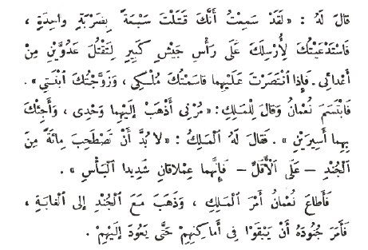
قصة شجاعة نعمان‬ - Story of the Bravery of Nauman
7. IN THE KING’S PRESENCE
Nauman continued on his journey till he reached the king’s palace where sweet slumber overcame him. Somepeople passed by while he was sleeping and read what was written on his belt, wondering about his courage and informed the king about it. The king called for him, and while Nauman was standing in front him, he asked him about his courageous feat of killing seven with one strike. He told Nauman that he was appointing him as the head of a big army to kill two of his enemies. If he succeeded, the king will give him half of his kingdom and give him his daughter in marriage as well. Nauman smiled and requested the king to let him go alone and he will bring both the enemies as prisoners. The king said that he must take one at least one hundred soldiers since the giants were very strong fighters. Nauman obeyed the king and marched with the soldiers towards the forest where he asked them to stay in their places till he came back.

Slide 15
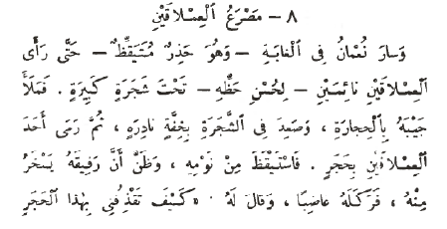
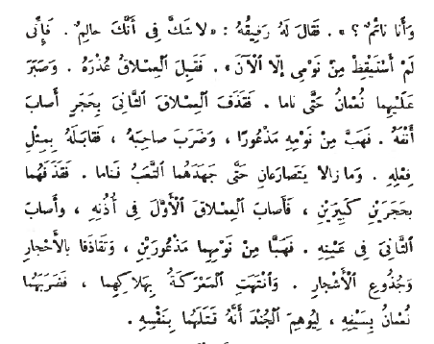
قصة شجاعة نعمان‬ - Story of the Bravery of Nauman
8. THE BATTLEFIELD OF THE GIANTS
Nauman moved into the forest, ever watchful, ever alert till he came upon the giants while their sleeping under a big tree. This was a stroke of good luck for him. He filled his pocket with stones and climbed up the tree with extraordinary quietness. He then threw a stone at one of the giants waking him up from sleep. The giant thought that his companion that played a joke on him so he kicked the later angrily and demanded how he could hit him with a stone while he was sleeping. His companion replied:
“In deed you must be dreaming since I have just wokenup!”
The first giant accepted his excuse. Nauman waited patiently till they both went back to sleep. He then pelted the second giant with a stone striking him on his nose. The giant woke up abruptly frightened and struck his companion who in turn struck back. The two continued to wrestle with each other, till overcome by fatigue, they dosed off again!
Nauman then hit both of them with bigger stones, striking one on his ear and the other over his eye. The two woke up confused and frightened and starting pelting each other with stones and trunks of trees. The fight ended with both of them dead. Nauman struck them with his sword to show his soldiers that it was he who had killed the giants.

Slide 16
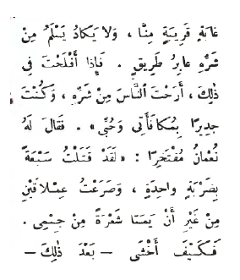
قصة شجاعة نعمان‬ - Story of the Bravery of Nauman
9. THE RAGING BULL
Nauman then called out his soldiers and showed themthe battlefield where he had killed the giants. They all acknowledged his strength. He then returned and the king came to know the story as he was informed. When Nauman stood in front of the royal presence, the king said to him: “I will never break my promise to you but I would likeyou to relieve us from the raging bull that lives in one ofthe nearby forests. No one passing by is safe from his attacks. If you succeed in this mission, the people will enjoy safety and you will become deserving of my reward and my affection.” Noman responded boastfully:
“I killed seven with one strike and fought with the giants without them touching even one hair on my body. How can I fear
قصة شجاعة نعمان‬ - Story of the Bravery of Numan

Slide 17
قصة شجاعة نعمان‬ - Story of the Bravery of Nauman
anything after that? He then proceeded to the forest carrying with him a sharp axe and a thick rope. He saw the raging bull running towards him rapidly. Nauman climbed up a big tree. The bull got enraged and starting hitting the tree with its horns until they got stuck into the trunk. He was not able to pull them out. Nauman got down quickly, tied the bull with a rope, cut his horns with the axe and led him to the king.

Slide 18
قصة شجاعة نعمان‬ - Story of the Bravery of Nauman
10. THE VICIOUS PIG
The king said to him:
“You have indeed deserved my promised reward but I
want that you relieve us of the vicious pig as well. He also
lives in the forest.”
So Noman went to the forest at night where he dug a big
hole in the ground close to the dwelling place of the pig
and covered it with grass and weeds. The vicious pig had
hardly walked over it till he fell down into the hole. The
king was amazed and planned to arrange his daughter’s
marriage with Nauman.

Slide 19
قصة شجاعة نعمان ‬ - Story of the Bravery of Nauman
11. THE RAVENOUS BEAR
No sooner had the king narrateNauman’s exploits to the princess than she said:
“I must ascertain his courage myself. If he is how you
describe him to be, then let him spend one night with the
ravenous bear.”
Nauman did not delay responding to her demand. When the night approached he was put into a room with the ravenous bear and the door was locked. Right away the bear rushed to attack Nauman who took out a nut and threw it into the bear’s mouth. The bear ate and found it quite delicious and demanded more of it. Nauman fed him nuts mixed with balls of lead. The bear was not able to chew the lead balls due to their hardness.

Slide 20
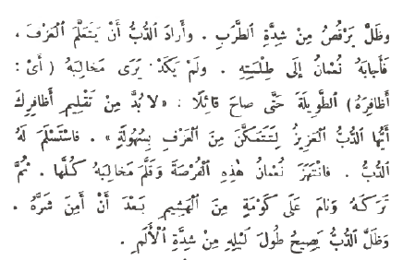
قصة شجاعة نعمان ‬ - Story of the Bravery of Nauman
Nauman started chewing some nuts instigating the bear to follow suit. The bear tried but lost his strong teeth in the attempt till none remained in his mouth. Noman did not waste a single moment and started playing a lute. The bear was enraptured by it and started dancing gleefully. He wanted to learn playing the lute and Nauman responded to his request. As soon as he saw the bear’slong claws, Nauman told the bear that his nails needed trimming so that he could play the lute easily. The bear acknowledged it. Nauman seized the opportunity and clipped away all the claws. He then left the bear alone and slept on a file of straw. The poor bear kept crying theentire night from the severity of pain.

Slide 21
قصة شجاعة نعمان ‬ - Story of the Bravery of Nauman
12. THE END OF THE STORY
When the dawn broke out, the princess and the king went and saw what Nauman had done with the bear.They could not but acknowledge his bravery and expressed their pleasure with him. After a few days Nauman married the princess and was awarded the titles of “the defender of the state and the leader of the leaders.”

Slide 22
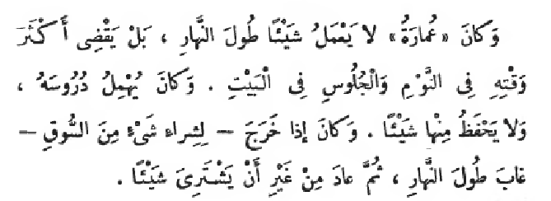
‫عمارة‬ - Ummara
1. Ummara in his mother’s house
Ummara was a very lazy boy. He used to live with his poor mother who earned hers and her son’s livelihood with hard work causing her to be very tired. She used to sew the clothes for her neighbors and she and her son survived on a meager income despite a lot of work.
Ummara would not do a thing the entire day. In fact, he spent most of his time sleeping and sitting at home. He neglected his studies and did not memorize anything. If he went out to buy something from the market, he would be away the whole day and return without ever buying anything.
His mother used to reproach him on his laziness and would take him to account for his negligence. However, the reproach would not benefit nor would the punishment affect Ummara. Eventually his mother lost all hope ofcorrecting him.

Slide 23
عمارة‬ - Ummara
2. Expulsion from the school
Ummara continued to be lazy in his studies and negligent towards his assignments. He would be late in his attendance at school and was eventually expelled due to his laziness and negligence. When the time for going to the school came next day and Ummara did not go, his mother asked him angrily:
“Why did you not go to the school today and why are still yawning O lazy boy?”
When he narrated to her what had happened to him, her anger increased further and she told him threateningly:
“I had already warned you about the consequences of negligence and laziness but you would not pay any attention to my advice. Now you have no option after your expulsion from the school except that you go out to learn some skills or that you engage in some work to earn your daily livelihood. Otherwise I will throw you out of the house just like they threw you out of the school.”

Slide 24
عمارة‬ - Ummara
3. Ummara and the planter
Ummara did not find any choice for himself except finding some work out of fear of expulsion. On the very first day went out of the home and worked with a planter the entire day. The planter gave him a Qarsh (a coin) as wages for his work. Ummara started walking on the way home holding the Qarsh in his hand. He saw a pond on his way so he jumped with all his strength to cross it. The coin fell from his hand into the water and despite a lot of search he did not find it. So he returned home experiencing pain and sadness.
When he narrated to his mother what had happened to him, she said out of astonishment.
“You should have put the coin in your pocket and it would not have fallen from your hand.”
He said to her: “I will follow your advice from tomorrow so don’t be angry with me my mother.”

Slide 25
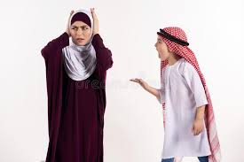
عمارة‬ - Ummara
4. A glass of milk
The next day the planter gave him a cup of milk. Ummara
put it in his pocket. He had hardly walked a little when the
milk spilled over his clothes. Nothing remained from it.
When he mentioned it to his mother, she was again
astonished and said to him:
“Woe to you! Why did you not cover the cup so that the
milk would not spill out of it?”
He told her: “I will do it the next time so that don’t be
angry with me my mother.”

Slide 26
عمارة‬ - Ummara
5. The little chicken
When the third day came, the planter gave him a small chicken as wages for his work. Ummara put it in a box and covered its lid tightly. When he reached home, he opened the box only to find that the chicken had died.
His mother reprimanded him and said in astonishment:
“Woe to you! Don’t you know that air is necessary forsurvival of human beings, animals and vegetation? How could the chicken survive after you covered the box and prevented her from breathing the air? Why did you not carry it in your hands? ”
Ummara was quite remorseful and said in a beseeching manner:
“I will do it the next time so don’t be angry with me my mother.”

Slide 27
عمارة‬ - Ummara
6. The baker’s cat
On the fourth day Ummah worked for the baker who provided him with a white cat as wages for his work. Ummara was quite happy with it and he carried the cat in his hands while returning home. He had hardly taken a few steps when the cat started scratching him with its claws and eventually ran away from him. When he reached home he narrated to his mother what had happened to him. She told him in astonishment:
“How strange your matter is O Ummara!” “Why did you not tie the cat with a rope and drag it home?”
He said: “I will do it the next time so do not be angry withme my mother.”

Slide 28
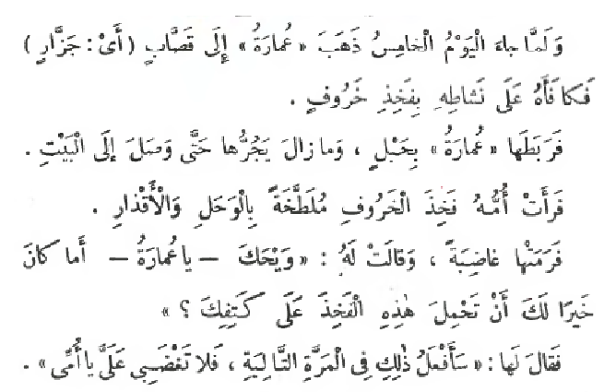
عمارة‬ - Ummara
7. Lamb’s thigh
When the fifth day came, Ummara went to the butcher (to work with him) who paid him for his work with a lamb’s
thigh. He tied it with a rope and continued to drag it till he reached home. When his mother saw the thigh covered with mud and filth she threw it away angrily and said to Ummara:
“Woe to you Ummara! Would it not have been better for
you if you had carried this thigh on your shoulder?”

Slide 29
عمارة‬ - Ummara
8. The Shepherd’s colt
On the sixth day Ummara went to work with the shepherd and continued to take care of the cattle for most of the day. The shepherd gave him his colt so that he would ride it and return with it the next morning. Ummara had a strong body so he carried the colt on his shoulders and started walking on his way home.

Slide 30
عمارة‬ - Ummara
9. The Sultan’s daughter
Ummara passed by the palace of the Sultan Az Zaman’s
daughter, the princess Hisan. She was standing on the
balcony of the palace. When she saw Ummara carrying
The colt over his shoulders she was astonished greatly and
started laughing at this scene.
Princess Hisan had a disease of the chest. When she
laughed her disease got cured. The Sultan was extremely
happy with her recovery and rewarded Ummara a great
reward on it since he was the reason for his daughter’s
recovery.

Slide 31
عمارة‬ - Ummara
10. The end of the story
Next day the Sultan had Ummara and his mother brought to the palace. They were provided with a residence there and the Sultan treated them with great honor. He appointed a teacher for Ummara who would teach him.
From that day on Ummara moved forward in his studies with wonderful enthusiasm and gave up his laziness. After a short time Ummara excelled in his studies. He became an example for enthusiasm and intelligence, just like he was once an example for laziness and idiocy. The Sultan was impressed with his manners and enthusiasm and gavehim his daughter in marriage. After years the Sultan passed away. Ummara succeeded him and became theSultan ruling his country with justice. Ummara and hismother continued to live in luxury and happiness.

