Slide 1
TOPIC :HUMAN RESOURCE MANAGEMENT
FACULTY NAME : S.FAIZ AHAMED
DEPARTMENT : BUSINESS ADMINISTRATION

Slide 2
HRM
              Selection
Selecting Qualified Employee is like putting money in the bank”
In this chapter, we shall discuss the process of selection.

Slide 3
SELECTION
Selection identified the best-fit between the person and the job
RIGHTMAN FOR RIGHT JOB

Slide 4
STEPS / PROCESS
Reception of Applicants
Initial Screening
Application Blank

Slide 5
Employment Test
Psychological Test
Performance Simulation Test

Slide 6
Employment Interviews
Unstructured
Structured
Problem Solving
Stress – Producing
Panel
Group

Slide 7
Reference checks
Physical examinations
Job offer decisions

Slide 8
The Selection Process has its objectives the sorting out or elimination of those judged unqualified to meet job and organization requirement

Slide 9


Slide 10
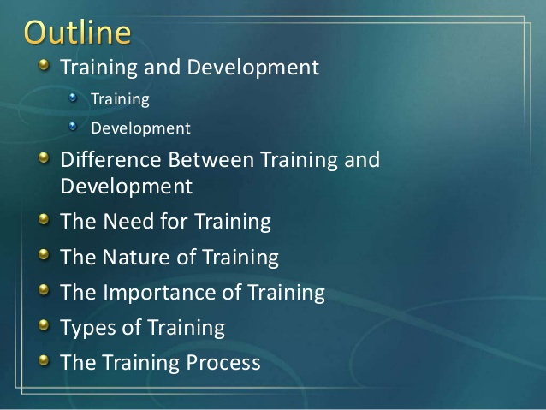

Slide 11
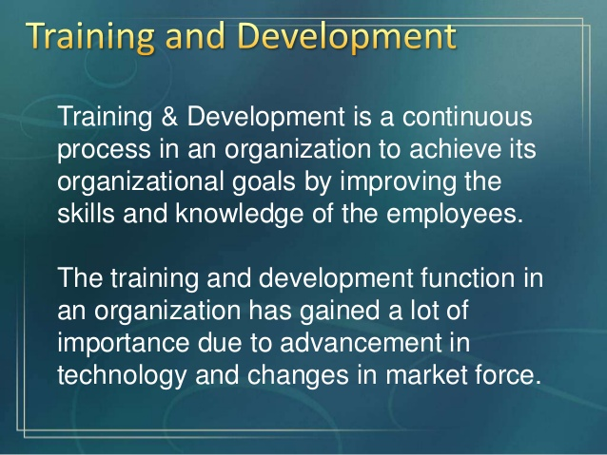

Slide 12
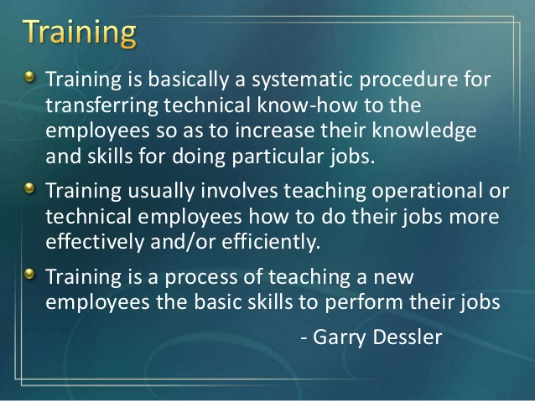

Slide 13
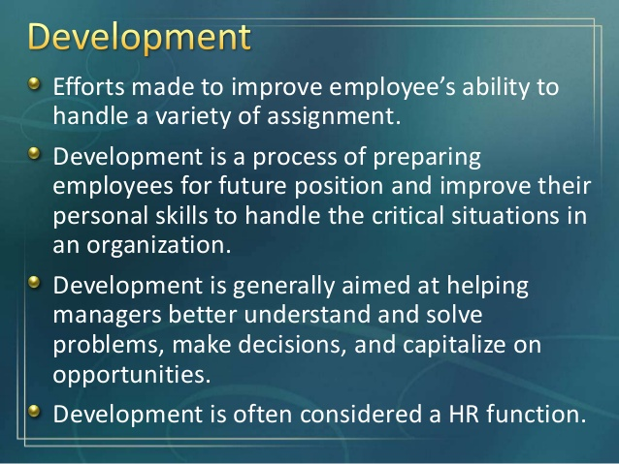

Slide 14
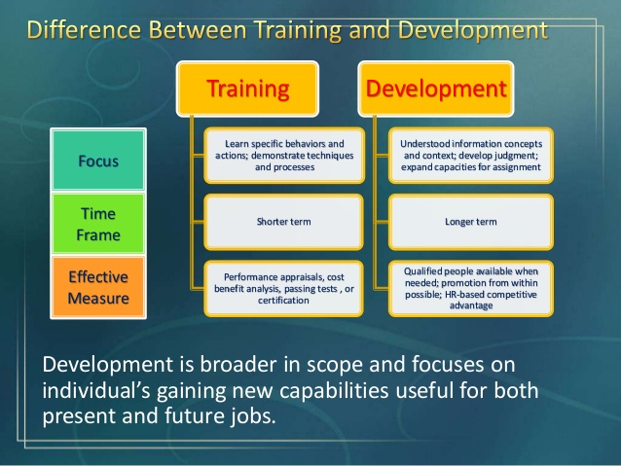

Slide 15
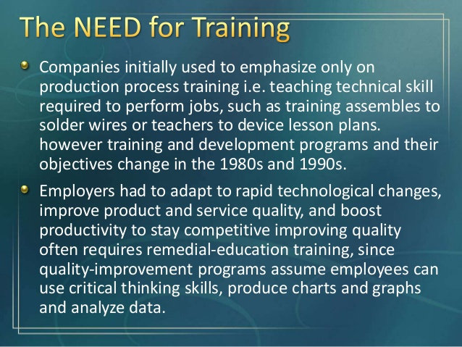

Slide 16
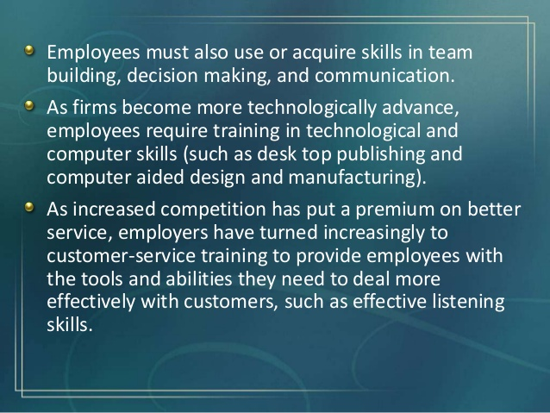

Slide 17
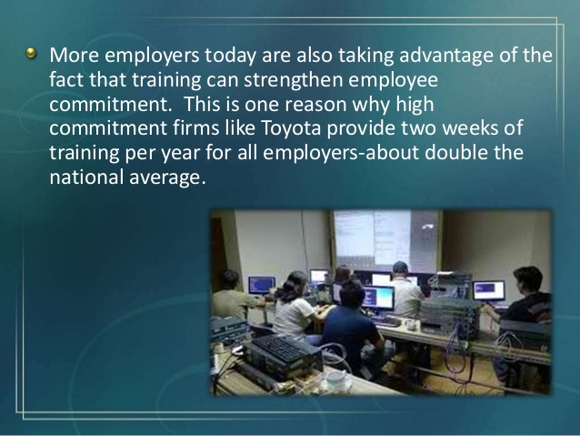

Slide 18
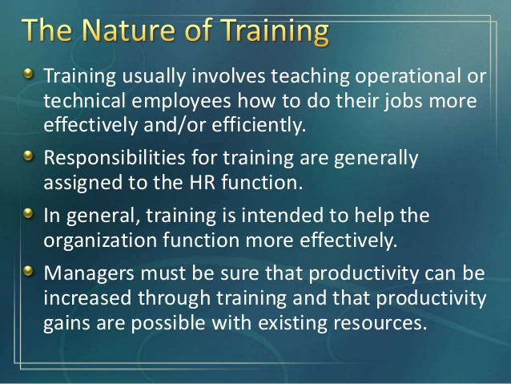

Slide 19
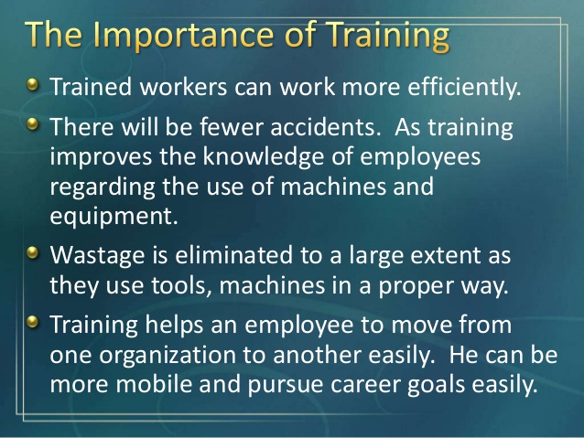

Slide 20
