Slide 1
HAJEE KARUTHA ROWTHER HOWDIA COLLEGE (Autonomous) Uthamapalayam
Course | Ancillary chemistry-IV
Course code | 17UCHA41
Topic | Commercial cells and batteries
Staff name | M. Rekha
Staff code | TNMK021SFT73

Slide 2
Commercial cells and batteries
Electrochemical cells act as a source of electricity.
“Few of the electrochemical cells have commercial importance called commercial cell”.
“Combination of two (or) more electrochemical cells is called batteries”.

Slide 3
Types of commercial cell
Primary cells
Secondary cells

Slide 4
Primary cells (or) Irreversible cells
In the primary cells, as a result of the chemical reaction electric current is produced.
Once the active chemicals are consumed, it doesn’t produce electricity.
They cannot be recharged, use and through type cells.
Ex., Dry cells

Slide 5
Secondary cells (or) Reversible cells (or) Storage cells
This type of electrochemical cells is readily recharged as the cell reactions are reversible in nature.
Ex., Lead storage cells.

Slide 6
Dry cell or Leclanche cell
It consists of graphite rod which is act as cathode (positive electrode).
Graphite is surrounded by muslin (Fine cloth) bag contains a paste of carbon, manganese oxide (MnO₂), zinc chloride (ZnCl₂), flour & plaster of Paris.
The zinc container serves as the anode (negative electrode). Electromotive force (EMF) of this cell is 1.5 V.

Slide 7
Cell reaction Zn → Zn²⁺ + 2e⁻ (oxidation) anode
2MnO₂ + 2NH₄⁺ + 2e⁻ → Mn₂O₃ + 2NH₃ + H₂O (Reduction) Cathode
Net cell reaction Zn + 2MnO₂ + 2NH₄⁺ → Zn²⁺ + Mn₂O₃ + 2NH₃ + H₂O

Slide 8
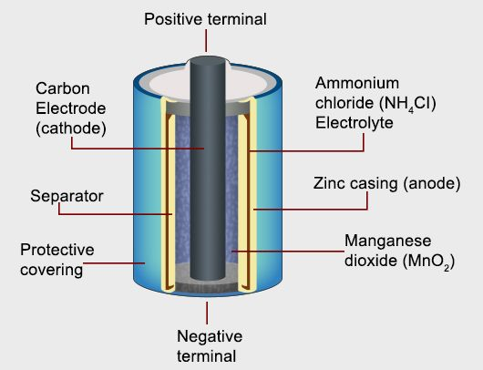

Slide 9
Lead storage cell (or) Acid storage cell
It consists of lead plate as anode (negative electrode).
The cathode is lead plate coated with lead oxide. Two electrodes are immersed in sulphuric acid.

Slide 10
Cell reaction Pb + H₂SO₄ → PbSO₄ + 2H⁺ + 2e⁻(anode)
PbO₂ + H₂SO₄ + 2H⁺ + 2e⁻ → PbSO₄ + 2H₂O (cathode)
Net cell reaction Pb + PbO₂ + 2H₂SO₄ → 2PbSO₄ + 2H₂O

Slide 11
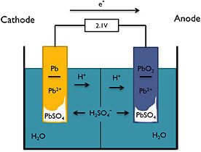

Slide 12
Reference books:
Principles of physical chemistry: Puri, Sharma, Pathania (revised edition, Vishal pub.,2010)

