Slide 1
HAJEE KARUTHA ROWTHER HOWDIA COLLEGE (Autonomous) Uthamapalayam
Course | Ancillary chemistry-IV
Course code | 17UCHA41
Topic | Buffer & its types
Staff name | M. Rekha
Staff code | TNMK021SFT73

Slide 2
Buffer solution
“A buffer solution is one which resists change in its pH on addition of small amount of acid (or) base”.
Two main types of buffer solutions are
Acidic buffer Basic buffer

Slide 3
Acid buffer
A weak acid together with a salt of the same acid with a strong base.
Ex., Weak acid - CH₃COOH
Salt of same acid with a strong base is - CH₃COONa
CH₃COOH CH₃COO⁻ + H⁺
CH₃COONa → CH₃COO⁻ + Na⁺

Slide 4
In the above equation CH₃COO⁻ is a common ion, which suppress the dissociation of CH₃COOH called common ion effect.
This effect reduces the concentration of H⁺.
pH of 0.1 M CH₃COOH is 2.87
But pH of 0.1 M CH₃COOH + 0.1 M CH₃COONa (acid buffer) is 4.74

Slide 5
Basic buffer
A weak base together with a salt of the same base with a strong acid.
Ex., Weak base - NH₄OH
(ammonium hydroxide)
Salt of same base with a strong acid is - NH₄Cl
(ammonium chloride)

Slide 6
NH₄OH NH₄⁺ + OH⁻
NH₄Cl → NH₄⁺ + Cl⁻
In the above equation NH₄⁺ is a common ion, which suppress the dissociation of NH₄OH called common ion effect.

Slide 7
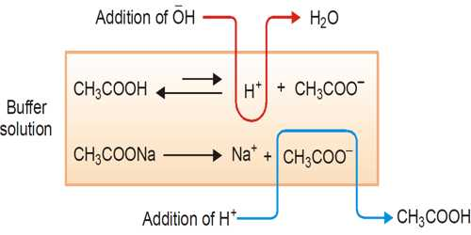
Buffer action

Slide 8
Addition of HCl
pH of the CH₃COOH + CH₃COONa (acidic buffer) is 4.74
Addition of HCl increases the concentration of H⁺. So we expect pH is decreased rapidly.
But the excess H⁺ ion is counteracted with CH₃COO⁻. So the pH is virtually unchanged.

Slide 9
For the encountered reaction, concentration of CH₃COOH is increased.
So the equilibrium (1) shifts slightly to the forward reaction. So [H⁺] ion is increased.
Due to this reason pH of CH₃COOH + CH₃COONa is decreased to about 4.74 → 4.66.

Slide 10
Addition of NaOH
When add NaOH to this buffer solution, OH⁻ ion combined with H⁺ ion to give H₂O.
So the equilibrium (1) is shift towards forward reaction and produce more amount of H⁺ ion until all the OH⁻ is neutralized.
So the pH is restored.But the concentration of CH₃COOH is decreased, so the pH is increased by small amount.

Slide 11
Reference books:
Principles of physical chemistry: Puri, Sharma, Pathania (revised edition, Vishal pub.,2010)

