Slide 1
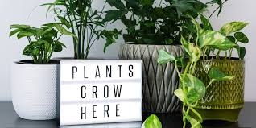
INDOOR GARDENING -COMPONENTS
By
A.M.RASHIDA BANU
ASSISTANT PROFESSOR
DEPARTMENT OF BOTANY
HAJEE KARUTHA ROWHER HOWDIA COLLEGE, UTHAMAPALAYAM,
THENI DISTRICT

Slide 2
INDOOR GARDENING
Growing of plants in suitable containers to beautify the areas inside the houses.
Earthen pots, ceramic pots, glass tanks or any other cheap container available to grow
Shade loving plants
Humidity and temperature , irrigation, natural light and ventilation
Open spaces, terraces, shade, inside the rooms, verandah

Slide 3
Components
Hanging baskets
Bonsai

Slide 4
Hanging baskets
Potted plants hung down from the roof or woden frames are called hanging baskets
Containers such as earthen pots, ceramic pots,plastic containers
Roof terraces, verandah, drawing room and shade of a tree

Slide 5
To retain moisture, before planting a plant, container is partly filled with coconut fibre, moss
Than filled with two parts of loamy soil and one part of well rotten dried cowdung.
Plant raised either seeds or seedlings or cutting
Plant may be erect – min height or pendent(drooping branches and colourful foliage)

Slide 6
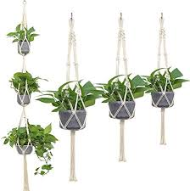

Slide 7
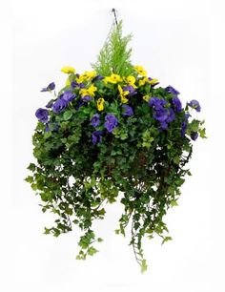
After planting, hung on roof or my nylon thread
Water regularly
NPK fertilizer
Eg Adiantum(fern)
Asparagus
Begonia recumbens
Petunia hybrida

Slide 8
Significance
Give additional decoration to the house
Done as a hobby
Give mental satisfaction to people

Slide 9
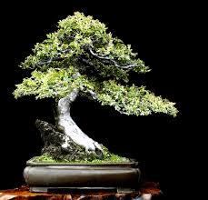
Bonsai
Dwarfing trees and shrubs by growing them in shallow containers is called Bonsai culture
Miniature tree or shrub is called bonsai
Japanese art
Less than 75cm in height
More than 10 years

Slide 10
Steps involve in bonsai culture
Selection of plants
Selection of containers
Making pot mixture
Planting
Watering
Manuring
Dwarfing
After care

Slide 11
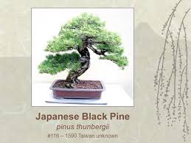
Selection of plants
Can adapt to extreme dwarfing
Large tree having attractive fruits, leave,flower and appearance
Initiated from seedling, layering, grafts, cutting
Eg Ficus, Polyalthia, Delonix, Pinus.

Slide 12
Selection of container
Attractive containers made of clay, china clay, concrete or brass.
5-7.5 cm deep and 45-60cm in diameter
Reactangular shape – evergreen plants
Oval or round – deciduous palnt
Colour – mosaic, sky blue, grey, jungle green

Slide 13
Making pot mixture
Bottom container with small brick piece and river sand
Mixing FYM, red earth, sand and leaf mould in equal proportion
Overlaid on brick piece layer, leaving a small margin of the container.

Slide 14
Planting
Round or oval container – single plant in the centre
Rectangular container – three plant with equal space in 3 way triangular relationship

Slide 15
Watering
Winter and rainy season – alternative days
Hot summer days – 4-5 times in a day
Quantity differ according to type of plant, nature and size of container and pot mixture
Broad leave require more water than decidous trees.
Overwatering - avoid

Slide 16
Manuring
Well decomposed FYM or bone meal is added once in a month.
2 spoon of groundnut or mustard cake once or twice a year
Dilute fertilizer solution at fruiting stage

Slide 17
Dwarfing
Done both root and shoot pruning
Root pruning – once or twice a year(dec or jan)
Plant taken out – remove dead / old root replanted in the same pot
Shoot pruning – proper time to maintain size
Pruning- branches are cut at required height and apical buds are removed to keep definite shape.

Slide 18
Aftercare
Trained in different shape
S – shape, upright, twisted trunk, cascade and semi – cascade shape
Branches bent in shape and ties with metallic wire t maintain shape for 3-4 month.
New shoots grows – cut to maintain dwarf
Dusting BHC 10% or moncrotophos in proper time protect from insect or pest.

Slide 21
Importance
Gives a beauty to indoor environment
Good hobby for educated people
Fetches high price in market
Gives jobs to growers.

Slide 22
Reference
Kumaresan .V., Horticulture and plant breeding, saras publication.
https://www.google.com/search?q=potting+of+a+plant&sxsrf=ALeKk02zCgQfKUE1ARLWCY_l53t8gxB4tw:1582526392816&source=lnms&tbm=isch&sa=X&ved=2ahUKEwjp5vabyunnAhWOzTgGHReCAgwQ_AUoAXoECA8QAw&biw=1366&bih=625#imgrc=MZuEtmGQplZz6M

Slide 23
Thank you

